Slide 1


Teaching teachers to teach inquiry
MTA-ELTE Research Group on Inquiry-based Chemistry Education
István Füzesi and Luca Szalay
11th EUROVARIETY conference, Poland, Krakow, Jagiellonian University, 3rd July, 2025

Slide 2
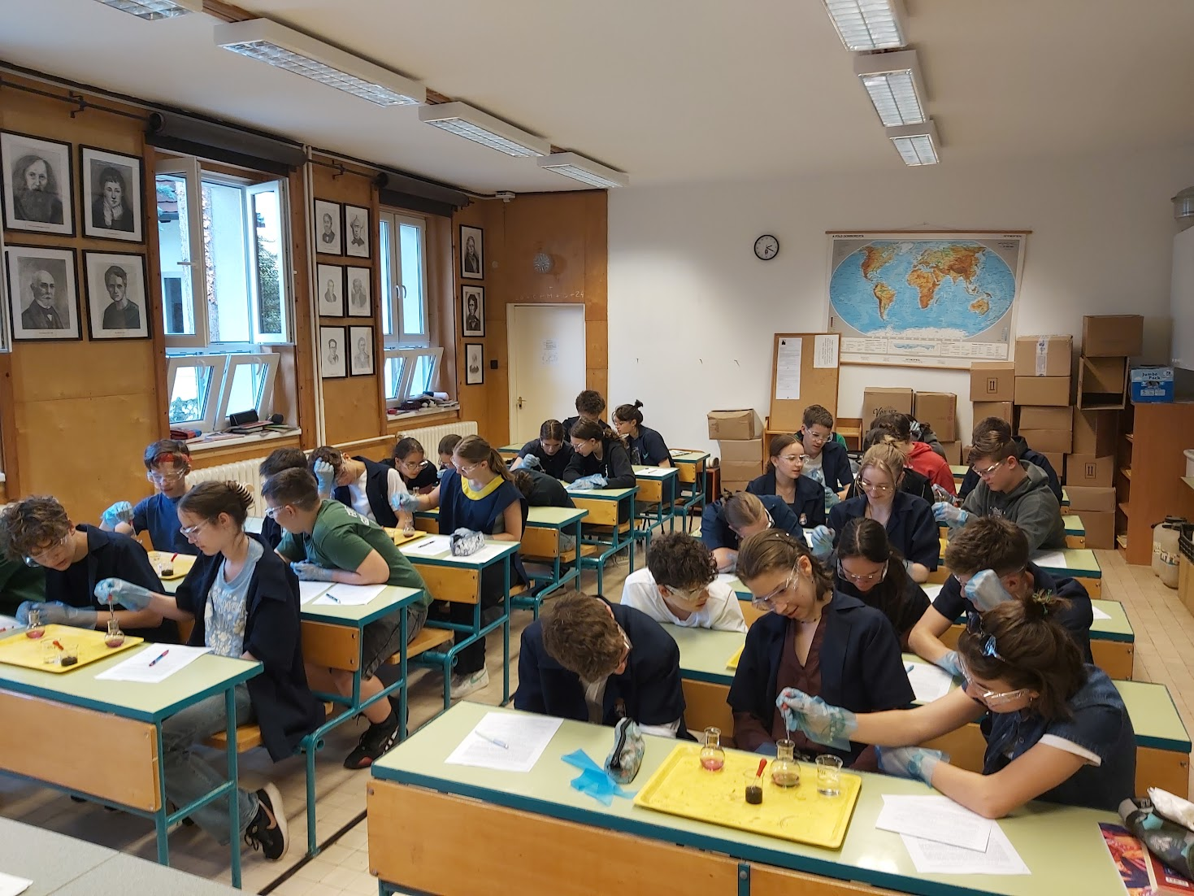
Content
Why inquiry?
The current 4-year project:
  Research method and sample
  Research model for 2021/2022.
  Experimental design tasks (example)
Systems thinking tasks (example)
The questionnaire filled in by pre-service teacher students
Pre-service teacher students’ views
Pros & cons
Conclusions
References
Teaching teachers to teach inquiry
EUROVARIETY conference, Krakow, Jagiellonian University, 3rd July 2025

Slide 3
I. Why inquiry?
The focus of student experiments should shift from reinforcing and demonstrating scientific content to practicing scientific thinking (Hofstein, 2015).
The elements of scientific thinking that are closely related to scientific cognition:
  identification and control of variables
  causality
  hypothesis generation
  testing and design of experiments (Csapó, 2022).
„inquiry-based science learning/teaching/education” (IBL, IBST, IBSE): teaching/learning process is modelling the steps of scientific research
classification according to the level of students’ independence: In a guided-inquiry format students are required to design the experiment (Walker, 2007)
Teaching teachers to teach inquiry
EUROVARIETY conference, Krakow, Jagiellonian University, 3rd July 2025

Slide 4
II.1. Research method and sample
The tried and tested student sheets are published on the research group’s website.
 | Longitudinal research: 4 school years 2021-2025 (Grade 7-10)
Intervention | 6 lessons/school year (=24 lessons, partially spent with the worksheets)
Tests | Test 0 (T0): September 2021 + T1 (T2, T3, T4): end of each school year
Number of students | T0: 890; T1: 886; T2: 811; T3: 603 students wrote each test
Age of students (years) | 12/13 (in the first year)
Number of teachers | 31 (in the first year)
Number of schools | 25 (in the first year)
Group 1 (control) | only step-by-step experiments
Group 2 (experimental) | Scheme to teach experimental design AFTER step-by-step experiments
Group 3 (experimental) | Scheme to help experimental design BEFORE planning experiments
+ Motivation | Context-based tasks + elements of systems thinking for all the students
Teaching teachers to teach inquiry
EUROVARIETY conference, Krakow, Jagiellonian University, 3rd July 2025

Slide 5
II.2. Research model for 2021/2022.
6 student sheets for 6 lessons
in 3 versions:
Type 1: only step-by-step experiments
Type 2: step-by-step experiments + scheme filled in AFTER the experiments
Type 3: scheme filled in BEFORE the experiments to help experimental design
Direct teaching of the experimental design skills
worked better in the previous project → Has the
teaching of using a scheme to develop experimental design even more effect on experimental design skills?
Statistical analysis of data
Choosing sample
Pre-test
Group 1
6 Type 1 student sheets
Post-test
Group 2
6 Type 2 student sheets
Post-test
Data collection
Group 3
6 Type 3 student sheets
Post-test
Note: Context-based / systems thinking tasks are on each type of the student worksheets for motivational purposes.

Slide 6
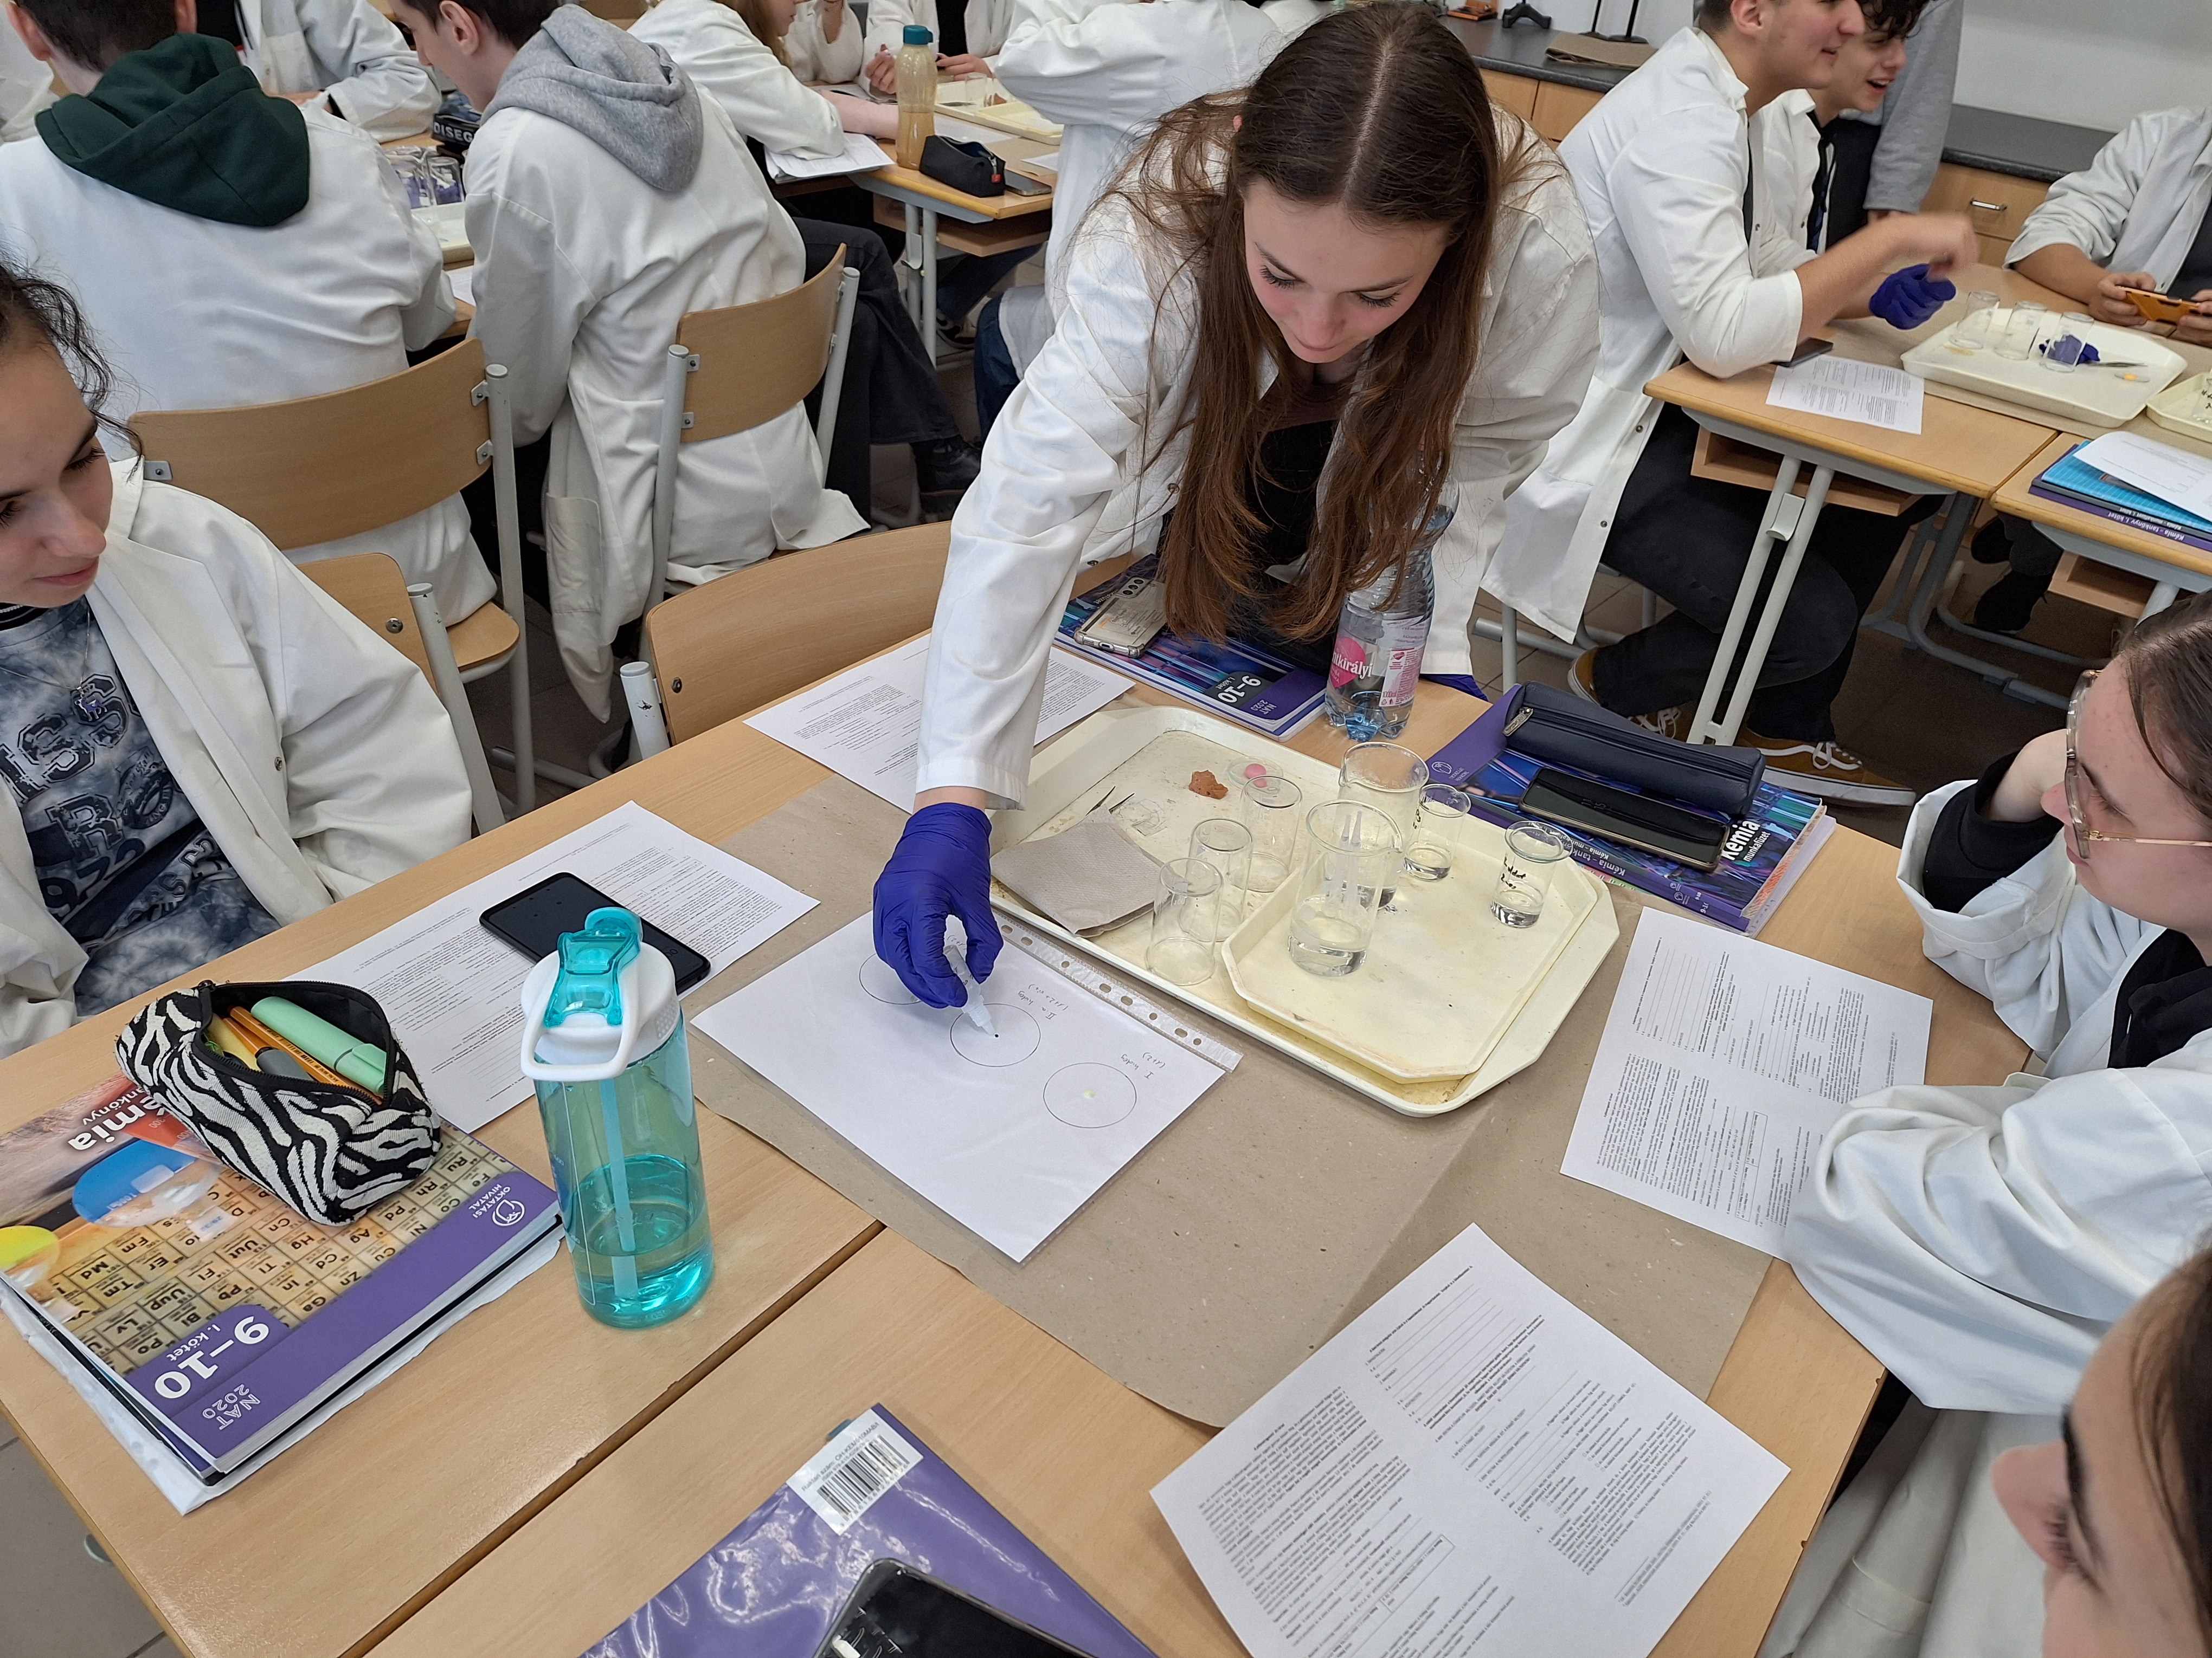
  II.3. Experimental design tasks (example)
  Teacher guide of worksheet 15 (about reaction rate)
Experiment I: Place the droppers containing the Na₂S₂O₃ solution and the hydrochloric acid solution in the cold water bath with the closed ends down (or place the bottles containing these solutions in the cold water bath). When they have cooled, drop 1 drop of Na₂S₂O₃ solution in the centre of the circle marked "Experiment I" on the plastic folder and drop 1 drop of hydrochloric acid (HCl solution) on it. Using the stopwatch function on your mobile phone, measure the time that elapses before you can no longer see the dot in the middle of the circle under the liquid. Record your experience and explain the changes!
Observation: After a while, the solution first became white (opalescent), and later changed to yellow.
The dot in the middle of the circle is no longer visible after this time: 30 s.
Explanation: The reaction between the sodium thiosulphate solution and hydrochloric acid is given by the following equation which has to be balanced. The colour was caused by the resulting sulfur. The pungent smelling gas is the sulfur dioxide.
Na₂S₂O₃ + 2 HCl → 2 NaCl + SO₂ + S + H₂O
Teaching teachers to teach inquiry
EUROVARIETY conference, Krakow, Jagellonian University, 3rd July 2025

Slide 7
  II.3. Experimental design tasks (example)
  Teacher guide of worksheet 15 (about reaction rate)
Experiment II: Use Experiment I as a control experiment, and compare the observations of the following two experiments to its observations. How could you use the materials and equipment you have to
(a) slow down the reaction in Experiment I in the circle marked II.a)?
(b) accelerate the reaction in Experiment I in the circle marked II.b)?
1. WHAT ARE THE INDEPENDENT VARIABLES THAT YOU HAVE TO CHANGE IN THE EXPERIMENTS?
YOU ARE ONLY ALLOWED TO CHANGE ONE FACTOR AT A TIME!
a) Concentration. b) Temperature.
2. WHAT IS THE DEPENDENT VARIABLE?
The reaction time.
3. HOW CAN YOU TEST THIS DEPENDENT VARIABLE?
By losing the visibility of the point in the centre of the circle.
Teaching teachers to teach inquiry
EUROVARIETY conference, Krakow, Jagellonian University, 3rd July 2025

Slide 8
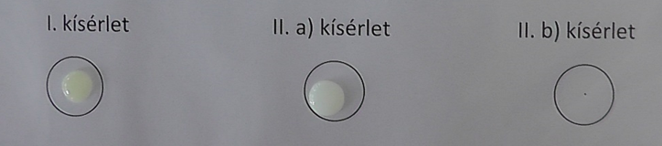
  II.3. Experimental design tasks (example)
  Teacher guide of worksheet 15 (about reaction rate)
Microscale experiments were done with drops of solutions:
  to reduce the amount of materials used
  to reduce the amount of sulfur dioxide generated
Time is measured when the tiny grey dot in the middle of the circles on the laminated paper could not be seen anymore
A photograph taken of the experiments:
Teaching teachers to teach inquiry
EUROVARIETY conference, Krakow, Jagiellonian University, 3rd July 2025

Slide 9
  II.3. Experimental design tasks (example)
  Teacher guide of worksheet 15 (about reaction rate)
4. THESE ARE THE ASSUMPTIONS (HYPOTHESES):
II.a) If we reduce the concentration (the independent variable changes as intended), then it increases the time needed for the reaction to take place (the dependent variable will change in this way).
II.b) If the temperature is raised (the independent variable changes as intended), then it reduces the time needed for the reaction to take place (the dependent variable will change in this way).
5. HOW CAN THE INDEPENDENT VARIABLES CHANGE? Plan which liquids and in which order should be dropped into the circles drawn on the sheet in the plastic bag and marked as follows.
II. a): 1 drop of cold Na₂S₂O₃ solution + 1 drop of cold water + 1 drop of cold hydrochloric acid | II. b): 1 drop of warm Na₂S₂O₃ solution + 1 drop of warm hydrochloric acid
Teaching teachers to teach inquiry
EUROVARIETY conference, Krakow, Jagiellonian University, 3rd July 2025

Slide 10
  II.3. Experimental design tasks (example)
  Teacher guide of worksheet 15 (about reaction rate)
6. WHICH OF THE FOLLOWING CONSTANTS SHOULD BE THE SAME IN ALL EXPERIMENTS? Mark with an X sign!
II. a) ☐ Volume of solutions. ☐ Concentration of solutions.
☒ Temperature of the solutions. ☐ The order in which the solutions are dropped.
II. b) ☒ Volume of solutions. ☒ Concentration of solutions.
☐ Temperature of the solutions. ☐ The order in which the solutions are dropped.
Teaching teachers to teach inquiry
EUROVARIETY conference, Krakow, Jagiellonian University, 3rd July 2025

Slide 11
  II.3. Experimental design tasks (example)
  Teacher guide of worksheet 15 (about reaction rate)
7. THE STEPS OF THE EXPERIMENTS:
II. a):
(1) Place the dropper or bottle containing the water in the cold water bath.
(2) Drop 1 drop of cold Na₂S₂O₃ solution into the circle marked II.a).
(3) Drop 1 drop of cold water on it.
(4) Drop 1 drop of cold hydrochloric acid on it.
(5) Measure the time that must elapse before you can no longer see the dot in the middle of the circle.
II. b):
(1) Place the droppers or bottles containing the Na₂S₂O₃ solution and the hydrochloric acid into the warm water bath.
(2) Drop 1 drop of warm Na₂S₂O₃ solution into the circle marked II.b).
(3) Drop 1 drop of warm hydrochloric acid on it.
(4) Measure the time that must elapse before you can no longer see the dot in the middle of the circle.
Teaching teachers to teach inquiry
EUROVARIETY conference, Krakow, Jagiellonian University, 3rd July 2025

Slide 12
  II.3. A sample of experimental design tasks
  Teacher guide of worksheet 15 (about reaction rate)
8. OBSERVATION:
II. a) In the case of dilution with water, the point in the centre of the circle is not visible after about 60 s.
II. b) For warm solutions, the dot in the middle of the circle is not visible after about 10 s.
9. Explanation:
II. a) At lower concentrations, there are fewer particles in a given space, so the particles collide less often and the reaction takes place more slowly.
II. b) At higher temperatures, more particles have the energy to meet the activation energy requirement of the process. The particles move faster and collide more often. So, there are more frequent useful collisions.
10. CONCLUSION:
II. a) By reducing the concentration, the reaction rate can be reduced.
II. b) By increasing the temperature, the reaction rate can be increased.
Teaching teachers to teach inquiry
EUROVARIETY conference, Krakow, Jagiellonian University, 3rd July 2025

Slide 13
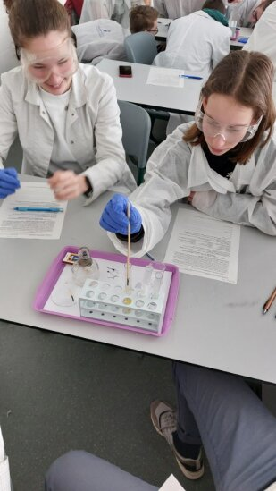
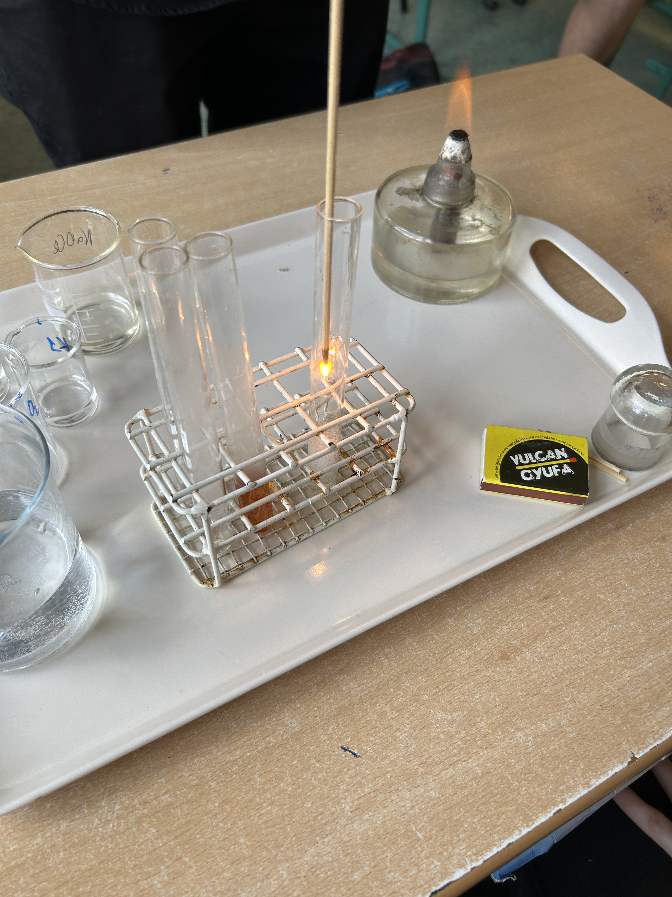
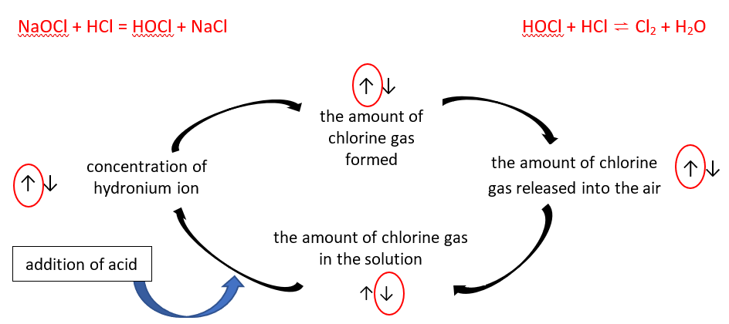
III. Systems thinking tasks for motivation (example)
on worksheet 18 (about redox reactions)
…"The Health Toxicology Information Service reported 101 cases of chlorine poisoning last year. The majority of these accidents occur in households, which is why it is important to be careful when using hypochlorite containing and acidic cleaning products." - can be read on the website hazipatika.com…”
Teaching teachers to teach inquiry
EUROVARIETY conference, Krakow, Jagiellonian University, 3rd July 2025

Slide 14
IV. A questionnaire filled in by
pre-service teacher students
Metadata [name; which course attended? etc.]
Piloting of worksheets: Which type and which one of the worksheet(s) does (s)he wants to try in future with students?
Worksheets: How easy/difficult to use them in theoretical/practical aspects, why?
Context-based/systems thinking tasks: How useful are they in terms of motivation/understanding?
Individual opinion/advice: How to improve the worksheets?
Number of pre-service teacher students who filled in the questionnaire:
  In academic year 2021/2022: 36 students
  In academic year 2022/2023: 28 students
  In academic year 2023/2024: 29 students
  (Altogether 103 students in 3 academic years.)
Teaching teachers to teach inquiry
EUROVARIETY conference, Krakow, Jagiellonian University, 3rd July 2025

Slide 15
V.1. Which type of worksheets do you want to try in future with your own students?
Teaching teachers to teach inquiry
EUROVARIETY conference, Krakow, Jagiellonian University, 3rd July 2025

Slide 16
V.3. How easy/difficult is it to use the worksheets 13-18 from a theoretical point of view?
Teaching teachers to teach inquiry
EUROVARIETY conference, Krakow, Jagiellonian University, 3rd July 2025

Slide 17
V.4. How easy/difficult is it to use the worksheets 13-18 from a practical point of view?
Teaching teachers to teach inquiry
EUROVARIETY conference, Krakow, Jagiellonian University, 3rd July 2025

Slide 18
V.6. Evaluation of systems thinking tasks
(Likert scale 0-4)
Teaching teachers to teach inquiry
EUROVARIETY conference, Krakow, Jagiellonian University, 3rd July 2025

Slide 19
VI, Pros and cons
Pros (advantages) | N*
The experiments are…
…easy to implement with simple tools | 39
… simple to carry out | 36
…use everyday materials | 36
…easy to design | 17
…easy to understand, easy to explain | 11
…are spectacular | 6
Cons (disadvantages) | N*
The experiments are…
…complicated, difficult to understand for the given age group | 22
… difficult to design | 6
…carried out with special and/or expensive materials | 5
…require time-consuming preparation | 4
…are time-consuming | 3
…may pose a risk of accident and/or fire. | 6
N = number of times it was mentioned by the pre-service teacher students
(sum of the 3 academic years)
Teaching teachers to teach inquiry
EUROVARIETY conference, Krakow, Jagiellonian University, 3rd July 2025

Slide 20
VII. Conclusion
One of the top three reasons for ease of use, year after year, is the ease of carrying out experiments. The fact that the experiments can be carried out with ordinary materials and simple tools is often highlighed.
Each year, it has been suggested that the use of the experiment design worksheets is made more difficult if the worksheets are complex and difficult for students to understand. However, the other key reasons have changed from year to year.
Discussions with students suggested that it is primarily the previous knowledge, the confidence level and the attitude of pre-service teachers that determines whether or not they will use the worksheets in the future.
Teaching teachers to teach inquiry
EUROVARIETY conference, Krakow, Jagiellonian University, 3rd July 2025

Slide 21
VIII. REFERENCES
Csapó B. (2022). Development of Thinking and Application of Knowledge in the Frameworks for Diagnostic Assessment of Science (in Hungarian), Magyar Tudomány. In: Current Issues in Teaching and Learning STEM, 2022/11, Thematic compilation, DOI: 10.1556/2065.183.2022.11.2
Hofstein A., (2015), The Development of Higher Order Learning Skills in High School Chemistry Laboratory: „Skills for Life”. In E. Serrano-Torregrosa & J. García-Martínez (Eds.), Chemistry Education: Best Practices, Opportunities and Trends. Wiley-VCH Verlag GmbH & Co., KGaA, Weinheim, Germany, pp. 517–535. https://onlinelibrary.wiley.com/doi/book/10.1002/9783527679300
Szalay, L., Tóth, Z., Borbás, R., Füzesi, I., (2023), Scaffolding of experimental design skills, Chemistry Education Research and Practice, 24, 599 – 623. https://doi.org/10.1039/D2RP00260D
Walker M. (2007). Teaching inquiry based science, LaVergne, TN: Lightning Source. ISBN: 978-1312955622
Teaching teachers to teach inquiry
EUROVARIETY conference, Krakow, Jagiellonian University, 3rd July 2025

Slide 22
Thank you for your attention!
This study was funded by the Research Programme for
Public Education Development of the Hungarian Academy of Sciences
Dr. Luca Szalay (luca.szalay@ttk.elte.hu)
MTA-ELTE Research Group on Inquiry-based Chemistry Education:
http://ttomc.elte.hu/publications/92

