Slide 1



Exploration of effective ways to develop experimental design skills
MTA-ELTE Research Group on Inquiry-based Chemistry Education
Dr. Luca Szalay and Dr. Zoltán Tóth
BICE 2024, Budapest, Hungary, 29. 11. 2024.

Slide 2
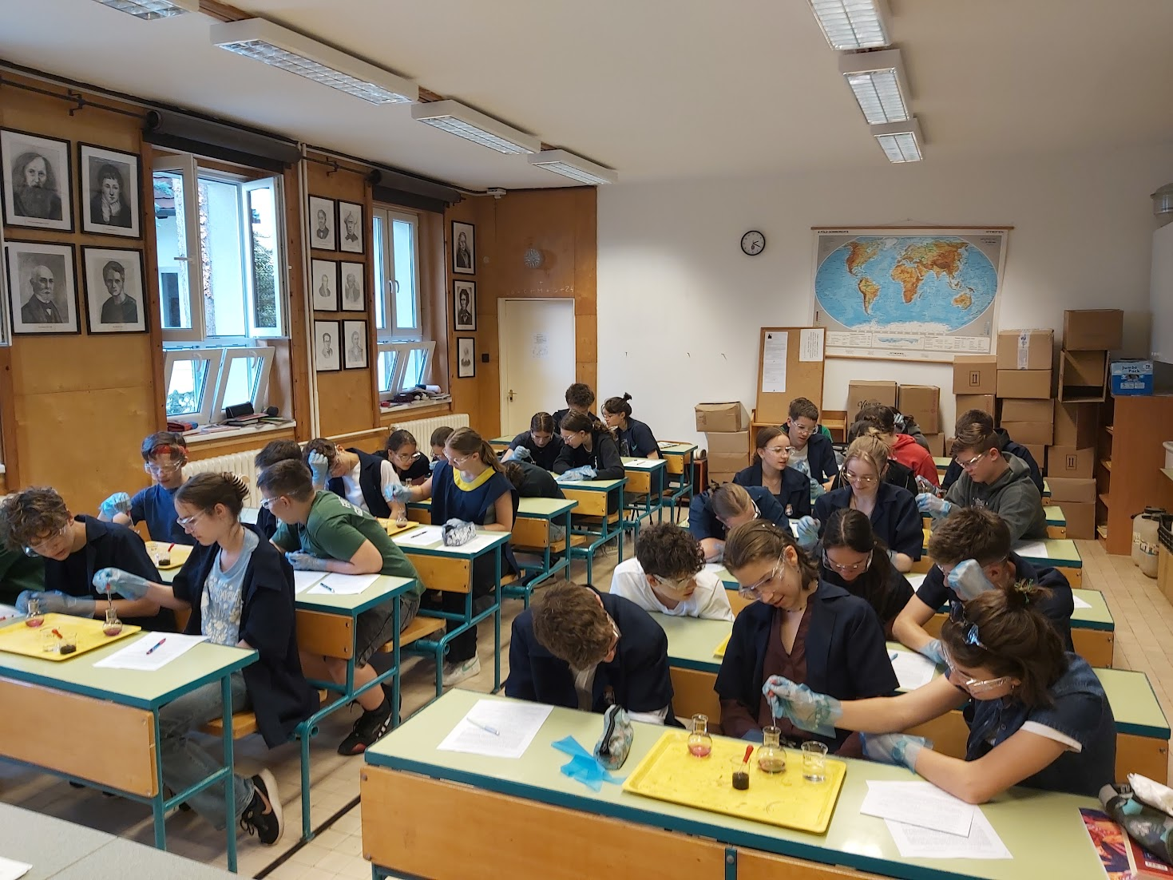
CONTENT
Introduction: scientific thinking, guided inquiry and the goal of the research group
The present 4-years project:
  Research method and sample
  Research model and questions
  Examples of worksheets
  Statistical methods
  Sample of students
Results of the first 3 school years:
  Effects on the experimental design
  skills and disciplinary content knowledge
  2. Effects on marks and attitudes
Summary, conclusions
BICE 2024, Budapest, Hungary, 29. 11. 2024.

Slide 3
I.1. Scientific thinking and student experiments
Focus of student experiments: reinforcing and demonstrating scientific content practicing scientific thinking (Hofstein, 2015).
Elements of scientific thinking that are closely related to scientific cognition:
  identification and control of variables
  causality
  hypothesis generation and testing
  design of experiments (Csapó, 2022).
* Hofstein A., (2015), The Development of Higher Order Learning Skills in High School Chemistry Laboratory: „Skills for Life”, in: Garcia-Martinez J. and Serrano-Torregosa E., (eds.), Chemistry Education: Best Practices, Opportunities and Trends, 1st ed., Wiley-VCH Verlag GmbH & Co., KGaA, Weinheim, Germany, pp. 517–535.
* * Csapó B., (2022), A gondolkodás fejlesztése és a tudás alkalmazása a természettudomány diagnosztikus értékelésének tartalmi kereteiben (Development of Thinking and Application of Knowledge in the Frameworks for Diagnostic Assessment of Science; in Hungarian), (2022), Magyar Tudomány, in: A STEM tanításának és tanulásának aktuális kérdései (Current Issues in Teaching and Learning STEM), 2022/11, Tematikus összeállítás (Thematic compilation), DOI: 10.1556/2065.183.2022.11.2
BICE 2024, Budapest, Hungary, 29. 11. 2024..

Slide 4
I.2. Guided inquiry and the goal of the research group
„inquiry-based science learning/teaching/education” (IBL, IBST, IBSE): teaching/learning process is modelling the steps of scientific research
classification e.g. according to the measure of students’ independence:
*Essentially no inquiry: Xu, H.; Talanquer, V. (2013), Effect of the level of inquiry of lab experiments on general chemistry students’ written reflections. Journal of Chemistry Education, 90 (1), 21−28.
Type of inquiry | Is it known for the students… | Adott a
 | …the research question? | …the research method? | …the explanation of the results?
Open | no | no | no
Guided/Bounded | yes | no | no
Structured | yes | yes | no
Confirmation/Closed* | yes | yes | yes
BICE 2024, Budapest, Hungary, 29. 11. 2024..

Slide 5
II.1. Research method and sample
 | Longitudinal research: 4 school years 2021-2025 (Grade 7-10)
Intervention | 6 lessons/school year (=24 lessons, partially spent with the worksheets)
Tests | Test 0 (T0): September 2021+T1 (T2, T3, T4): end of each school year
Number of students | Initially: 992, but 603 filled in all the 4 tests till now (T0, T1, T2 and T3)
Age of students (years) | Initially: 12/13 in the 1st year; 14/15 in the 3rd year (2023/2024)
Number of teachers | Initially: 31, at present 26 (+2, who does not work with students)
Number of schools | Initially: 25, at present: 22
Group 1 (control) | only step-by-step experiments
Group 2 (experimental) | Scheme to teach experimental design AFTER step-by-step experiments
Group 3 (experimental) | Scheme to help experimental design BEFORE planning experiments
+ Motivation | Context-based tasks + elements of systems thinking for all the students
BICE 2024, Budapest, Hungary, 29. 11. 2024.

Slide 6
II. 1. a) The scheme* for Group 2
4. WHAT WAS THE INDEPENDENT VARIABLE THAT YOU HAD TO CHANGE IN THE EXPERIMENTS? YOU ARE ONLY ALLOWED TO CHANGE ONE FACTOR AT A TIME!
5. WHAT WAS THE DEPENDENT VARIABLE WHOSE CHANGE DEPENDED ON THE INDEPENDENT VARIABLE?
6. HOW COULD YOU TEST THIS DEPENDENT VARIABLE?
7. THIS WAS THE ASSUMPTION (HYPOTHESIS):
If………………………………………………………… (the independent variable changes as intended), then …………………………………………………………… (the dependent variable will change in this way).
8. WHICH OF THE FOLLOWING CONSTANTS SHOULD BE THE SAME IN ALL EXPERIMENTS? Mark with a + sign!
*Cothron, J. H., Giese, R. N., Rezba, R. J., (2000). Students and research: Practical strategies for science classrooms and competitions, (3rd Ed.)., Dubuque, IA: Kendall/Hunt Publishing Company
BICE 2024, Budapest, Hungary, 29. 11. 2024.

Slide 7
II. 1. b) The scheme for Group 3
1. WHAT IS THE INDEPENDENT VARIABLE THAT YOU HAVE TO CHANGE IN THE EXPERIMENTS? YOU ARE ONLY ALLOWED TO CHANGE ONE FACTOR AT A TIME!
2. WHAT IS THE DEPENDENT VARIABLE WHOSE CHANGE DEPENDED ON THE INDEPENDENT VARIABLE?
3. HOW CAN YOU TEST THIS DEPENDENT VARIABLE?
4. THIS IS THE ASSUMPTION (HYPOTHESIS):
If…………………………………………………………. (the independent variable changes as intended), then …………………………………………………………… (the dependent variable will change in this way).
5. HOW CAN THE INDEPENDENT VARIABLE CHANGE?
6. WHICH OF THE FOLLOWING CONSTANTS SHOULD BE THE SAME IN ALL EXPERIMENTS? Mark with a + sign!
BICE 2024, Budapest, Hungary, 29. 11. 2024.

Slide 8
II.2. Research model and questions from September 2021
Direct teaching of the experimental design skills worked better in a previous project →
Has the teaching of using a scheme to help experimental design even more effect on experimental design skills (EDS)/disciplinary content knowledge (DCK)/attitudes?
6 student sheets for 6 lessons
(taking only cca. 25-35 min) in 3 versions:
Type 1: only step-by-step experiments
Type 2: step-by-step experiments + scheme filled in AFTER the experiments
Type 3: scheme filled in BEFORE the experiments and used in practice
Statistical analysis of data
Choosing sample
Pre-test
Group 1
6 Type 1 student sheets
Post-test
Group 2
6 Type 2 student sheets
Post-test
Data collection
Group 3
6 Type 3 student sheets
Post-test
Note: Context-based and systems thinking* tasks are on each type of the students worksheets for motivational purposes.
*Orgill, M. K., York, S.; MacKellar, J. (2019). Introduction to Systems Thinking for the Chemistry Education Community. Journal of Chemical Education, 96, 2720-2729.

Slide 9
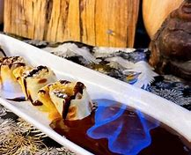
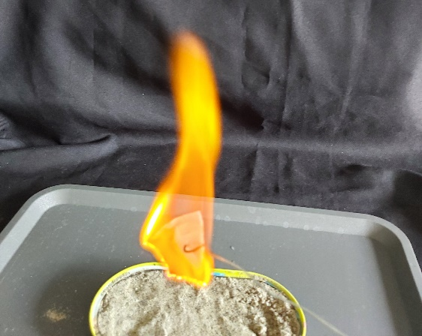
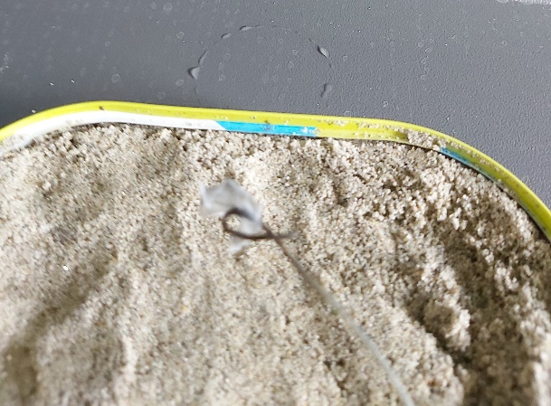
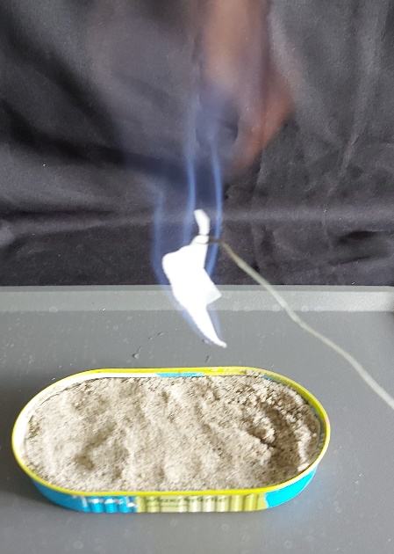
II.3.a) Examples of the contexts and topics of worksheets
For discussing healthy lifestyle:
Student sheet 11: Can the topping of a “Dobos” cake be made of birch sugar?
Student sheet 16: Geyser in a bottle, or the Mentos-Cola story
Student sheet 17: Sour as vinegar
Student sheet 20: Is it worth flambéing with pure alcohol?
Student sheet 21: The sweet secret of cola zero
Student sheet 22: How much vitamin C is in the orange juice?
Student sheet 23: A 4000-year-old success story – the Aspirin
Student sheet 24: Chicken from a boiled egg?
For discussing environmental issues and sustainability:
Student sheet 3: „The drowning duck”
Student sheet 10: Does acid rain harm mussels and coral reefs?
Student sheet 12: From superhero to supervillain? - Creating mountains of waste from useful plastics
Student sheet 14: Is it possible to walk on water?
Student sheet 19: Latte macchiato and other heterogeneous systems
BICE 2024, Budapest, Hungary, 29. 11. 2024.

Slide 10
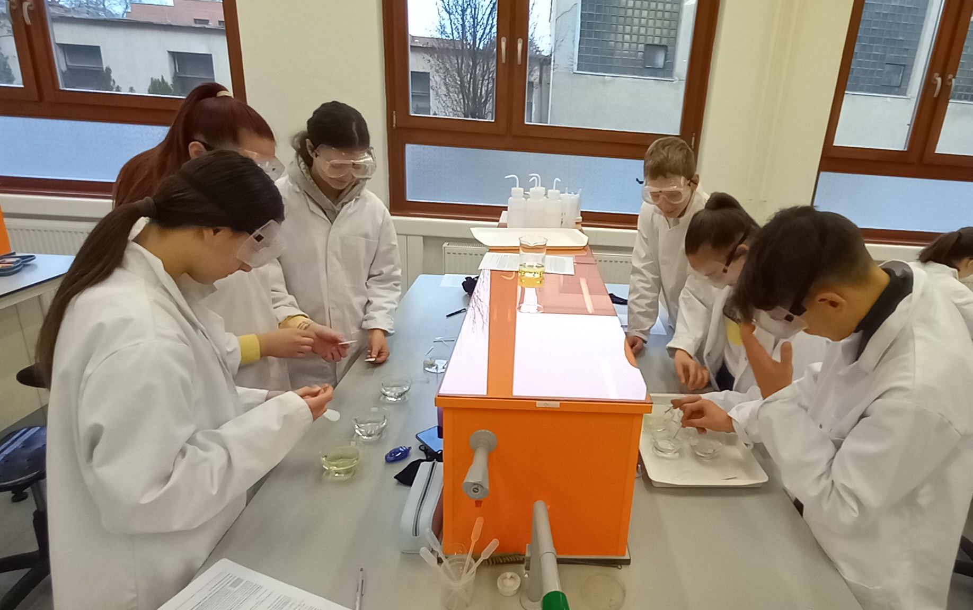
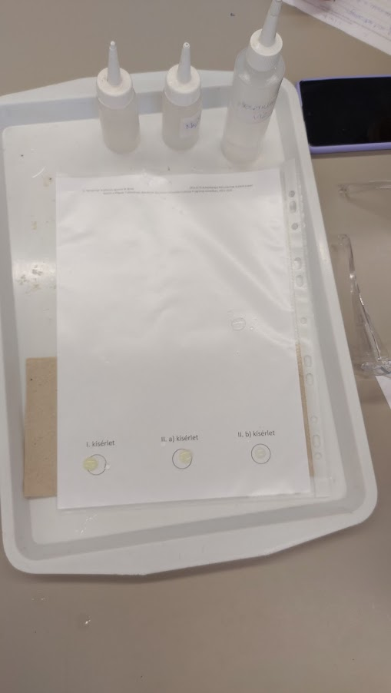
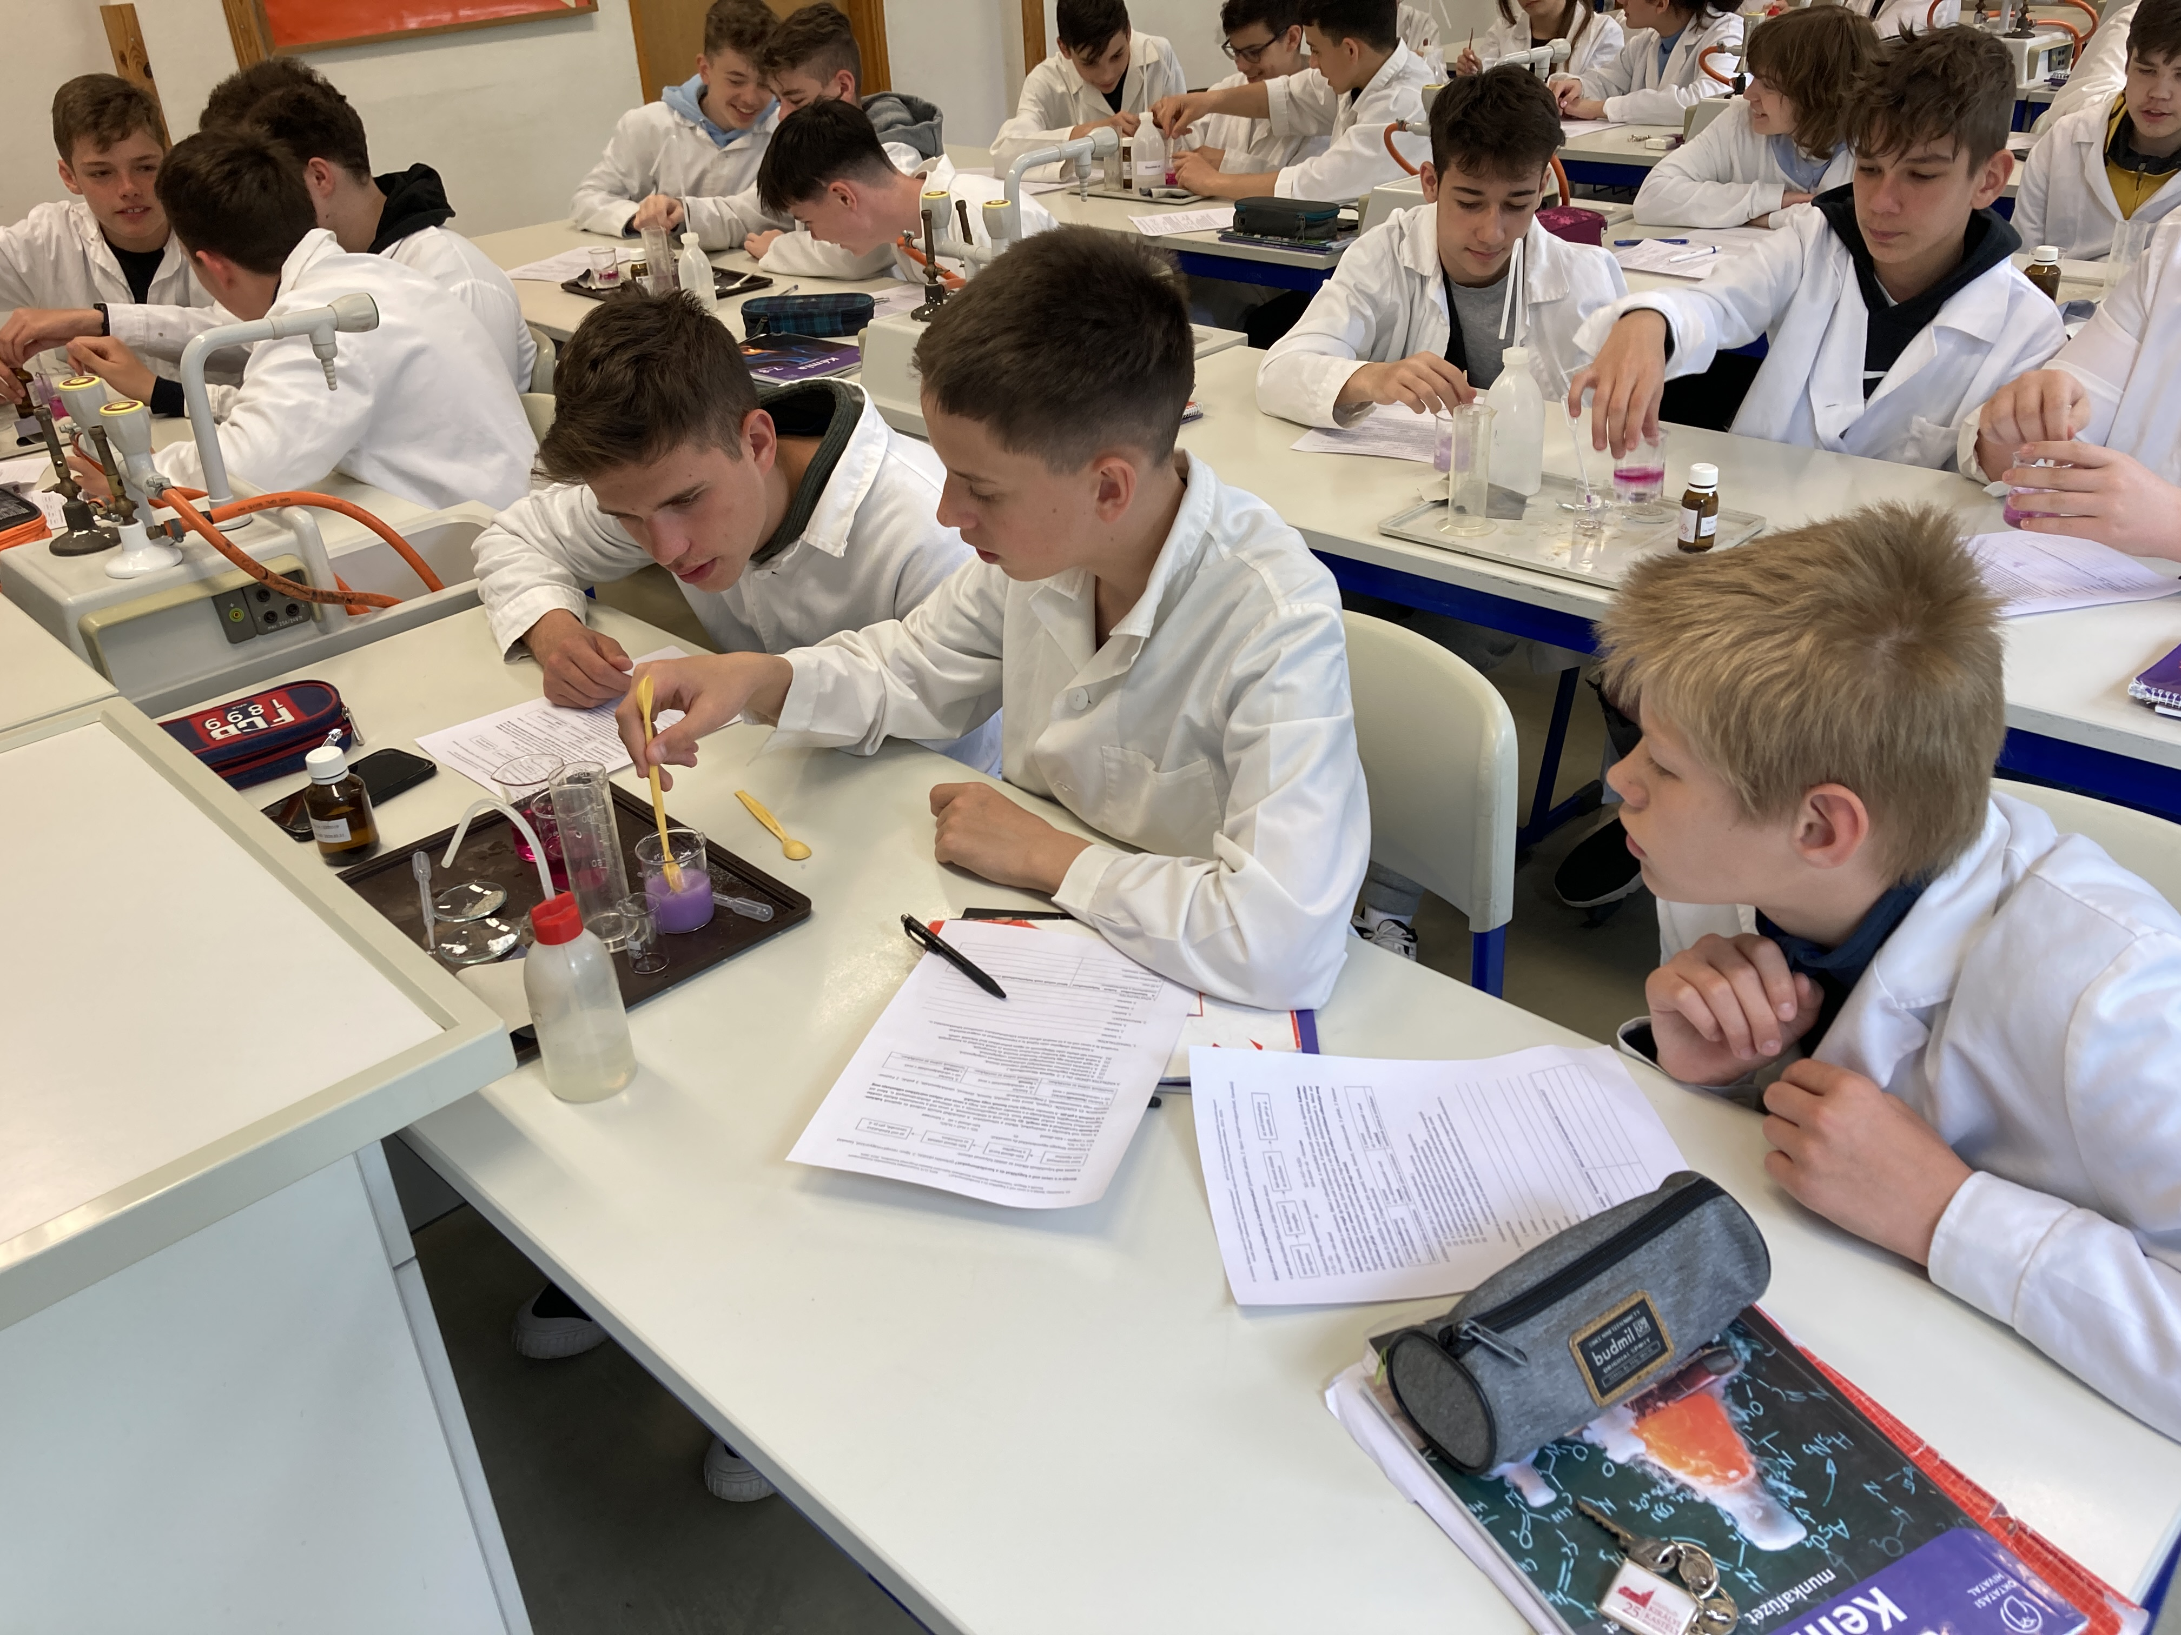
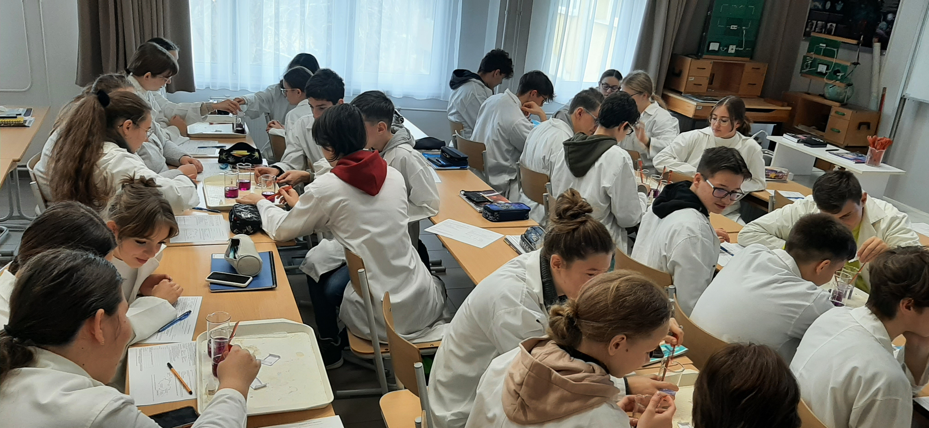
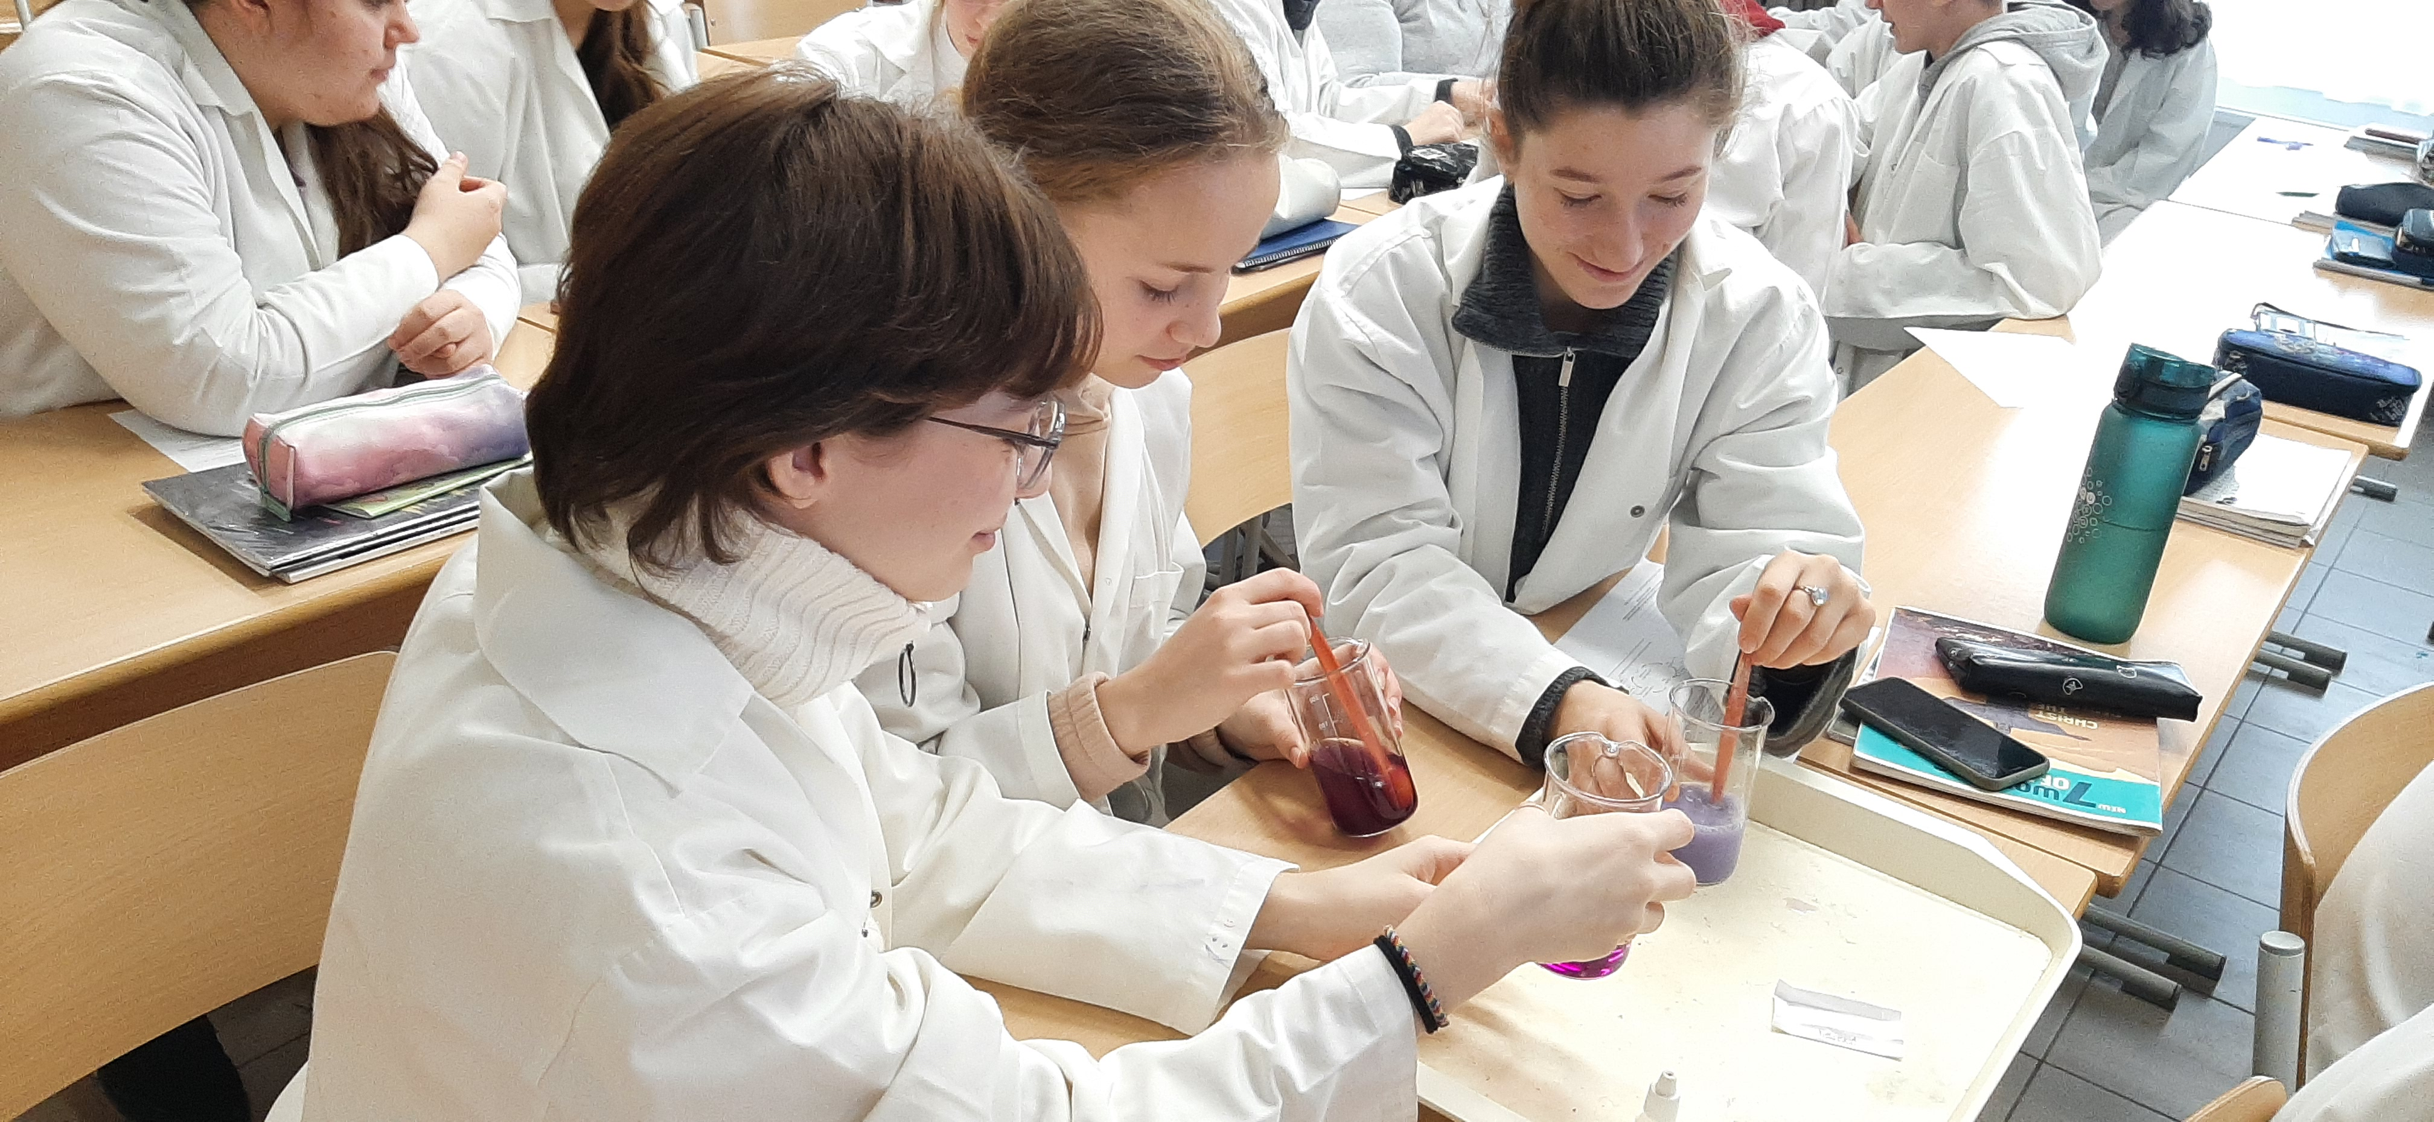
II.3.b) Examples of students doing the experiments
BICE 2024, Budapest, Hungary, 29. 11. 2024.

Slide 11
II.4. Statistical methods
Structured paper and pencil tests; tasks (far transfer for EDS!) intending to measure:
disciplinary content knowledge (DCK, 9 items) + experimental design skills (EDS, 9 items)
Analysis of covariance (ANCOVA) of the SPSS Statistics software
Independent variables (parameters):
  Groups (3 types of instruction methods: Group 1, Group 2, Group 3)
  School ranking (3 categories: relatively high, medium and low ranking schools)
  Mother’s education (2 categories: mother has/has not got a degree in higher education)
  Gender of the student (2 categories: boys, girls)
Covariant: Result of Test 0 (continuous variable)
No significant difference among the 3 groups on T0_{DCK}, on T0_{EDS}, and in any of the parameters in the beginning of the project (according to chi-square tests).
Dependent variables: percents of students’ scores (%) in the tests (on DCK and EDS tasks) analysed as continuous variables.
Cohen’s d effect size values were calculated.
Partial eta-squared (PES) was used as a measure of the effect size calculated by ANCOVA.

Slide 12
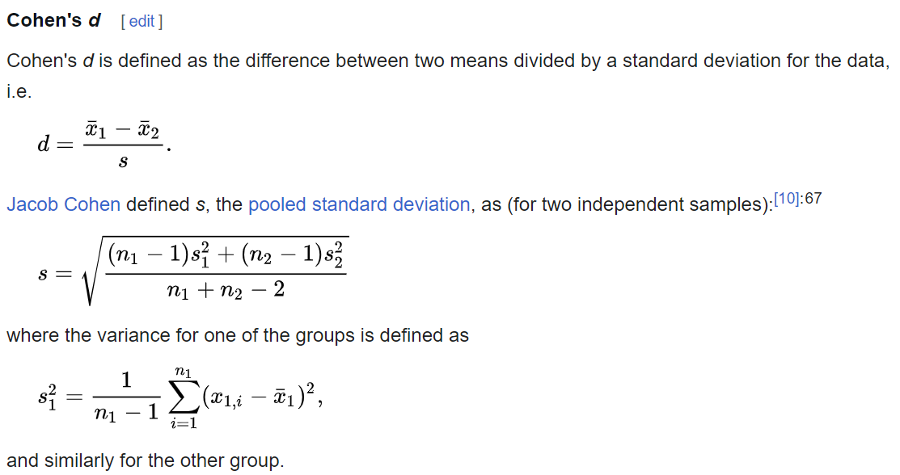
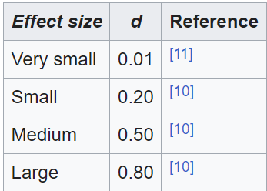
(II.4.) Cohen’s d effect size*
  .01: Small effect size
  .06: Medium effect size
  .14 or higher: Large effect size
*Effect size - Wikipedia

Slide 13
(II.4.) Partial eta-squared (PES)
Partial eta-squared (PES) was also used as a measure of the effect size.
The formula to calculate Partial eta squared is as follows:
Partial eta squared = SS_{effect} / (SS_{effect} + SS_{error})
where:
  SS_{effect}: The sum of squares of an effect for one variable.
  SS_{error}: The sum of squares error in the ANOVA model.
The value for Partial eta squared ranges from 0 to 1, where values closer to 1 indicate a higher proportion of variance that can be explained by a given variable in the model after accounting for variance explained by other variables in the model.
The following rules of thumb are used to interpret values for Partial eta squared:
  .01: Small effect size
  .06: Medium effect size
  .14 or higher: Large effect size

Slide 14
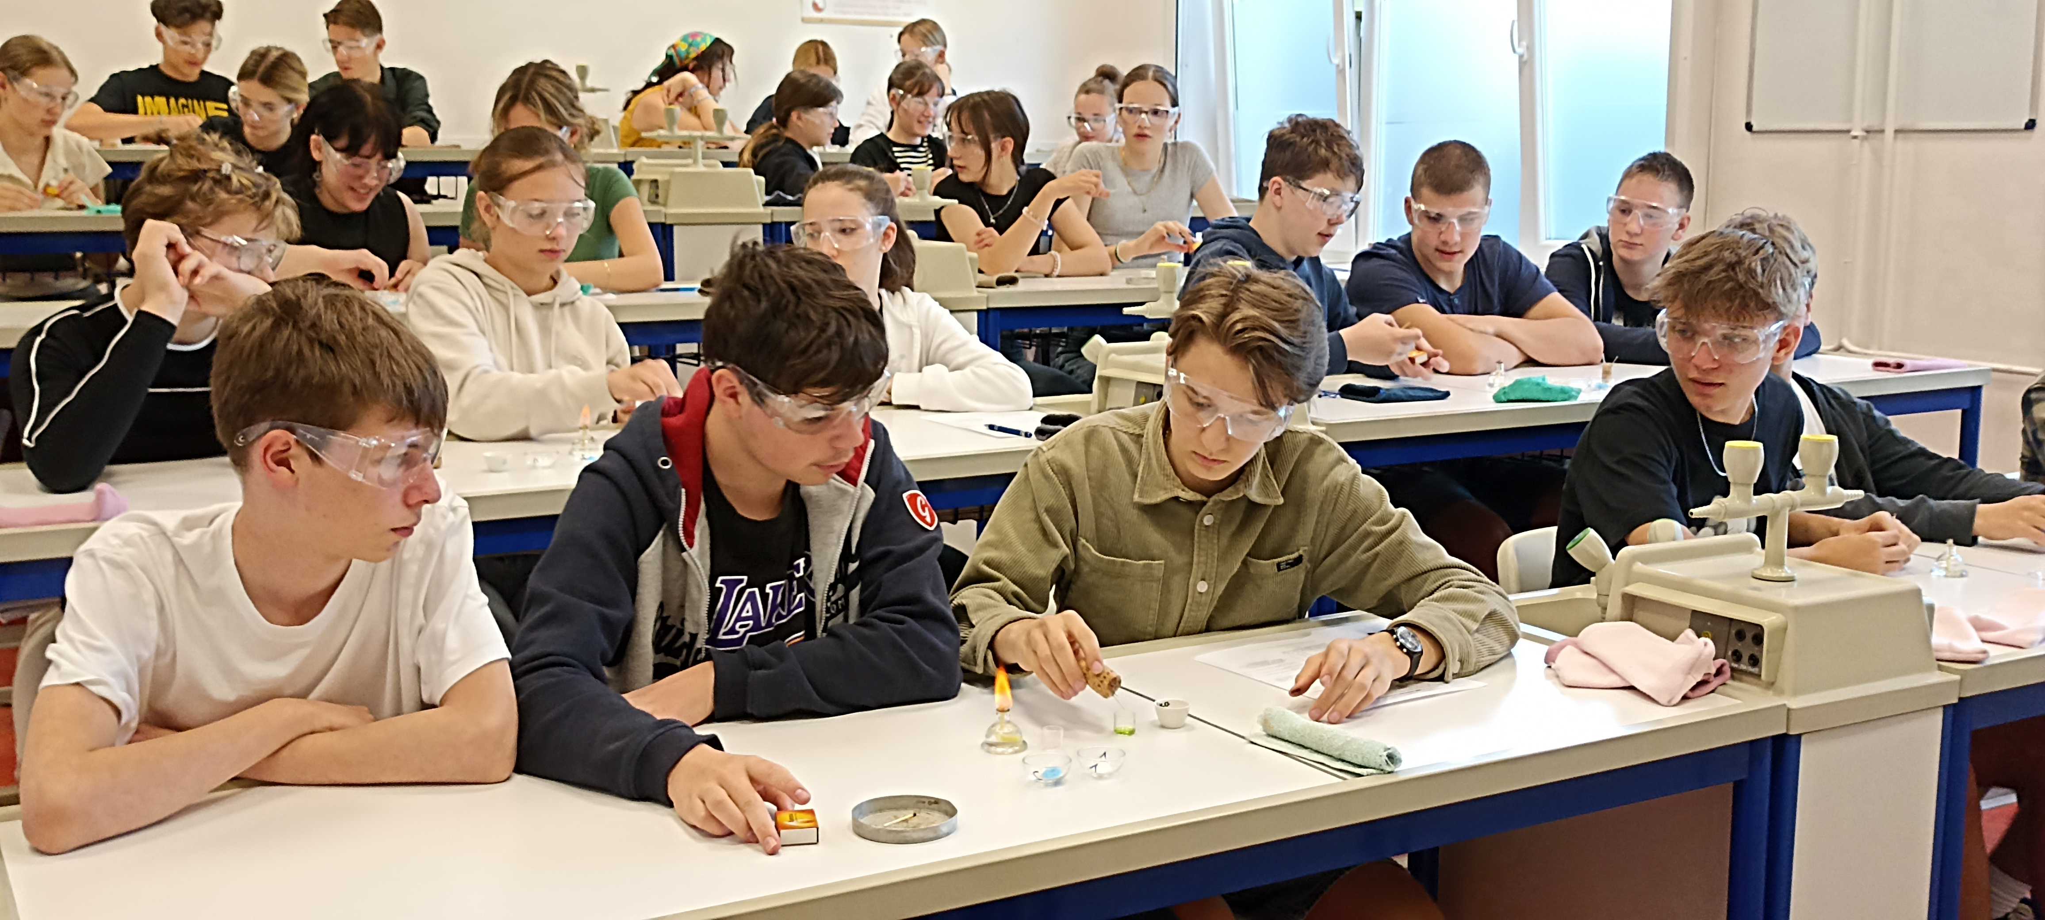
II.5. Sample of students filling in all the 4 tests till now
603 students filled in each test (T0, T1, T2, T3)
  298 boys (49.4%)
  305 girls (50.6%)
Number of students (N) in the groups:
  Group 1: 163 (control group)
  Group 2: 224
  Group 3: 216
Cronbach’s alpha values show acceptable reliability:
T0: 0.740; T1: 0.678; T2: 0.689; T3: 0.734
According to chi-squared tests among the :
there is a significant difference in the school ranking [Χ² (4, N = 603) = 39.74, p = .000]
there is no significant difference in the mother’s education [Χ² (2, N = 603) = 2.234, p = .327]
there is no significant difference in the genders [Χ² (2, N = 603) = 1.216, p = .545]

Slide 15
III.1.a) Cohen’s d effect sizes (N=603), calculated from the mean differences between two tests and their standard deviations
Groups compared | T1 – T0 | T2 – T1 | T3 – T2 | T3 – T0
TOTAL TEST SCORES
Group 2 / Group 1 | -0.28 | 0.19 | -0.04 | -0.13
Group 3 / Group 1 | 0.24 | -0.18 | -0.05 | 0.01
DCK (DISCIPLINARY CONTENT KNOWLEDGE SCORES)
Group 2 / Group 1 | -0.29 | 0.19 | 0.03 | -0.07
Group 3 / Group 1 | 0.00 | 0.01 | -0.21 | -0.19
EDS (EXPERIMENTAL DESIGN SKILL SCORES)
Group 2 / Group 1 | -0.13 | 0.11 | -0.09 | -0.13
Group 3 / Group 1 | 0.32 | -0.28 | 0.10 | 0.16
DCK for the 3 years period:
Group 2: negative
Group 3: negative
EDS for the 3 years period:
Group 2: negative
Group 3: positive

Slide 16
III.1.b) Effect sizes (PES), (N=603) of the assumed parameters and the covariant on the students’ scores
Parameter/covariant↓ PES→ | T0_{DCK} | T1_{DCK} | T2_{DCK} | T3_{DCK}
Group (effect of intervention) | 0.000 | 0.035* | 0.002 | 0.012
School ranking | 0.022* | 0.109* | 0.002 | 0.034*
Mother’s education | 0.019* | 0.000 | 0.002 | 0.000
Gender | 0.007 | 0.002 | 0.001 | 0.002
T0_{DCK} | - | 0.044* | 0.050* | 0.016*
Parameter/covariant↓ PES→ | T0_{EDS} | T1_{EDS} | T2_{EDS} | T3_{EDS}
Group (effect of intervention) | 0.003 | 0.050* | 0.003 | 0.014(*)
School ranking | 0.090* | 0.012 | 0.056* | 0.014(*)
Mother’s education | 0.000 | 0.005 | 0.007 | 0.001
Gender | 0.000 | 0.004 | 0.000 | 0.004
T0_{EDS} | - | 0.076* | 0.064* | 0.066*
*sign. (p < .013, Bonferroni correction
Weak significant effect of the intervention on the EDS scores in the end of the 3rd school year.

Slide 17
III.2.a) Effect on marks: changes in marks
(T0: mark in science; T1-T3: mark in chemistry)
(Best mark is 5.)
Marks got worse in each group in Grade 7 and Grade 8, but stabilised in Grade 9.
Marks in Group 1 (control group) increased in Grade 9.
BICE 2024, Budapest, Hungary, 29. 11. 2024.

Slide 18
III.2.b) Impact on how much students like the subject
(5-point Likert scale; T0: science; T1-T3: chemistry)
Students like the subject (science/chemistry) less and less by the years.
Group 1 (control group) likes it slightly more than the experimental groups.
(The difference due to the better marks?)
BICE 2024, Budapest, Hungary, 29. 11. 2024.

Slide 19
III.2.c) Impact on students' perception of the importance of experiments in science (5-point Likert scale)
High average values that do not change much.
Experimental groups are not better than the control group.
BICE 2024, Budapest, Hungary, 29. 11. 2024.

Slide 20
III.2.d) Impact on students’ preference of step-by-step experiments to experimental design (5-point Likert scale)
The lower the value the less student rejects experiment designing activities.
Group 3 rejects slightly less the experimental design than the other two groups.
BICE 2024, Budapest, Hungary, 29. 11. 2024.

Slide 21
IV. Conclusions
Direct teaching of experimental design by using the scheme:
  Group 3: small positive effect BEFORE the experiment→ seems to be worth using it;
  Group 2: AFTER the step-by-step experimentt does not seem to work.
  Groupd 3: seemed to gain less DCK than the control group in grade 9.
Group 3 rejects slightly less the experimental design than the other two groups.
Preliminary knowledge (T0) had the strongest effect on the EDS scores.
LIMITATIONS
  The number of students have decreased by the years.
  There must be many other factors that influence the student achievements.
  The tasks of the tests could be improved.
  Probabaly not all the students provide there best knowledge on the tests.
  The intervention could have other positive or negative effects that we are not able to measure.
BICE 2024, Budapest, Hungary, 29. 11. 2024.

Slide 22
Publications
Szalay, L., Tóth, Z., (2016), An inquiry-based approach of traditional ’step-by-step’ experiments, Chemistry Education Research and Practice, 17, 923–961., (DOI: https://doi.org/10.1039/C6RP00044D)
Szalay, L., Tóth, Z., Kiss, E., (2020), Introducing students to experimental design skills, Chemistry Education Research and Practice, 21, 331–356. (DOI: https://doi.org/10.1039/C9RP00234K)
Szalay, L., Tóth, Z., Borbás, R., (2021), Teaching of experimental design skills: results from a longitudinal study, Chemistry Education Research and Practice, 22, 1054–1073. (DOI: https://doi.org/10.1039/D0RP00338G)
Szalay, L., Tóth, Z., Borbás, R., Füzesi, I., (2023), Scaffolding of experimental design skills, Chemistry Education Research and Practice, 24, 599–623. (DOI: https://doi.org/10.1039/D2RP00260D)
Szalay, L., Tóth, Z., Borbás, R. & Füzesi, I. (2024) Progress in developing experimental design skills among junior high school learners; Journal of Turkish Science Education. 21(3), 484-511. DOI: https://doi.org/10.36681/ View of Volume: 21 Issue: 3 (2024): Journal of Turkish Science Education (tused.org)
BICE 2024, Budapest, Hungary, 29. 11. 2024.

Slide 23
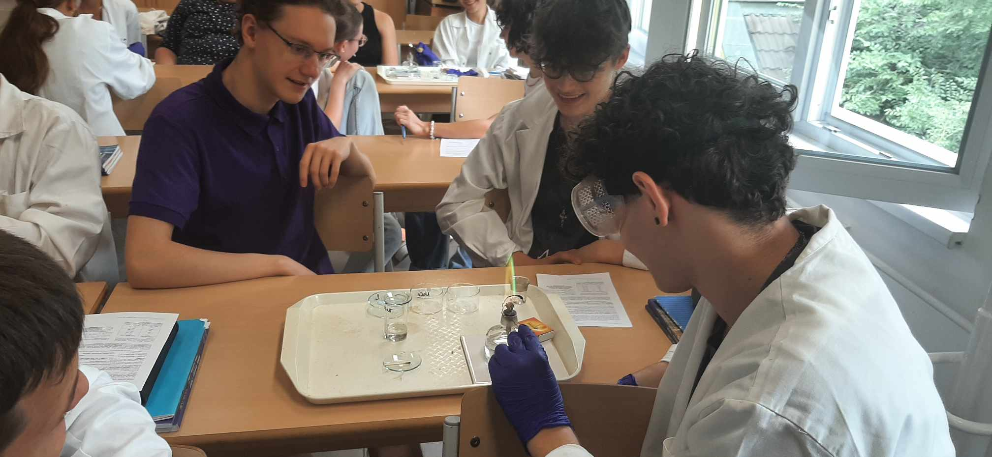
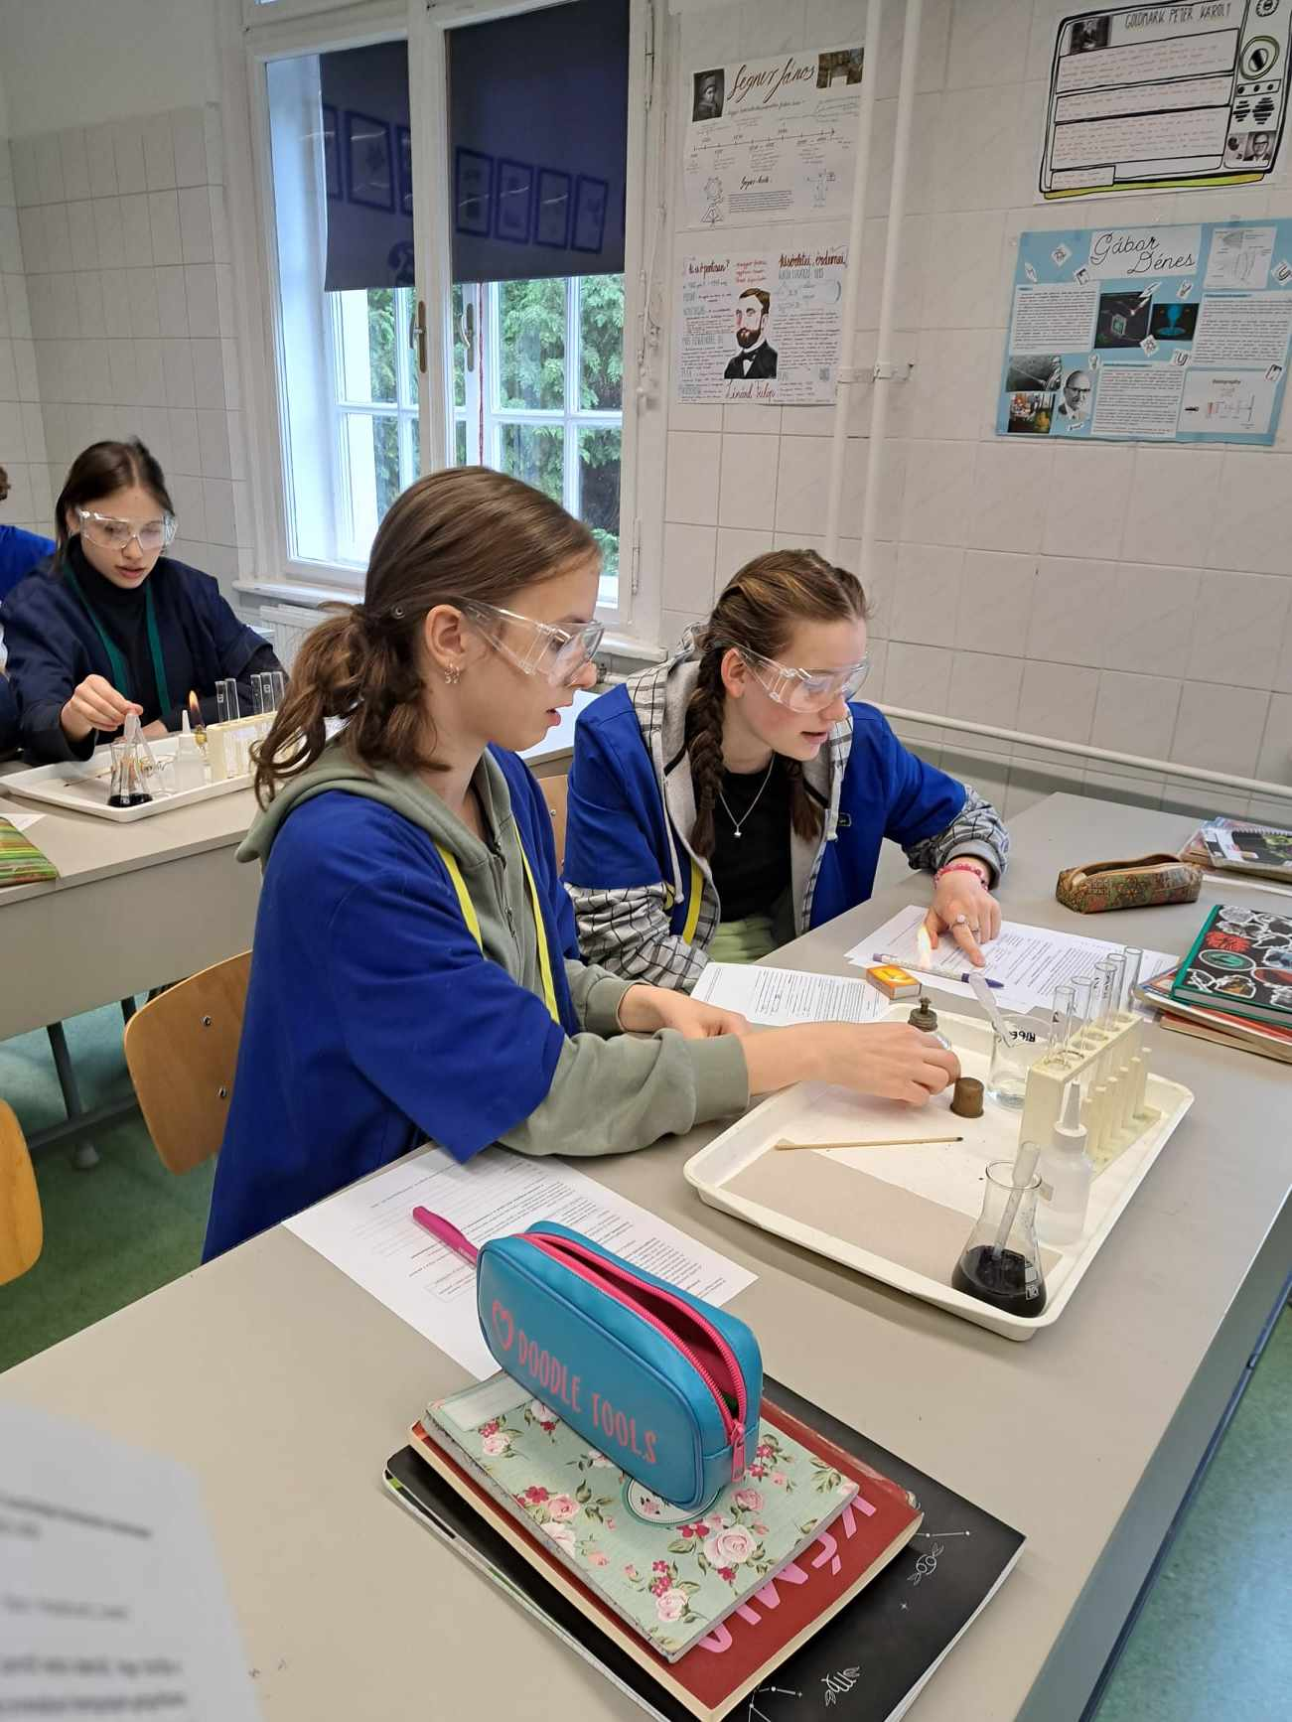
Thank you for your attention!
This study was funded by the Research Programme for
Public Education Development of the Hungarian Academy of Sciences
Dr. Luca Szalay (luca.szalay@ttk.elte.hu)
MTA-ELTE Research Group on Inquiry-based Chemistry Education:
http://ttomc.elte.hu/publications/90

