Slide 1


Teaching of the experimental design skills
Edina Kiss¹, Zoltán Tóth², Luca Szalay¹
8th EUROVARIETY, 17-19 July, 2019, Prato
¹ELTE, Eötvös Loránd University, Budapest, Hungary, drkissed@gmail.com
²University of Debrecen, Debrecen, Hungary, tothzoltandr@gmail.com
Content Pedagogy Research Program of the
Hungarian Academy of Sciences (2016-2020), MTA-ELTE Research Group on Inquiry-Based Chemistry Education

Slide 2
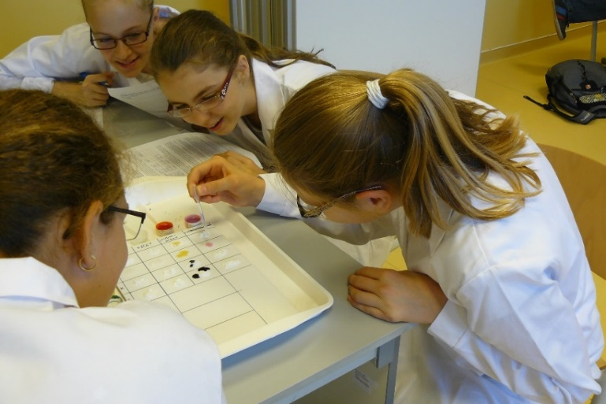
Content
Introduction: Research questions
Research method of 2016/2017
Change of the research method in the 2nd year
Main results
Conclusions
How the main results have been used in our chemistry teacher education?
http://ttomc.elte.hu/
Notes:
Let me show you a brief overview what I am going to talk about.
First I will explain the research questions that were raised by a previous empirical research.
Then I want to show you the research method that was changed in the second year.
At last I am going to talk about our results and conclusions and say a few sentences about how the main results have been used in our chemistry teacher education in Hungary.

Slide 3
1.1. Research questions
Positive results of our earlier research¹ (brief intervention, ‘step-by-step’ experiments, but some steps were designed by the 14-15 years old students of the experimental group).
  1. Would the difference in the ability of designing experiments between the groups grow in a longitudinal research?
  2. Does the intervention change the students’ attitudes and motivation?
  3. Does it matter if the students actually carry out the designed experiments, or designing the experiments in theory has got similar effect?
  ¹Szalay, L., Tóth, Z., (2016), An inquiry-based approach of traditional ’step-by-step’ experiments, Chem. Educ. Res. Pract., 17, 923-961.

Slide 4
2.1. Research method of 2016/2017
Content Pedagogy Research Program of the
Hungarian Academy of Sciences: 19 projects (2016-2020)
MTA-ELTE Research Group on Inquiry-Based Chemistry Education – members:
  25 chemistry teachers and 5 university chemistry lecturers
  5 pre-service chemistry teacher students.
4 school years: 4x6=24 student sheets and teacher guides
2016 autumn: pre-test, end of 4 school years: 4 post-tests:
  experimental design skills
  ‚other’ knowledge (recall, measuring development.
  understanding, application)
  attitude toward chemistry
Test questions structured according to Bloom’s taxonomy
Statistical analysis of data.

Slide 5
2.2. The sample
18 secondary schools in Hungary, 31 classes of students (they study chemistry for 4 years)
At the beginning 883 students, 7th grade (12-13 years), divided randomly:
  Group 1: following ‚step-by-step’ experiments (‚control’);
  Group 2: following the same ‚step-by-step’ recipes + theoretical experiment designing tasks;
  Group 3: designing and doing the same student experiments as Group 1 and Group 2.
September 2016: pre-test (18 items, Bloom’s taxonomy)
May 2017, 2018, 2019: 1st, 2nd, 3rd post-test (18 items, same structure as the pre-test), 694 students, Group 1: 234; Group 2: 216; Group 3: 244

Slide 6
2.3. The research model of 2016/2017
6 student sheets for 6 lessons
(45 min) in 3 versions:
Type 1: step-by-step experiments
Type 2: step-by-step experiments + experimental design tasks on paper
Type 3: experimental design in practice
Statistical analysis of data
Choosing sample
Group 1
Pre-test
6 Type 1 student sheets
Post-test
Group 2
Pre-test
6 Type 2 student sheets
Data collection
Post-test
Group 3
Pre-test
6 Type 3 student sheets
Post-test
Note: Each student sheet contained practical activities that required doing student experiments (the same for each type).

Slide 7
3.1. Changes in the 2nd year
The results of the first year were below expectations.
Discussions with experts of psychology and assessment →
The important aspect of the experimental design has to be taught + closely related testing is needed.
E.g. ‘other variables held constant’
  Group 1: keeps doing only step-by-step experiments;
  Group 2:
    does the same step-by-step experiments as Group 1;
    + after the experiments it is explained how the ‘other variables held constant’ principle was applied;
  Group 3:
    learns the ‘other variables held constant’ principle
    + designs experiments when they have to apply the ‘other variables held constant’ principle.
    Tests: Can they apply this principle while designing experiments?

Slide 8
3.2. Changes in the 2nd year
6 student sheets for 6 lessons
(45 min) in 3 versions:
Type 1: step-by-step experiments
Type 2: step-by-step experiments + principles of experimental design explained AFTER the experiments
Type 3: principles of experimental design explained BEFORE the experiments and used in practice
Statistical analysis of data
Choosing sample
Group 1
Pre-test
6 Type 1 student sheets
Post-test
Group 2
Pre-test
6 Type 2 student sheets
Data collection
Post-test
Group 3
Pre-test
6 Type 3 student sheets
Post-test
THE RESEARCH MODEL FROM 2017/2018

Slide 9
4.1. Mean differences on the whole test
%
The mean difference is significant at the 0.05 level.

Slide 10
4.2. Mean differences on the sub-tests
%
The mean difference is significant at the 0.05 level.

Slide 11
4.3. Mean differences on the sub-tests
%
The mean difference is significant at the 0.05 level.
Notes:
.

Slide 12
5. Conclusions
  Preliminary analysis:
    It is worth asking students to design some experiments before carrying out those experiments.
    PRINCIPLES OF EXPERIMENTAL DESIGN HAVE TO BE TAUGHT AND PRACTICED.
  It also seems to be necessary to find a more appropriate method for the statistical analysis of the results.
    Matched pair design
    ANCOVA
      The effect of mother’s education
      The effect of school ranking

Slide 13
6.1. How the main results have been used in our chemistry teacher education?
A study was carried out by a pre-service chemistry teacher student and presented at the National Conference of Scientific Students' Associations
  about physical and chemical misconceptions in the students’ answers
Three other pre-service chemistry teacher students have contributed to the work of our research group as part of their theses work, e.g.:
  examining the objectivity of the correction of the tests
  examining attitude and motivation
  writing a student sheet and trial of a post-test.
Notes:
.

Slide 14
6.2. How the main results have been used in our chemistry teacher education?
The project has been built in the pre-service chemistry teachers’ training
  Every student sheet and teacher guide have been tried by the chemistry teacher students during their laboratory practice.
  They had to use them and/or write similar student sheets for their own lessons held at their practicals.
Results gained by the statistical analysis of data were presented at continuous professional development (CPD) courses organised for chemistry teachers. They also tried in our lab the student sheets requiring experiment design.
Notes:
A lecture concerning the basic concepts of the inquiry-based science education and a summary of the project has been built in the pre-service chemistry teachers’ training.
Of course they can use all the student sheets in the lab and at their practicals.
Results gained by the statistical analysis of data were presented at CPD courses organised for chemistry teachers, when they could also try each student sheet written for the Group 3 students.

Slide 15
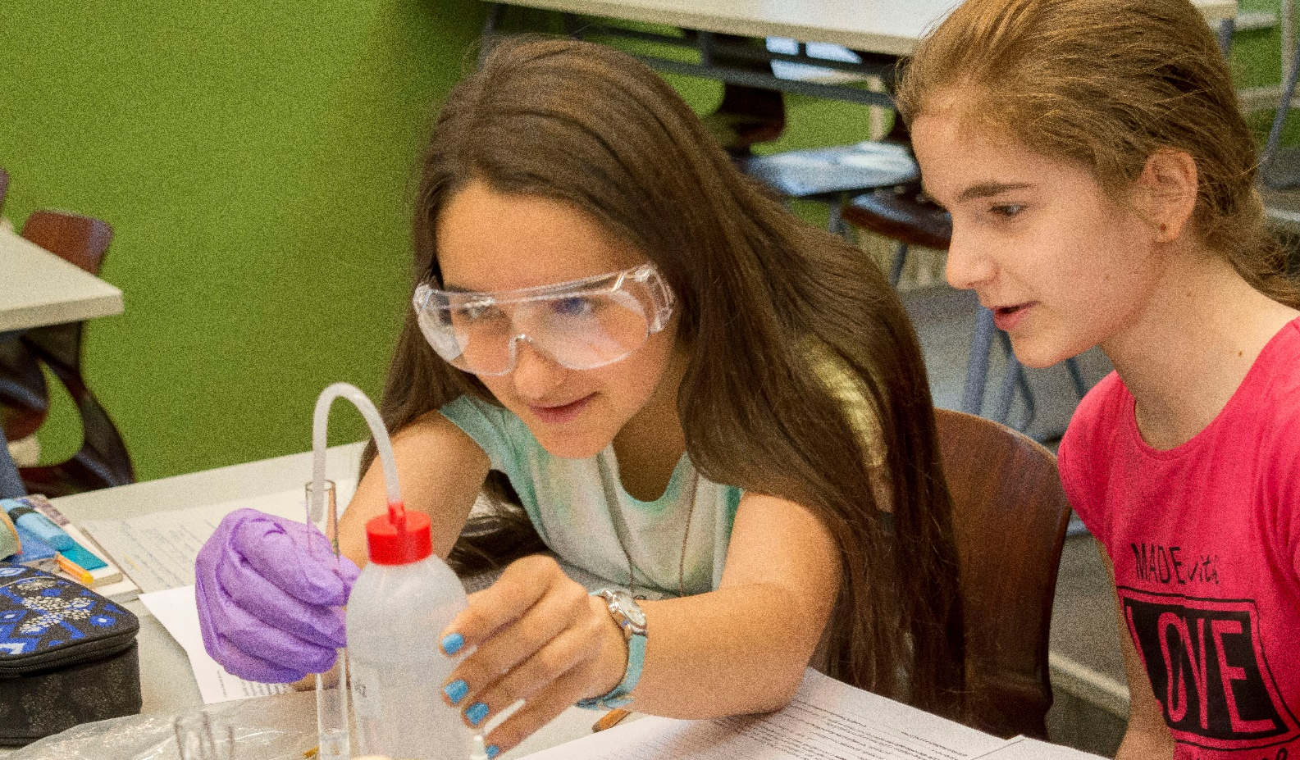
This study was funded by the
Content Pedagogy Research Program of the
Hungarian Academy of Sciences.
Many thanks for all the collegues’ work. Project No.: 471026.
THANK YOU FOR YOUR ATTENTION!

