Slide 1



New results in improving
experimental design skills
MTA-ELTE Research Group on Inquiry-based Chemistry Education
Dr. Luca Szalay and Dr. Zoltán Tóth
ECRICE 2024, Lisbon, Portugal, 06. 09. 2024.

Slide 2
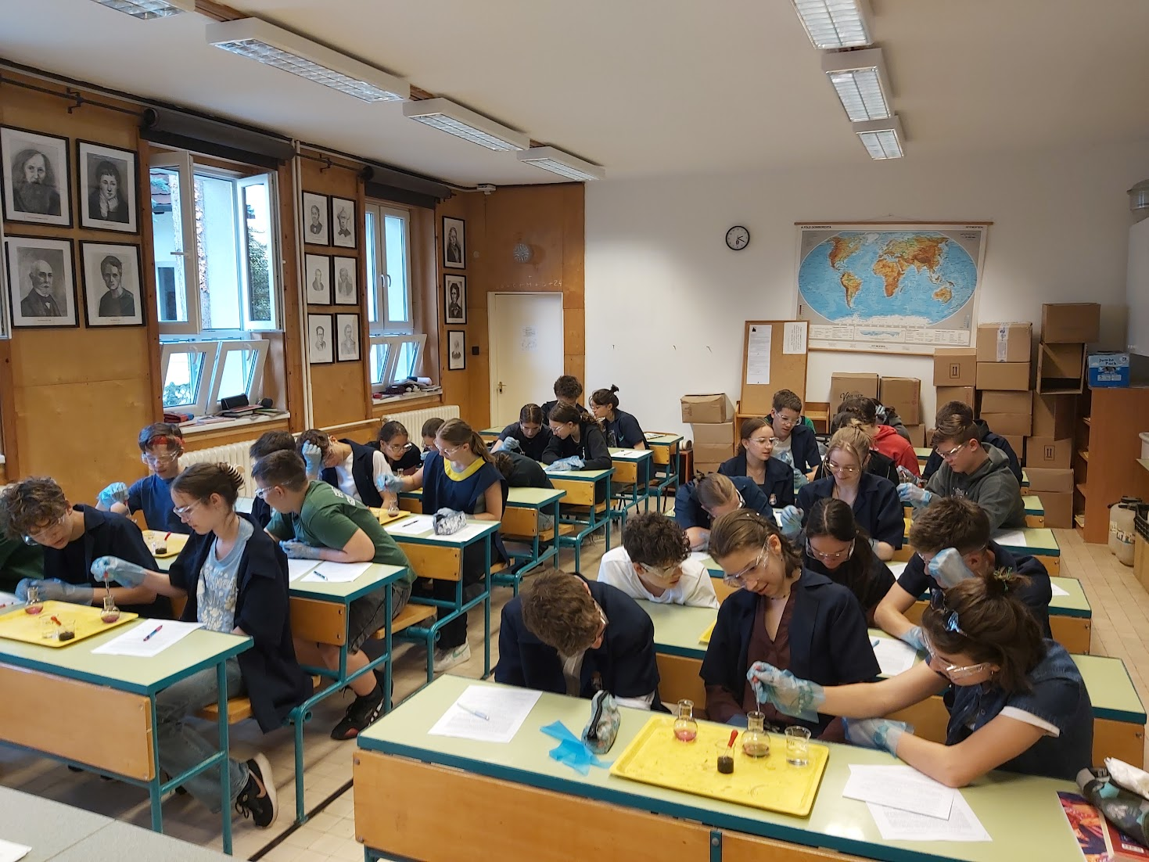
CONTENT
Introduction: guided inquiry and the goal of the research group
The present 4-years project:
  Research method and sample
  Research model and questions
  Examples of worksheets
  An example of EDS test questions
  Statistical methods
Results of the first 3 school years:
  Effects on the experimental design
  skills and disciplinary content knowledge
  2. Effects on marks and attitudes
Summary, conclusions
ECRICE 2024, Lisbon, Portugal, 06. 09. 2024.

Slide 3
I. Guided inquiry and the goal of the research group
„inquiry-based science learning/teaching/education” (IBL, IBST, IBSE): teaching/learning process is modelling the steps of scientific research
classification e.g. according to the measure of students’ independence:
*Essentially no inquiry: Xu, H.; Talanquer, V. (2013), Effect of the level of inquiry of lab experiments on general chemistry students’ written reflections. Journal of Chemistry Education, 90 (1), 21−28.
Type of inquiry | Is it known for the students… | Adott a
 | …the research question? | …the research method? | …the explanation of the results?
Open | no | no | no
Guided/Bounded | yes | no | no
Structured | yes | yes | no
Confirmation/Closed* | yes | yes | yes
ECRICE 2024, Lisbon, Portugal, 06. 09. 2024.

Slide 4
II.1. Research method and sample
 | Longitudinal research: 4 school years 2021-2025 (Grade 7-10)
Intervention | 6 lessons/school year (=24 lessons, partially spent with the worksheets)
Tests | Test 0 (T0): September 2021+T1 (T2, T3, T4): end of each school year
Number of students | Initially: 931, but 603 filled in all the 4 tests till now (T0, T1, T2 and T3)
Age of students (years) | Initially: 12/13 in the 1st year; 14/15 in the 3rd year (2023/2024)
Number of teachers | Initially: 31, at present 26 (+2, who does not work with students)
Number of schools | Initially: 25, at present: 22
Group 1 (control) | only step-by-step experiments
Group 2 (experimental) | Scheme to teach experimental design AFTER step-by-step experiments
Group 3 (experimental) | Scheme to help experimental design BEFORE planning experiments
+ Motivation | Context-based tasks + elements of systems thinking for all the students
ECRICE 2024, Lisbon, Portugal, 06. 09. 2024.

Slide 5
II.2. Research model and questions from September 2021
Direct teaching of the experimental design skills worked better in a previous project →
Has the teaching of using a scheme to help experimental design even more effect on experimental design skills (EDS)/disciplinary content knowledge (DCK)/attitudes?
6 student sheets for 6 lessons
(taking only cca. 25-35 min) in 3 versions:
Type 1: only step-by-step experiments
Type 2: step-by-step experiments + scheme filled in AFTER the experiments
Type 3: scheme filled in BEFORE the experiments and used in practice
Statistical analysis of data
Choosing sample
Pre-test
Group 1
6 Type 1 student sheets
Post-test
Group 2
6 Type 2 student sheets
Post-test
Data collection
Group 3
6 Type 3 student sheets
Post-test
Note: Context-based and systems thinking tasks are on each type of the students worksheets for motivational purposes.

Slide 6
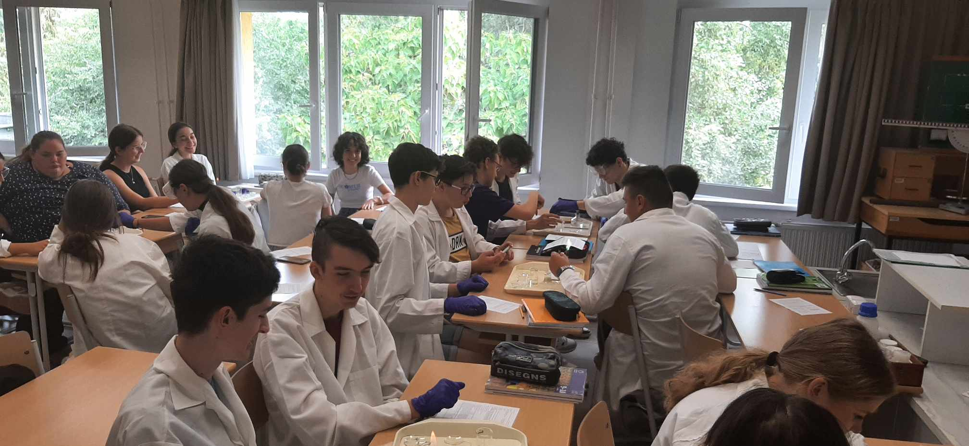
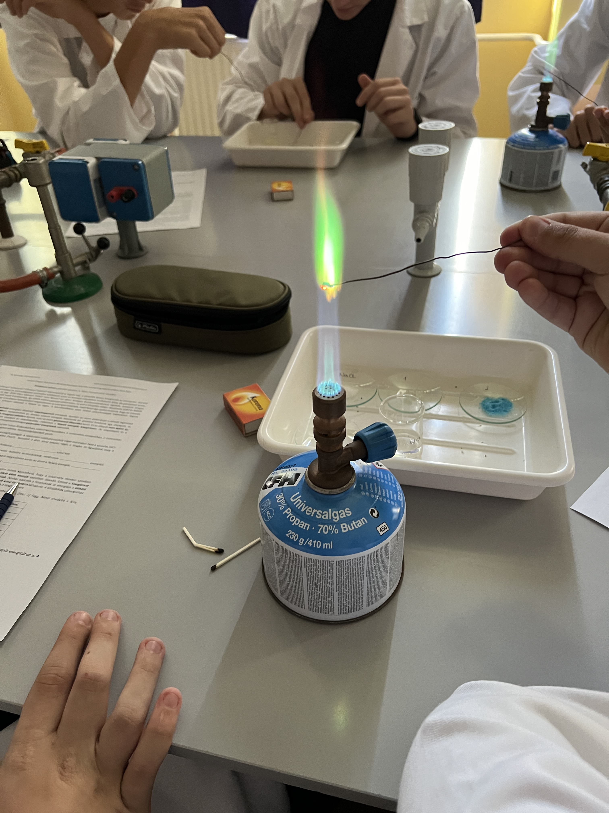
II.3. An example of worksheets in Year 3
Title of worksheet 13: Exploding colours
Topic: ground state and excited state of atoms, flame tests
Introduction: history and present use of fireworks
Previous knowledge (on worksheet):
  Concepts: ground state of atom, excitation energy
  Wavelength, λ (nm) of visible colours (in a table)
  The energy of a photon of radiation is inversely proportional to its wavelength (+ formula)
  Experiment: flame test of sodium (recipe)
Research question: How could you find out, whether the excitation energy of unknown salt 1 and 2 is higher or lower than the excitation energy of sodium?
ECRICE 2024, Lisbon, Portugal, 06. 09. 2024.

Slide 7

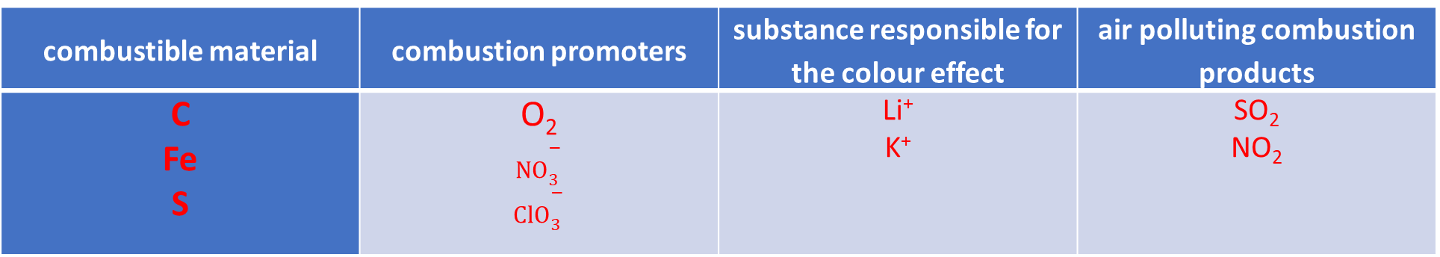
II.3. An example of worksheets in Year 3
Context-based/systems thinking task
Text: Disadvantages of fireworks:
    environmental pollution
    scared animals
    expenses
and possible replacement (sound and light show)
Task:
combustible material | combustion promoters | substance responsible for the colour effect | air polluting combustion products
C Fe S | O₂ $${NO}_{3}^{−}$$ $${ClO}_{3}^{−}$$ | Li⁺ K⁺ | SO₂ NO₂
ECRICE 2024, Lisbon, Portugal, 06. 09. 2024.

Slide 8


II.3.Examples of worksheets that can be used in acaSTEMy project
„Trans-national STEM teacher education focusing on transversal competence and sustainability education”
ERASMUS+ (Grant Agreement - GAP-101104631)
For the „Health and medicine” modul:
Student sheet 11: Can the topping of a “Dobos” cake be made of birch sugar?
Student sheet 16: Geyser in a bottle, or the Mentos-Cola story
Student sheet 17: Sour as vinegar
Student sheet 20: Is it worth flambéing with pure alcohol?
Student sheet 21: The sweet secret of cola zero
Student sheet 22: How much vitamin C is in the orange juice?
Student sheet 23: A 4000-year-old success story – the Aspirin
Student sheet 24: Chicken from a boiled egg?
For discussing environmental issues and sustainability:
Student sheet 3: „The drowning duck”
Student sheet 10: Does acid rain harm mussels and coral reefs?
Student sheet 12: From superhero to supervillain? - Creating mountains of waste from useful plastics
Student sheet 14: Is it possible to walk on water?
Student sheet 19: Latte macchiato and other heterogeneous systems
ECRICE 2024, Lisbon, Portugal, 06. 09. 2024.

Slide 9
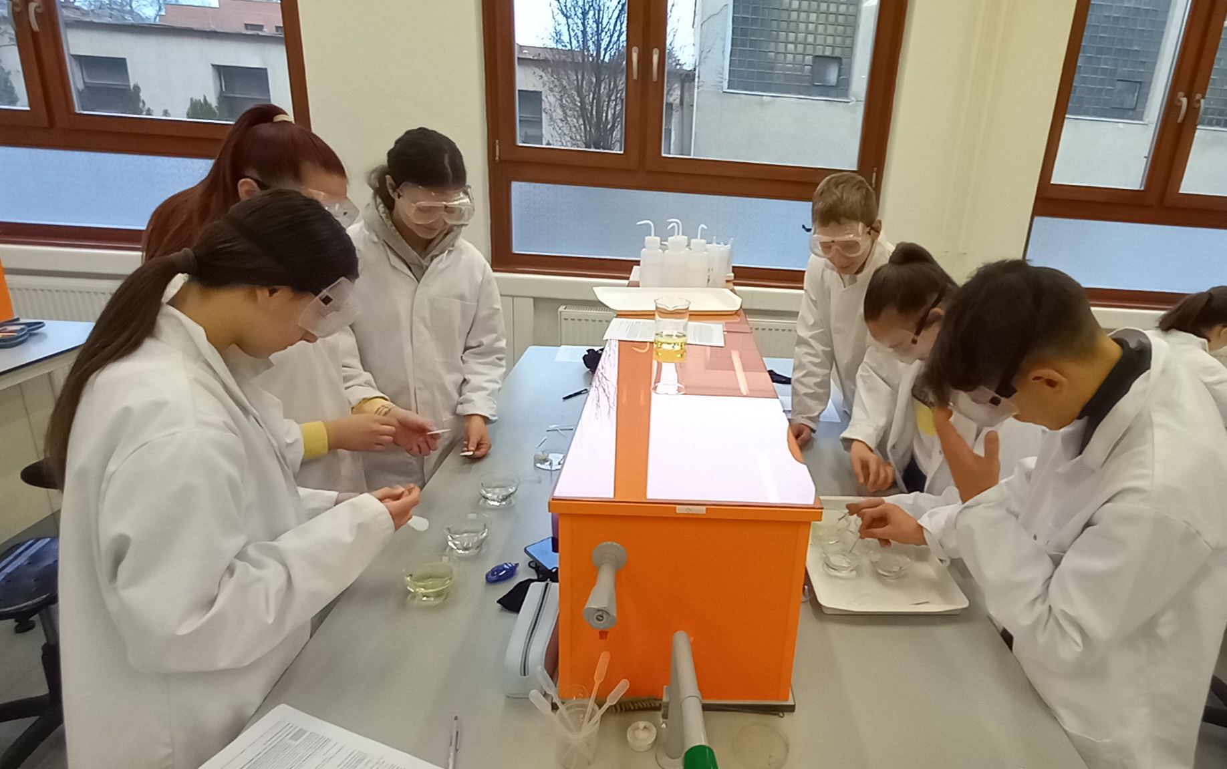
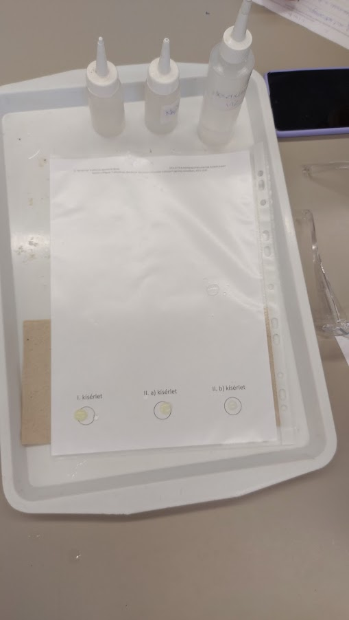
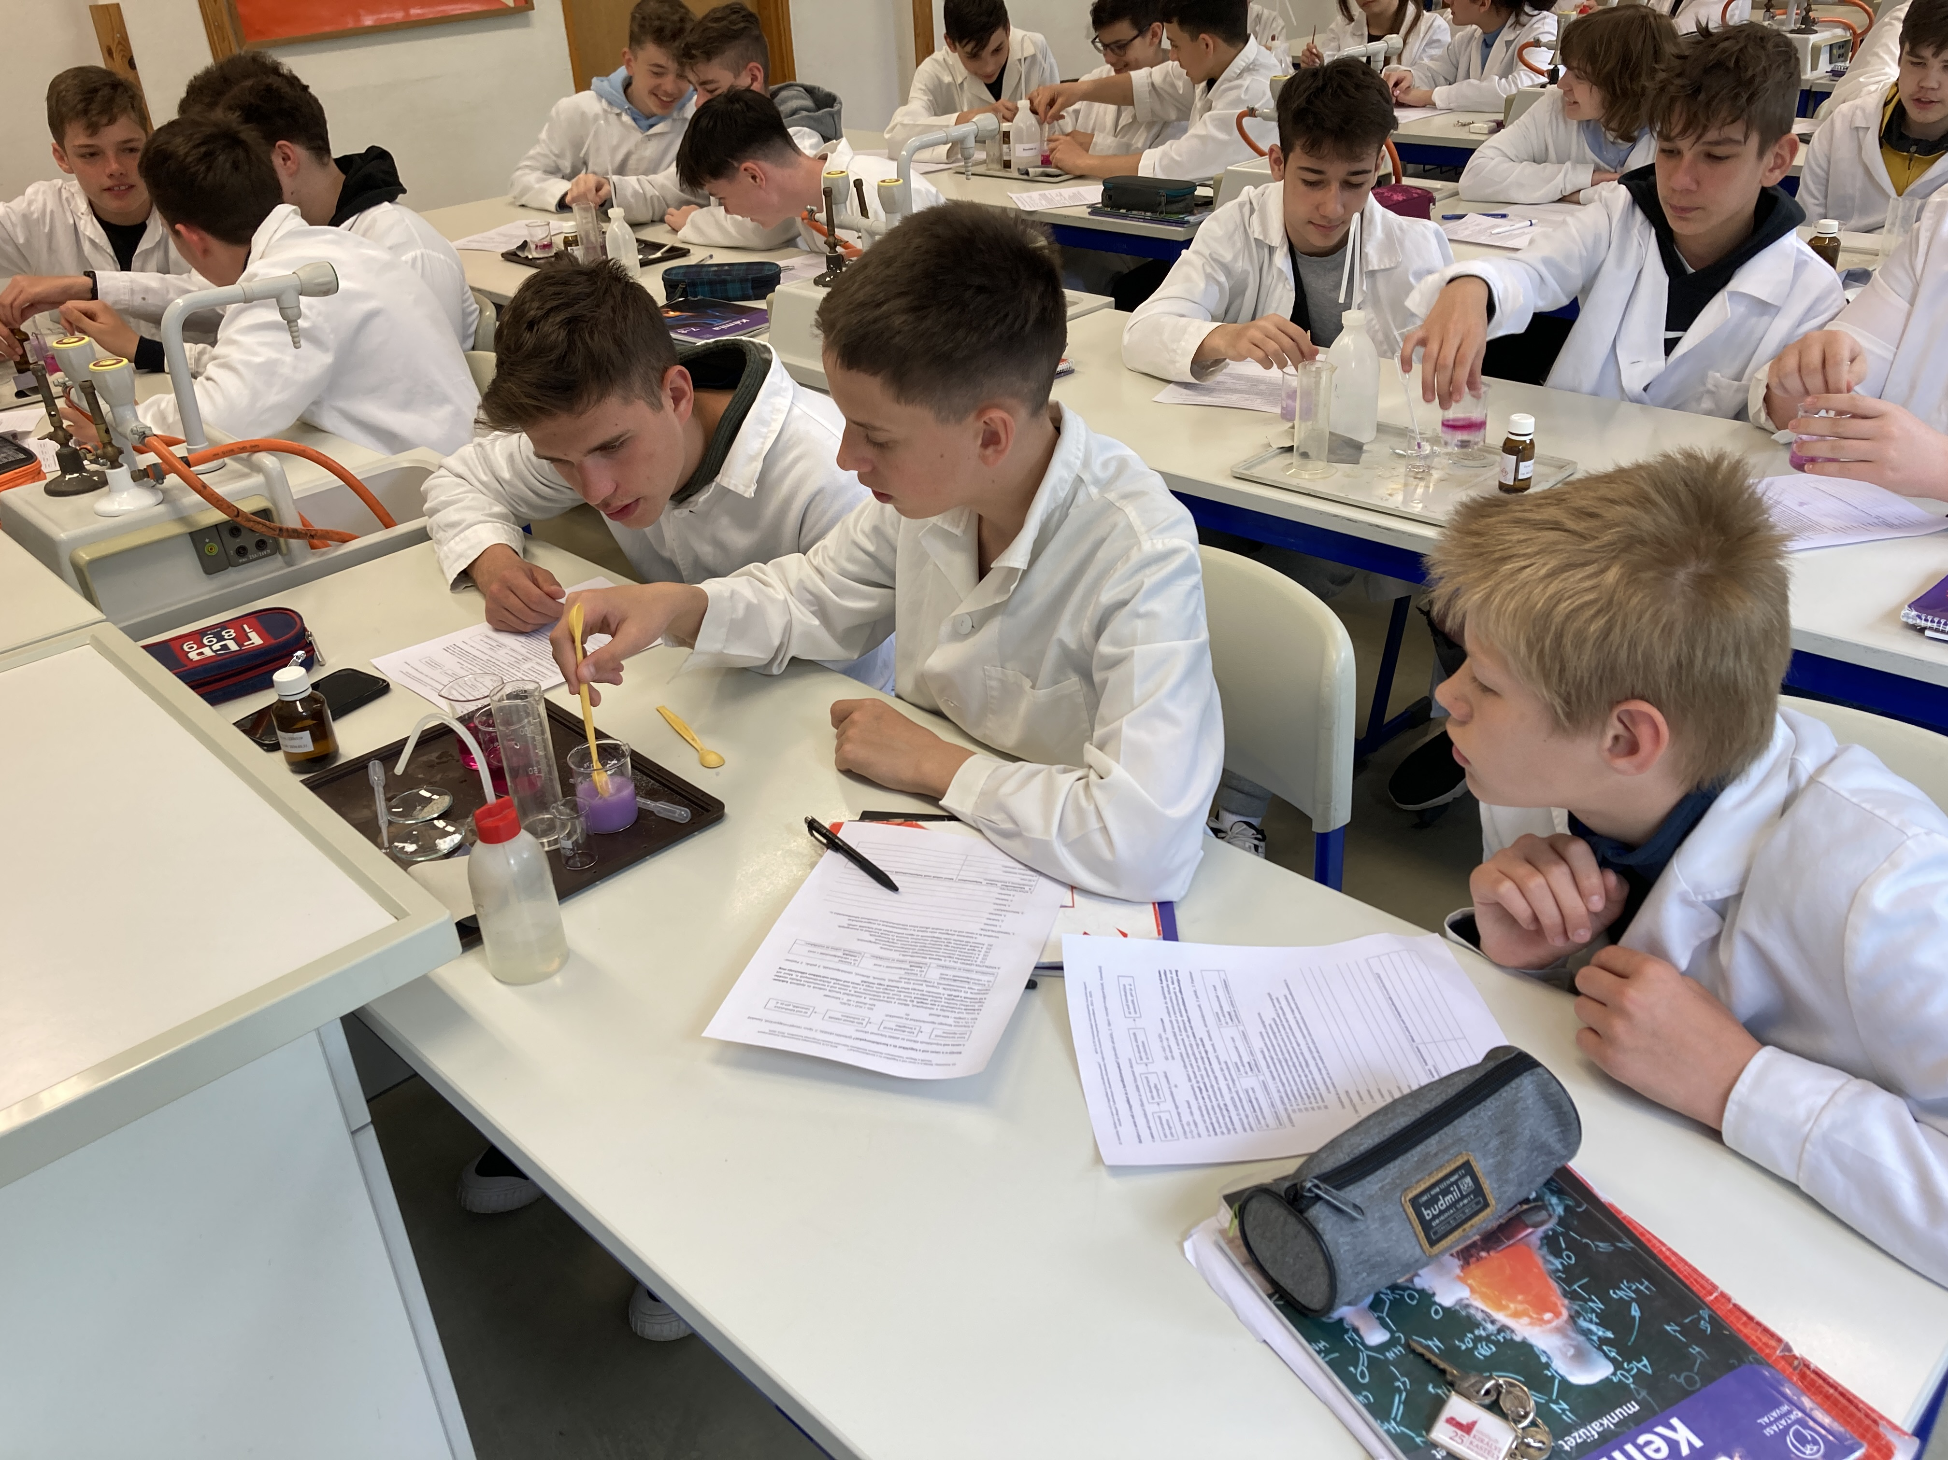
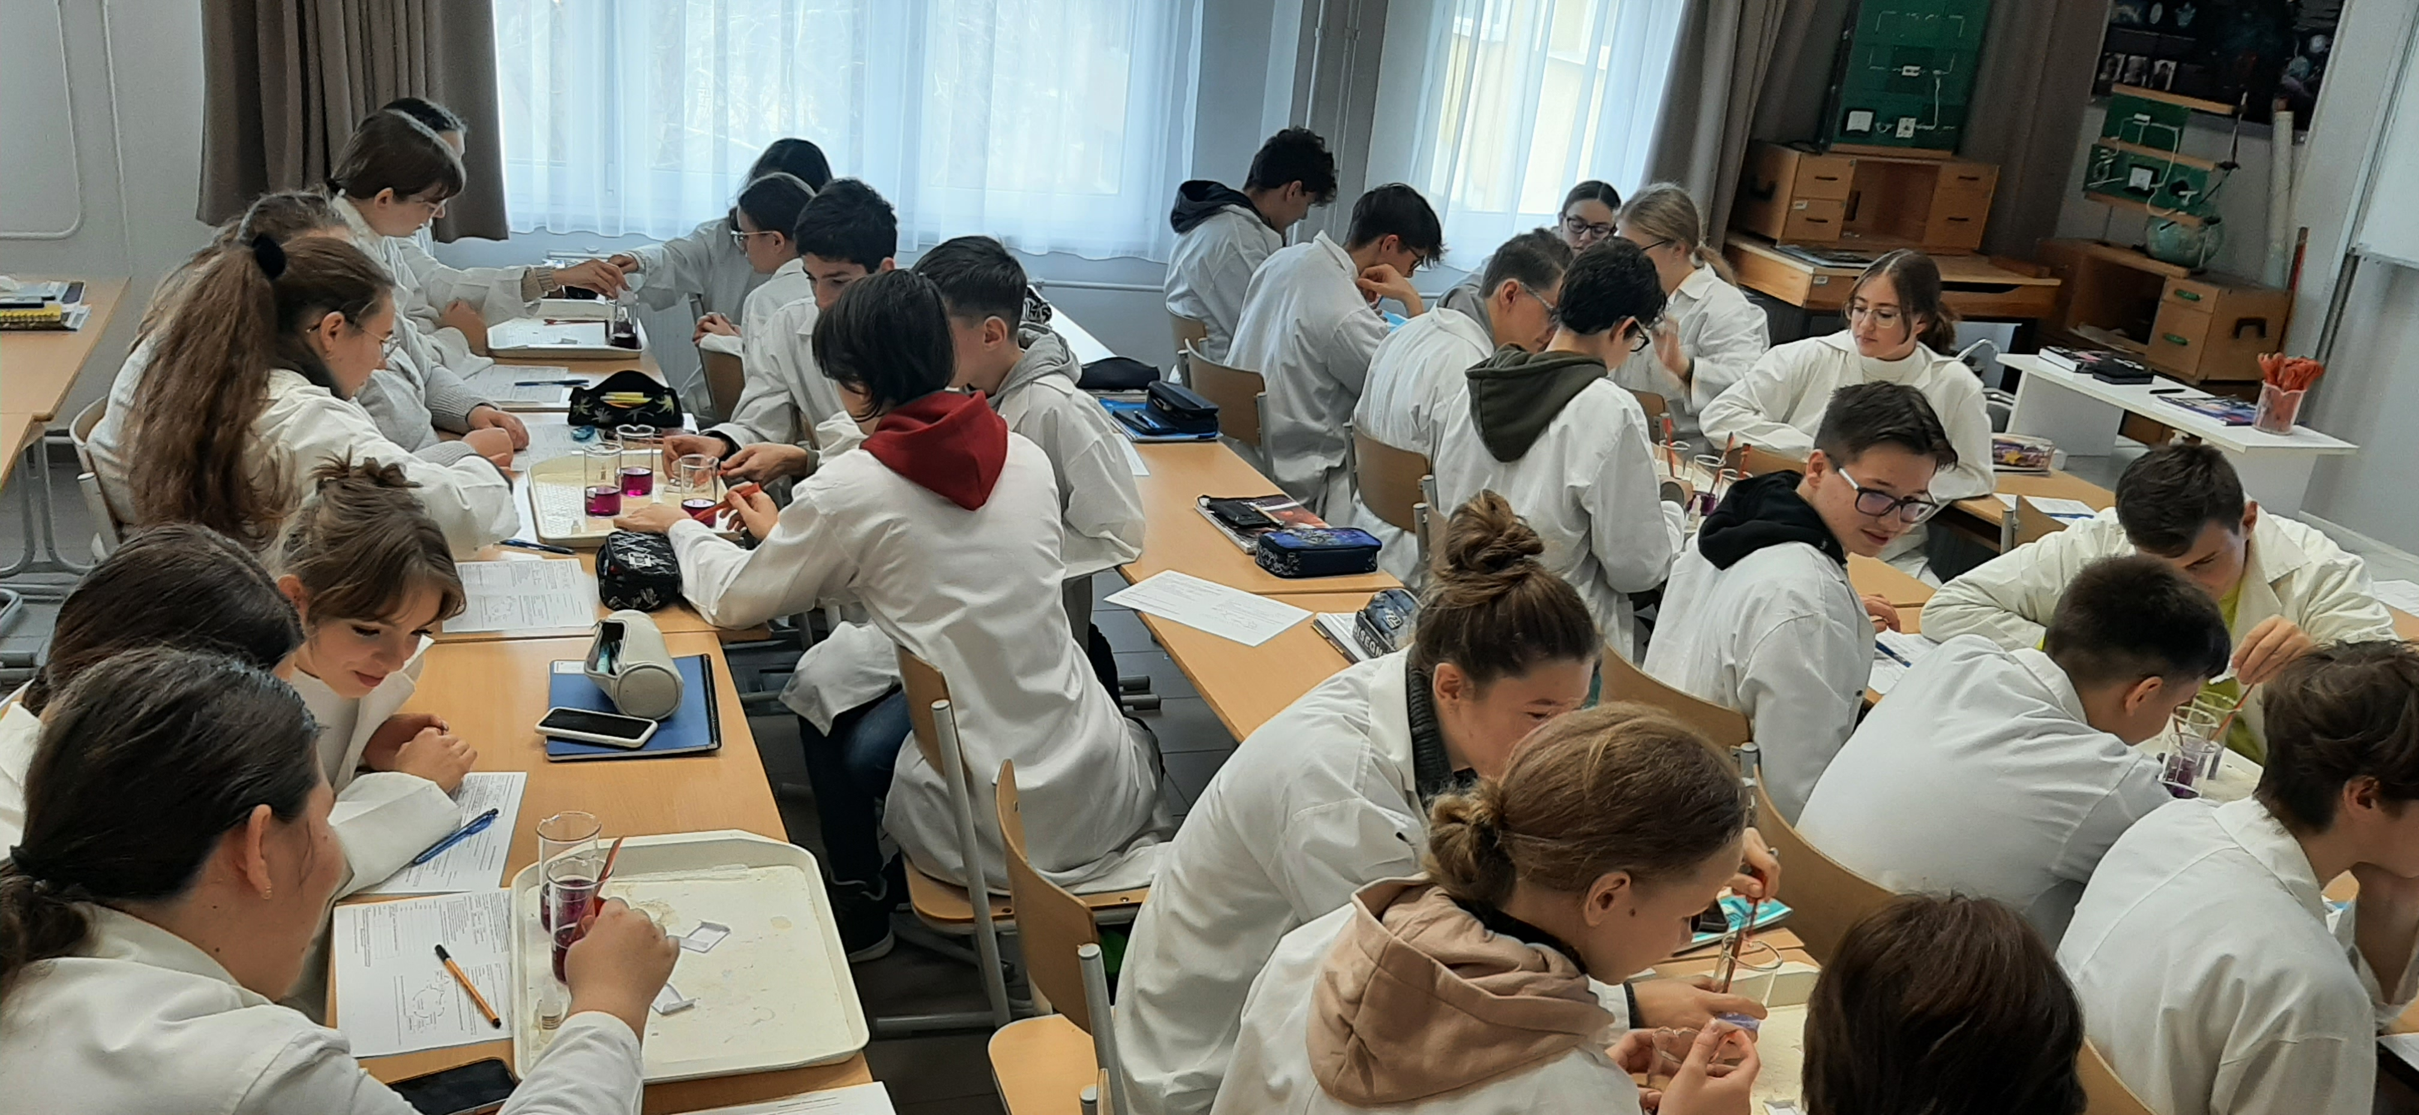
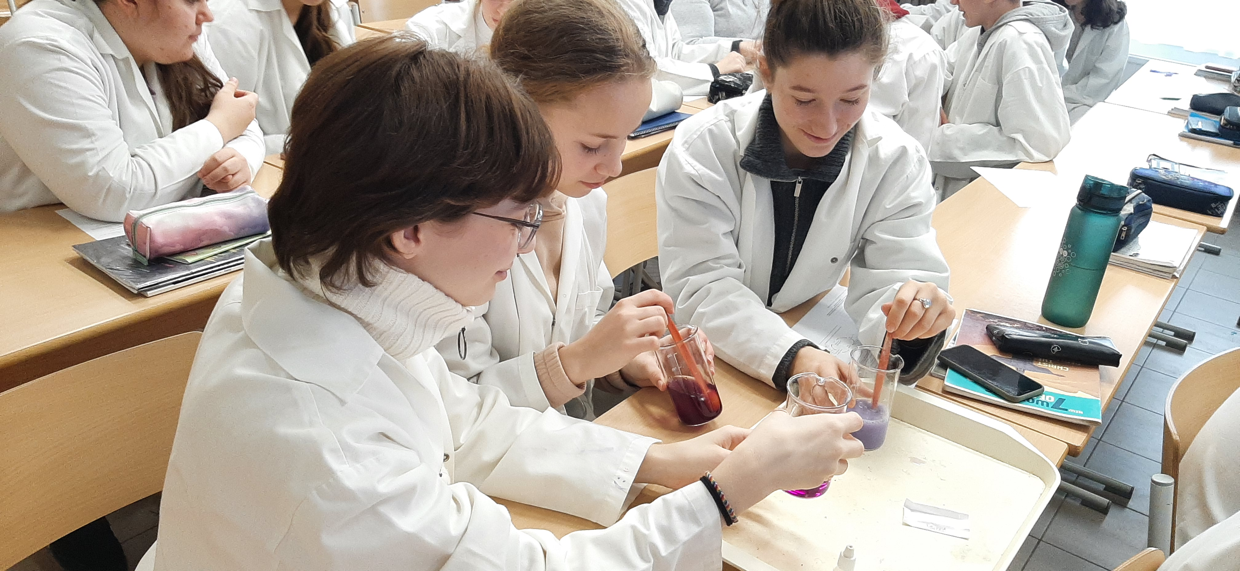
II.4. Examples of students doing the experiments
ECRICE 2024, Lisbon, Portugal, 06. 09. 2024.

Slide 10
II.4. An example of EDS test questions – the „story”
T3, Task 2.
The "bath bomb" is a ball made of citric acid, baking soda, starch and cocoa butter with a few drops of essential oil and colouring. It's fun to use because it bubbles up fragrantly when added to the bath water. In water, the reaction of baking soda and citric acid produces carbon dioxide gas. Let's say you want to make lots of these bath bombs as gifts for your friends. According to a source on the Internet, 50 g of citric acid requires 100 g of baking soda. However, based on the reaction equation and the molar masses, 192 g of citric acid reacts with 252 g of baking soda. You don't want to waste the materials (which cost money), so you decide to experiment by reacting small amounts of citric acid and baking soda to see which mass ratio produces more gas. (This can be compared, for example, by reacting the materials in bottles, with a balloon placed over the mouth of the bottle after adding water to the substances.)
ECRICE 2024, Lisbon, Portugal, 06. 09. 2024.

Slide 11
II.4. An example of EDS test questions – How to determine the best ratio of citric acid and baking soda in ”bath bombs”?
a) What would you change during the experiments?
b) The amount of which product of the chemical reaction that is important for the effervescence depends on the change you cause?
c) How could you test the amount of the reaction product named in (b)?
d) How would you decide which weight ratio to use?
e) Why is it always important to shake the contents of the bottles thoroughly?
f) Put a + sign in front of the statement in the list below if you think it is true, and a - sign in front of the statement if you think it is not true. (You can write another sign after a clear cross-out if you change your mind.)
  The same mass of citric acid should be used in each experiment.
  The same mass of baking soda should be used in each experiment.
  The same volume of bottle should be used in each experiment.
  The bottles used for each experiment should be made of the same material.
ECRICE 2024, Lisbon, Portugal, 06. 09. 2024.

Slide 12
II.5. Statistical methods
Structured paper and pencil tests; tasks intending to measure:
disciplinary content knowledge (DCK, 9 items) + experimental design skills (EDS, 9 items)
Analysis of covariance (ANCOVA) of the SPSS Statistics software
Independent variables (parameters):
  Groups (3 types of instruction methods: Group 1, Group 2, Group 3)
  School ranking (3 categories: relatively high, medium and low ranking schools)
  Mother’s education (2 categories: mother has/has not got a degree in higher education)
  Gender of the student (2 categories: boys, girls)
Covariant: Result of Test 0 (continuous variable)
No significant difference among the 3 groups on T0_{DCK}, on T0_{EDS}, and in any of the parameters in the beginning of the project (according to chi-square tests).
Dependent variables: percents of students’ scores (%) in the tests (on DCK and EDS tasks) analysed as continuous variables.
Cohen’s d effect size values were calculated.
Partial eta-squared (PES) was used as a measure of the effect size calculated by ANCOVA.

Slide 13
II.5. Partial eta-squared (PES)
Partial eta-squared (PES) was used as a measure of the effect size.
The formula to calculate Partial eta squared is as follows:
Partial eta squared = SS_{effect} / (SS_{effect} + SS_{error})
where:
  SS_{effect}: The sum of squares of an effect for one variable.
  SS_{error}: The sum of squares error in the ANOVA model.
The value for Partial eta squared ranges from 0 to 1, where values closer to 1 indicate a higher proportion of variance that can be explained by a given variable in the model after accounting for variance explained by other variables in the model.
The following rules of thumb are used to interpret values for Partial eta squared:
  .01: Small effect size
  .06: Medium effect size
  .14 or higher: Large effect size

Slide 14
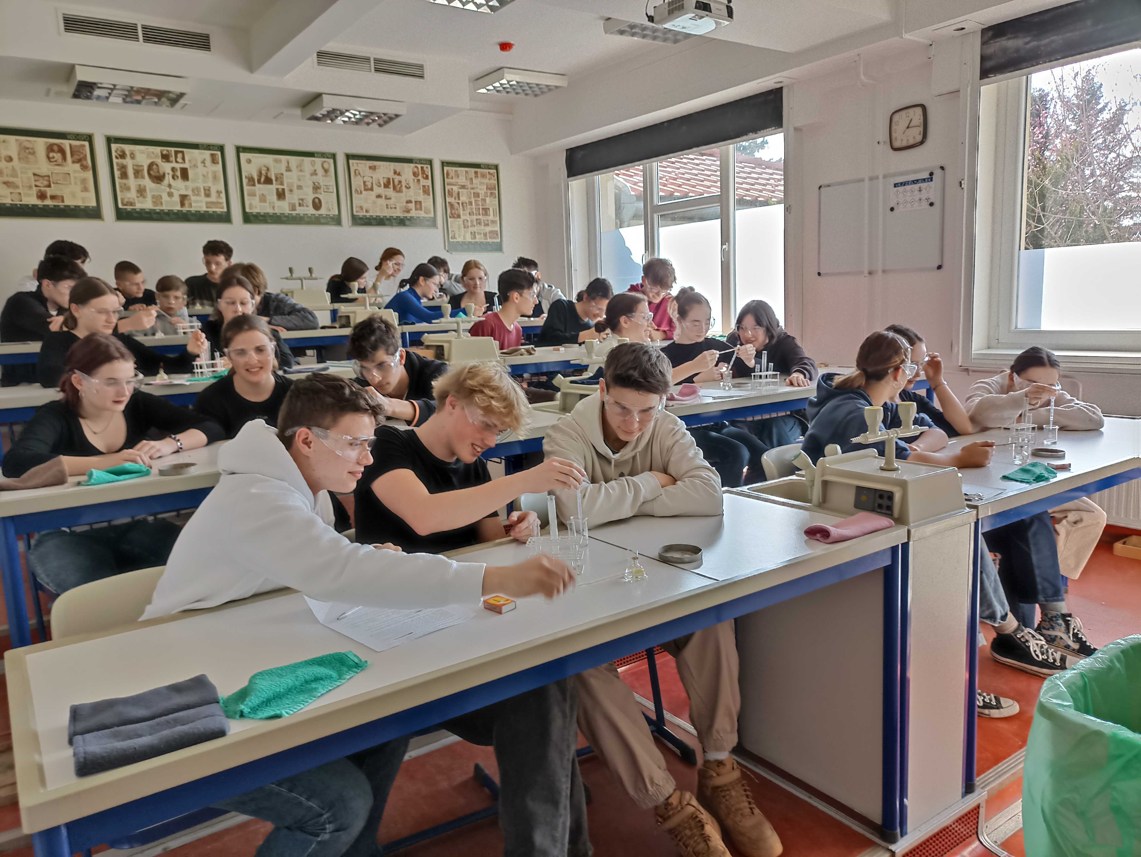
III.1.a) Sample of students filling in all the 4 tests till now
603 students filled in each test (T0, T1, T2, T3)
  298 boys (49.4%)
  305 girls (50.6%)
Number of students (N) in the groups:
  Group 1: 163 (control group)
  Group 2: 224
  Group 3: 216
Cronbach’s alpha values show acceptable reliability:
T0: 0.740; T1: 0.678; T2: 0.689; T3: 0.734
According to chi-squared tests among the :
there is a significant difference in the school ranking [Χ² (4, N = 603) = 39.74, p = .000]
there is no significant difference in the mother’s education [Χ² (2, N = 603) = 2.234, p = .327]
there is no significant difference in the genders [Χ² (2, N = 603) = 1.216, p = .545]

Slide 15
III.1.a) Cohen’s d effect sizes (N=603), calculated from the mean differences between two tests and their standard deviations
Groups compared | T1 – T0 | T2 – T1 | T3 – T2 | T3 – T0
TOTAL TEST SCORES
Group 2 / Group 1 | -0.28 | 0.19 | -0.04 | -0.13
Group 3 / Group 1 | 0.24 | -0.18 | -0.05 | 0.01
DCK (DISCIPLINARY CONTENT KNOWLEDGE SCORES)
Group 2 / Group 1 | -0.29 | 0.19 | 0.03 | -0.07
Group 3 / Group 1 | 0.00 | 0.01 | -0.21 | -0.19
EDS (EXPERIMENTAL DESIGN SKILL SCORES)
Group 2 / Group 1 | -0.13 | 0.11 | -0.09 | -0.13
Group 3 / Group 1 | 0.32 | -0.28 | 0.10 | 0.16
DCK for the 3 years period:
Group 2: negative
Group 3: negative
EDS for the 3 years period:
Group 2: negative
Group 3: positive

Slide 16
III.1.b) Effect sizes (PES), (N=603) of the assumed parameters and the covariant on the students’ scores
Parameter/covariant↓ PES→ | T0_{DCK} | T1_{DCK} | T2_{DCK} | T3_{DCK}
Group (effect of intervention) | 0.000 | 0.035* | 0.002 | 0.012
School ranking | 0.022* | 0.109* | 0.002 | 0.034*
Mother’s education | 0.019* | 0.000 | 0.002 | 0.000
Gender | 0.007 | 0.002 | 0.001 | 0.002
T0_{DCK} | - | 0.044* | 0.050* | 0.016*
Parameter/covariant↓ PES→ | T0_{EDS} | T1_{EDS} | T2_{EDS} | T3_{EDS}
Group (effect of intervention) | 0.003 | 0.050* | 0.003 | 0.014(*)
School ranking | 0.090* | 0.012 | 0.056* | 0.014(*)
Mother’s education | 0.000 | 0.005 | 0.007 | 0.001
Gender | 0.000 | 0.004 | 0.000 | 0.004
T0_{EDS} | - | 0.076* | 0.064* | 0.066*
*sign. (p < .013, Bonferroni correction
Weak significant effect of the intervention on the EDS scores in the end of the 3rd school year.

Slide 17
III.2.a) Effect on marks: changes in marks (ANOVA analysis)
(T0: mark in science; T1-T3: mark in chemistry)
(Best mark is 5.)
Marks got worse in each group in Grade 7 and Grade 8, but stabilised in Grade 9.
Marks in Group 1 (control group) increased in Grade 9.
ECRICE 2024, Lisbon, Portugal, 06. 09. 2024.

Slide 18
III.2.b) Impact on how much students like the subject
(5-point Likert scale; T0: science; T1-T3: chemistry, ANOVA)
Students like the subject (science/chemistry) less and less by the years.
Group 1 (control group) likes it slightly more than the experimental groups.
(The difference due to the better marks?)
ECRICE 2024, Lisbon, Portugal, 06. 09. 2024.

Slide 19
III.2.c) Impact on students' perception of the importance of experiments in science (5-point Likert scale; ANOVA)
High average values that do not change much.
Experimental groups are not better than the control group.
ECRICE 2024, Lisbon, Portugal, 06. 09. 2024.

Slide 20
III.2.d) Impact on students’ preference of step-by-step experiments to experimental design(5-point Likert scale)
The lower the value the less student rejects experiment designing activities.
Group 3 rejects slightly less the experimental design than the other two groups.
ECRICE 2024, Lisbon, Portugal, 06. 09. 2024.

Slide 21
IV. Conclusions
Direct teaching of experimental design by using the scheme:
  Group 3: small positive effect BEFORE the experiment→ seems to be worth using it;
  Group 2: AFTER the step-by-step experimentt does not seem to work.
Preliminary knowledge (T0) had the strongest effect on the EDS scores.
School variables (represented by school ranking): mostly had an effect on the EDS scores.
Social variables (represented by mother’s degree in higher education):
  did not have a significant effect on the students’ achievement on the EDS scores;
  reason: students carefully selected by the schools!
The average of the students’ marks in science/chemistry decreases by the year.
Group 1: slightly better marks than the other two groups.
(?) → Group 1 likes chemistry more than the other two groups.
Students regard experiments important in science (this does not change much).
Group 3 rejects slightly less the experimental design than the other two groups.
ECRICE 2024, Lisbon, Portugal, 06. 09. 2024.

Slide 22
References:
Cothron, J. H., Giese, R. N., Rezba, R. J., (2000). Students and research: Practical strategies for science classrooms and competitions, (3rd Ed.)., Dubuque, IA: Kendall/Hunt Publishing Company
Orgill, M. K., York, S.; MacKellar, J. (2019). Introduction to Systems Thinking for the Chemistry Education Community. J. Chem. Ed., 96, 2720-2729.
Szalay, L., Tóth, Z., Borbás, R., Füzesi, I., (2023), Scaffolding of experimental design skills, Chemistry Education Research and Practice, 24, 599–623.
Szalay, L., Tóth, Z., Borbás, R., Füzesi, I., (2024), Progress In Developing Experimental Design Skills, Journal of Turkish Science Education (accepted manuscript)
ECRICE 2024, Lisbon, Portugal, 06. 09. 2024.

Slide 23
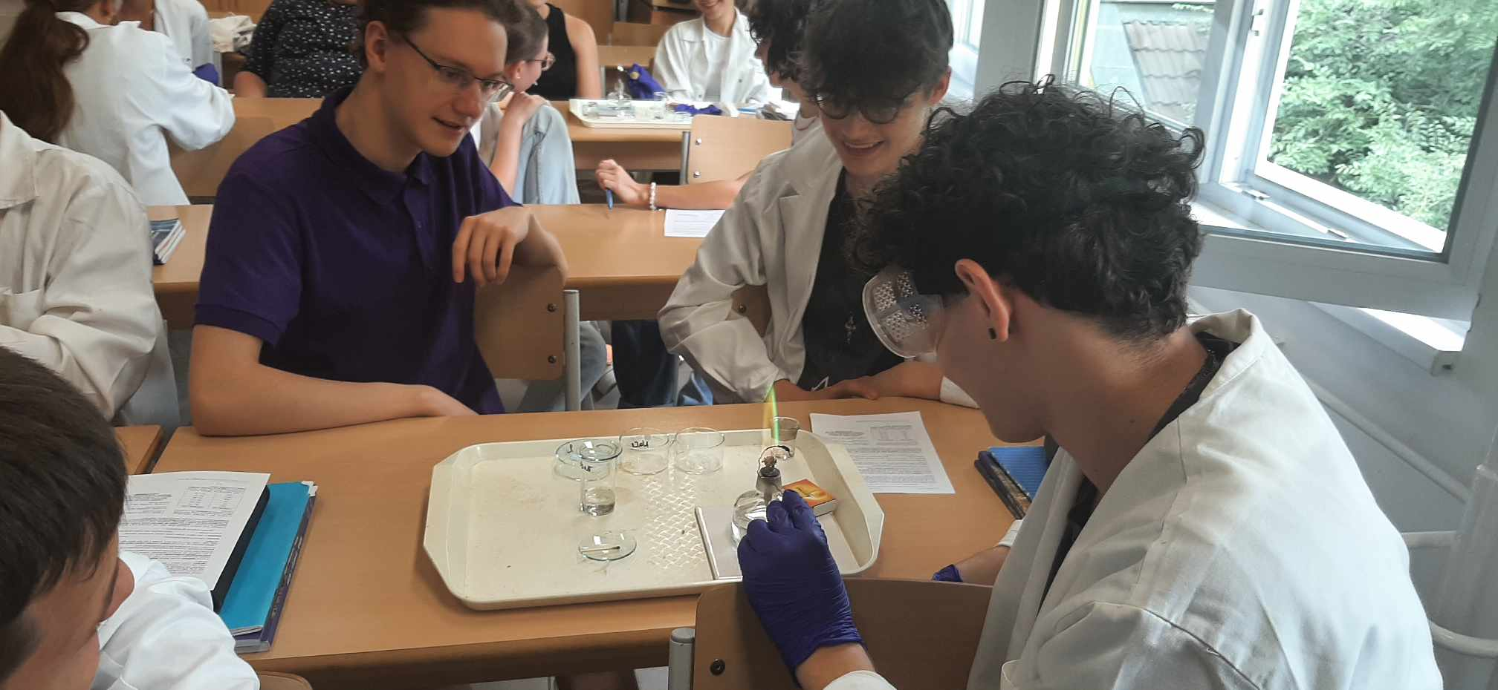
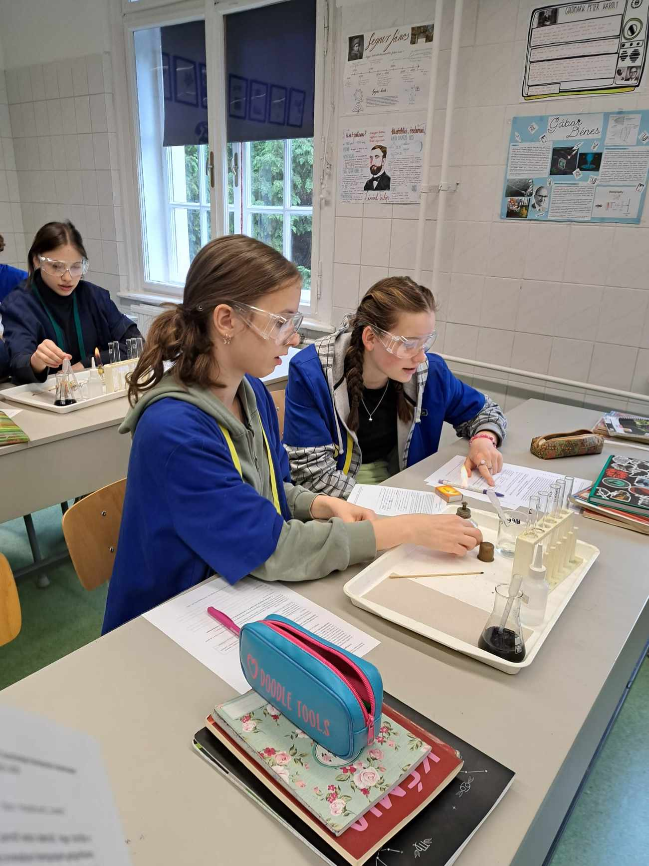
Thank you for your attention!
This study was funded by the Research Programme for
Public Education Development of the Hungarian Academy of Sciences
Dr. Luca Szalay (luca.szalay@ttk.elte.hu)
MTA-ELTE Research Group on Inquiry-based Chemistry Education:
http://ttomc.elte.hu/publications/90

