Slide 1


IN-SERVICE AND PRE-SERVICE Teacher VIEWs on chemistry experimental design worksheets
MTA-ELTE Research Group on Inquiry-based Chemistry Education
Dr. Luca Szalay and Dr. István Füzesi
10th EUROVARIETY, University of Tartu, Estonia, 29. 06. 2023.

Slide 2
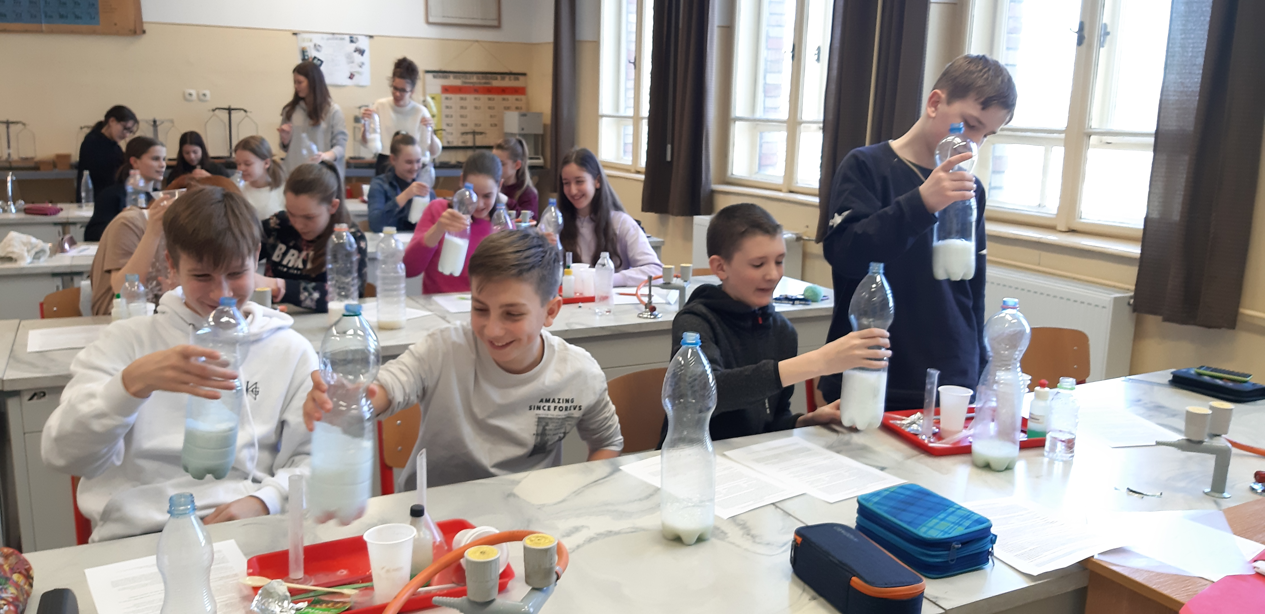
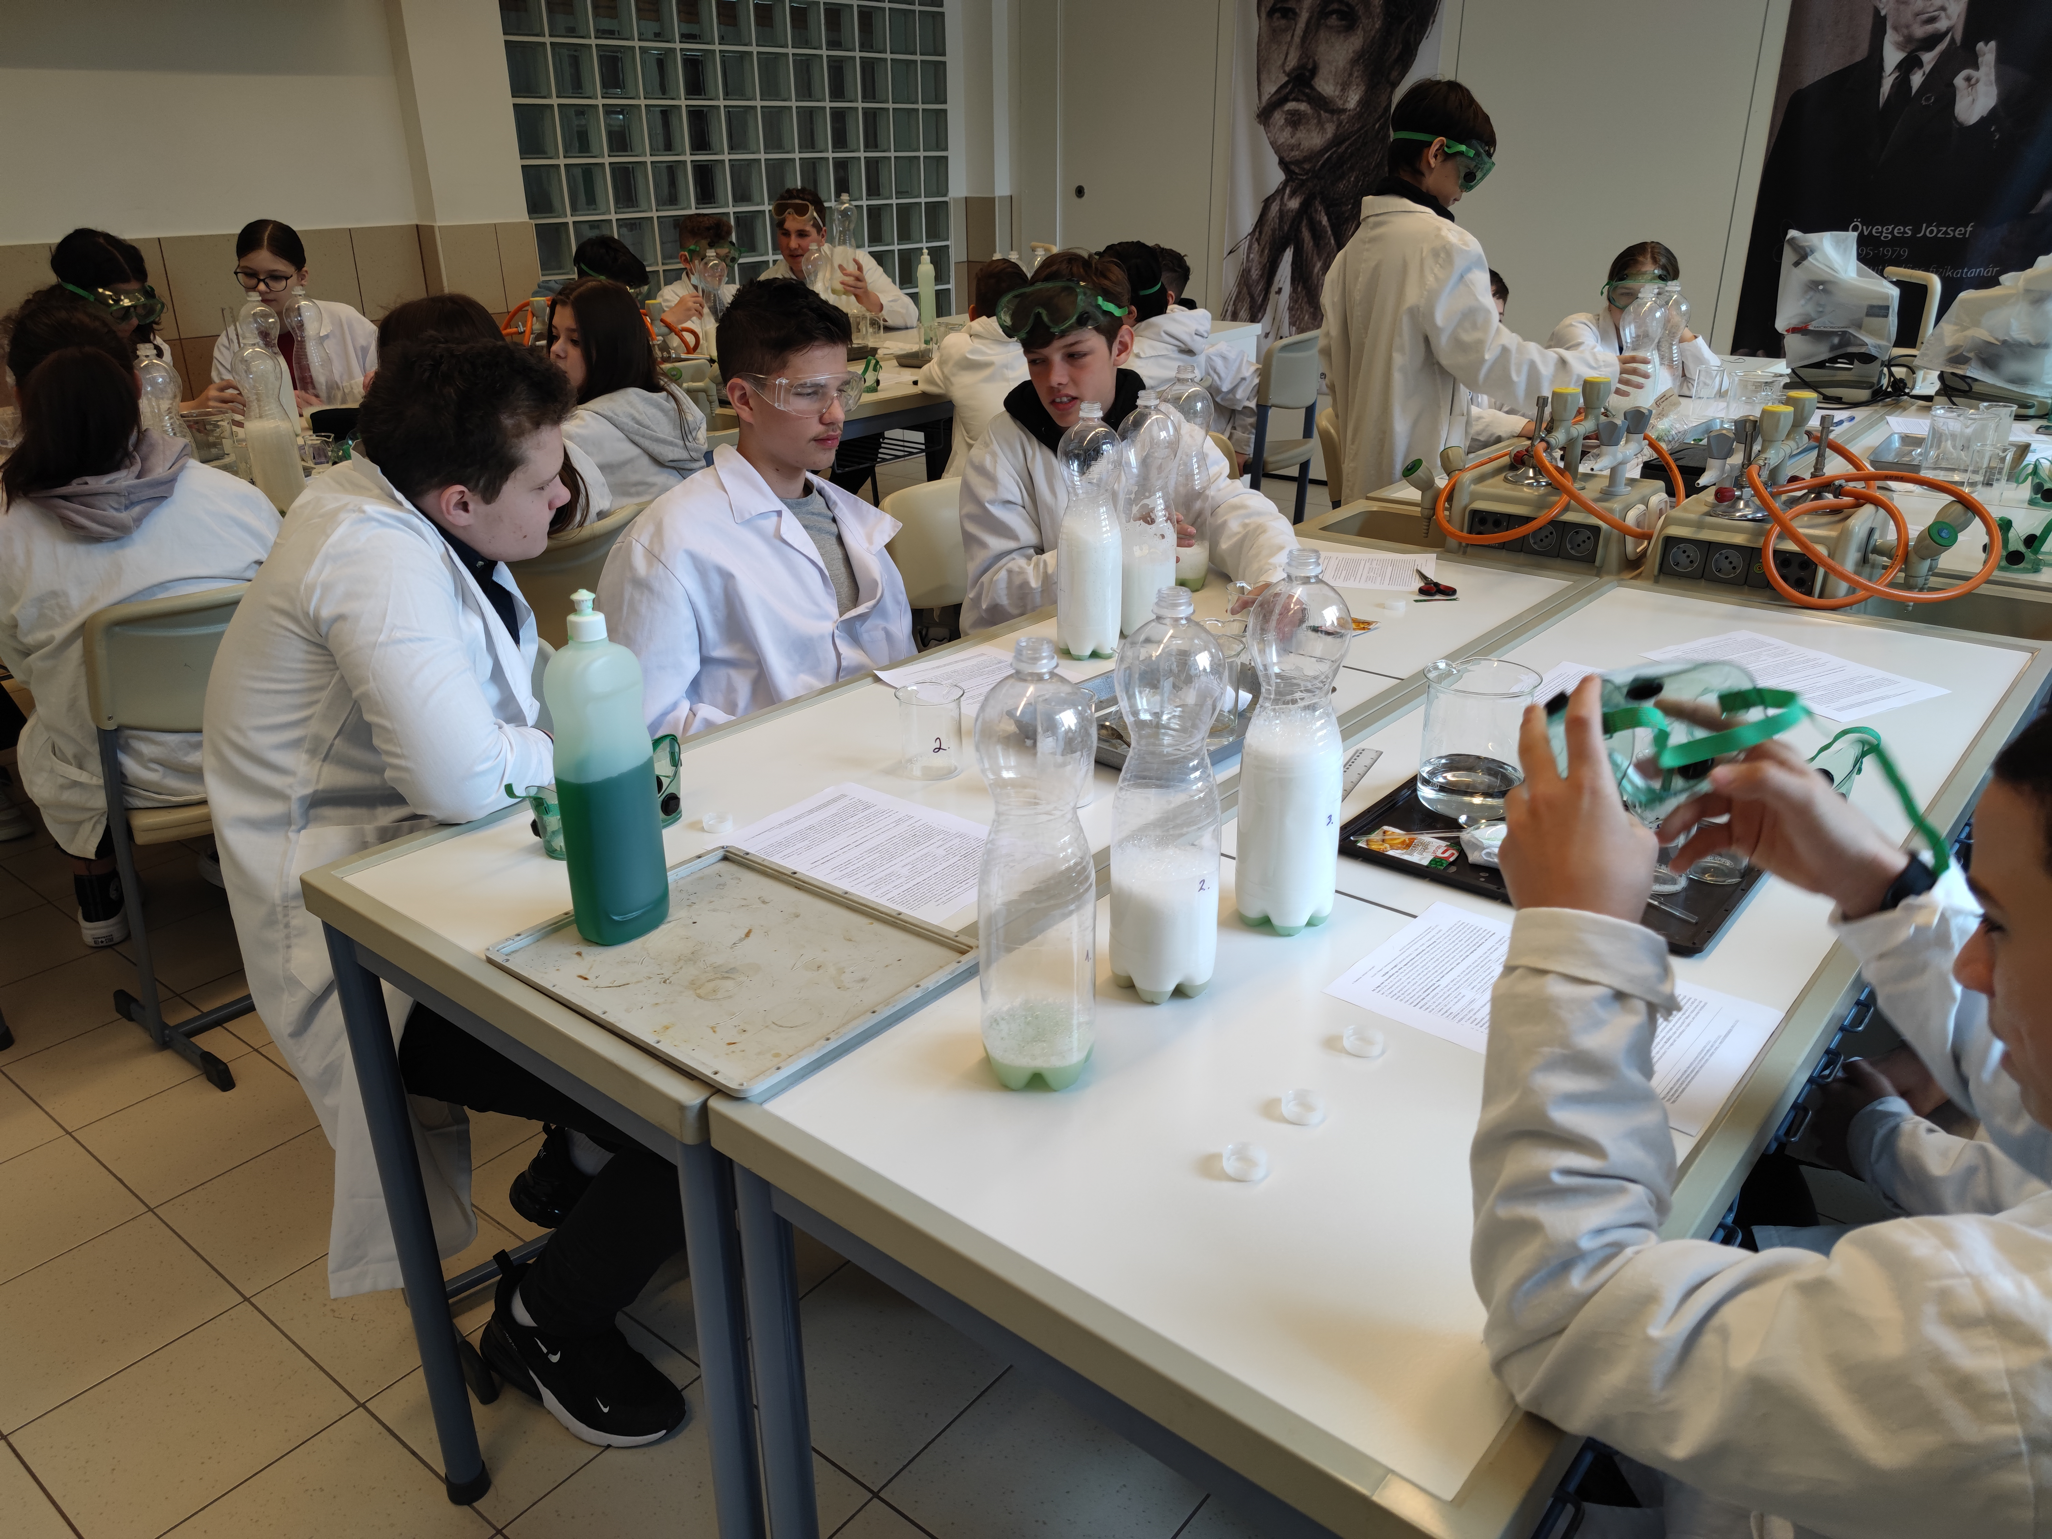
Content
Inquiry: pros & cons
The current 4-year project:
  Research method and sample
  Research model for 2021/2022.
  Samples of experimental design tasks
      a) Student worksheets
      b) Tests
III. Systems thinking tasks for motivation
IV. Teachers’ views:
  The questionnaires
  Results
V. Conclusion
EUROVARIETY 2023, University of Tartu, Estonia, 29 06. 2023.

Slide 3
I.1. Types of inquiry-based education
„inquiry-based science learning/teaching/education” (IBL, IBST, IBSE): teaching/learning process is modelling the steps of scientific research
classification e.g. according to the level of students’ independence:
*Essentially no inquiry: Xu, H.; Talanquer, V. (2013)
Type of inquiry | Is it known for the students… | Adott a
 | …the research question? | …the research method? | …the explanation of the results?
Open | no | no | no
Guided/Bounded | yes | no | no
Structured | yes | yes | no
Confirmation/Closed* | yes | yes | yes
EUROVARIETY 2023, University of Tartu, Estonia, 29. 06. 2023.

Slide 4
I.2. Pros & cons
ADVANTAGES
Increases motivation among ’curious’ and ’socially motivated’ students (Hofstein and Kempa, 1985)
Increases conceptual understanding (Minner et al., 2010)
Develops higher order cognitive skills (Tomperi and Aksela, 2014)
Positive impact on situational interest (Lavonen et al., 2021)
Better understanding of the difference between science and pseudoscience (Finlayson et al., 2015)
DISADVANTAGES
Disliked by ‘achiever’ and ‘conscientious’ students (Bolte, Streller and Hofstein, 2013)
Less efficient - misconceptions or incomplete or disorganized knowledge (Kirschner, Sweller and Clark, 2006)
Less effective if cognitive load is not properly managed (Sweller, 1988)
EU projects did not increase interest in science careers (Lavonen et al., 2021)
PISA 2015: inquiry activities - lower test scores in disorderly classrooms (Mostafa et. al., 2018)
Teachers' scepticism: large class size, lack of time, public examinations (Cheung, 2011)
EUROVARIETY 2023, University of Tartu, Estonia, 29. 06. 2023.

Slide 5
II.1. Research method and sample
 | Longitudinal research: 4 school years 2021-2025 (Grade 7-10)
Intervention | 6 lessons/school year (=24 lessons, partially spent with the worksheets)
Tests | Test 0 (T0): September 2021 + T1 (T2, T3, T4): end of each school year
Number of students | T0: 890; T1: 886; T2: 811 students wrote each test
Age of students (years) | 12/13 (in the first year)
Number of teachers | 31 (in the first year)
Number of schools | 25 (in the first year)
Group 1 (control) | only step-by-step experiments
Group 2 (experimental) | Scheme to teach experimental design AFTER step-by-step experiments
Group 3 (experimental) | Scheme to help experimental design BEFORE planning experiments
+ Motivation | Context-based tasks + elements of systems thinking for all the students
EUROVARIETY 2023, University of Tartu, Estonia, 29. 06. 2023.

Slide 6
II.2. Research model for 2021/2022.
6 student sheets for 6 lessons
in 3 versions:
Type 1: only step-by-step experiments
Type 2: step-by-step experiments + scheme filled in AFTER the experiments
Type 3: scheme filled in BEFORE the experiments to help experimental design
Direct teaching of the experimental design skills
worked better in the previous project → Has the
teaching of using a scheme to develop experimental design even more effect on experimental design skills?
Statistical analysis of data
Choosing sample
Pre-test
Group 1
6 Type 1 student sheets
Post-test
Group 2
6 Type 2 student sheets
Post-test
Data collection
Group 3
6 Type 3 student sheets
Post-test
Note: Context-based / systems thinking tasks are on each type of the student worksheets for motivational purposes.

Slide 7
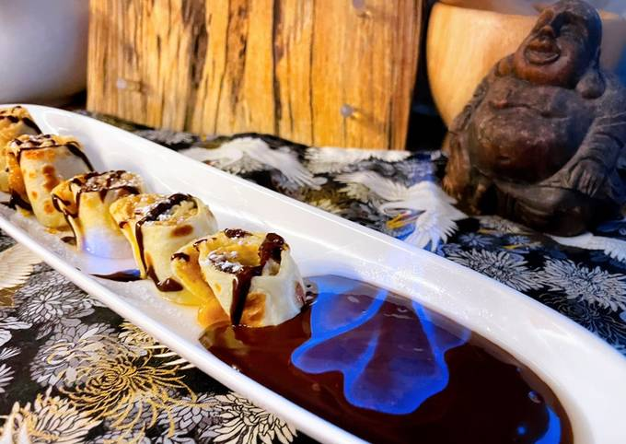
II.3.a The scheme of the experimental design (EDS) tasks
E.g. EDS task from T1 test: Which of the three types of rum (containing 40%, 60%, 80% alcohol) has the lowest alcohol content that can be used to ignite the chocolate sauce of a pancake? (real life situation + list of equipment & materials)
a) Which of the materials being at home should be put into each glass during the experiments?
b) How should the contents of each glass be compared to the chocolate sauces that are made from different concentrations of rum bought from the shop?
c) What should be changed in each experiment because of your answer to question b) above?
d) Which of the properties of the contents of the glasses should be tested in each experiment?
e) How can you test the property of the contents of the glasses in your answer to d)?
f) How can you decide which rum to buy based on the experience of the experiments?
(g) Put a (+) sign in front of the statement(s) in the list below that are important…
EUROVARIETY 2023, University of Tartu, Estonia, 29. 06. 2023.

Slide 8
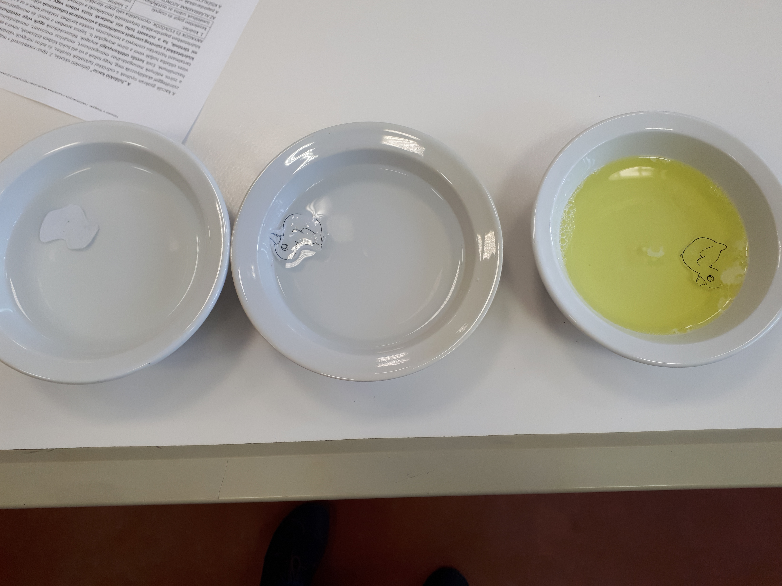
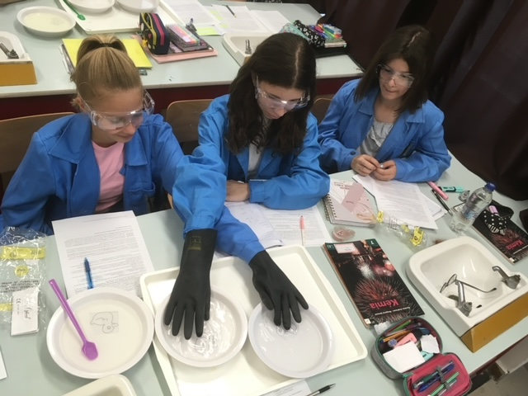
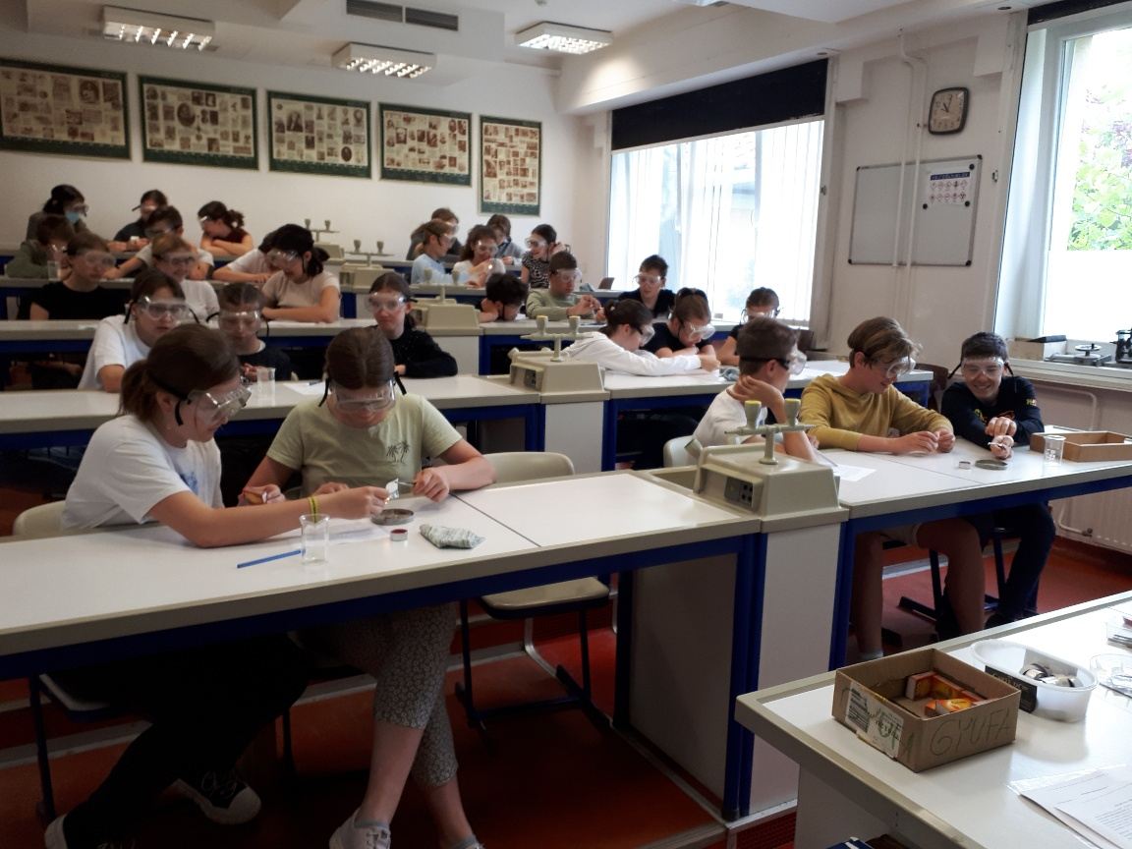
II.3.b EDS on worksheets –
research questions, e.g.:
Worksheet 1: Particle modell of matter
How does the speed of the particles depend on temperature?
Worksheet 2: Chemical reactions
Which of the three ingredients in baking powder
is NOT needed to produce the carbon dioxide?
Worksheet 3: Solubility
How does the greasing of the ducks’ feathers affects whether they can swim or they sink in clean water or water containing dishwashing liquid/soap?
Worksheet 6: Conditions of combustion
Are all the three of conditions really necessary for combustion?
EUROVARIETY 2023, University of Tartu, Estonia, 29. 06. 2023.

Slide 9
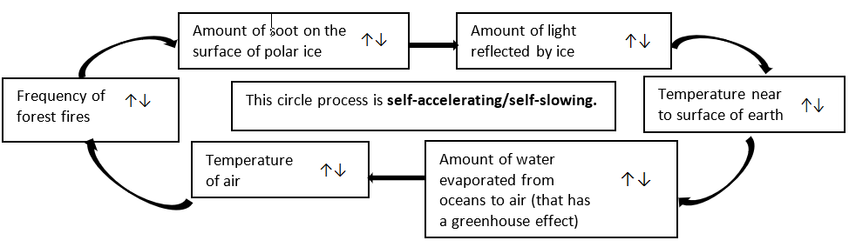
III. Systems thinking tasks for motivation (e.g.)
Worksheet 6: Conditions of combustion: Circle the up or down arrows in the diagram that show the change of the amount as the frequency of forest fires increases.
EUROVARIETY 2023, University of Tartu, Estonia, 29. 06. 2023.

Slide 10
III. Systems thinking tasks for motivation (e.g.)
Worksheet 6: Conditions of combustion – Correct solution in red.
EUROVARIETY 2023, University of Tartu, Estonia, 29. 06. 2023.

Slide 11
IV.1. Teachers’ views: questionnaire filled in (2022/2023.)
by 32 in-service and 36 pre-service teachers
Metadata [name; member of our research group?/which course attended? etc.]
Piloting of worksheets:
  Which type and which one of the worksheet(s) has (s)he tried/wants to try in future with students and with how many classes?
  Why did (s)he choose that type and that one(s) of the worksheets?
Experimental design tasks: Which (s)he think is/are easy/difficult to use, why?
Worksheets: How easy/difficult to use them in theoretical/practical aspects, why?
Context-based/systems thinking tasks: How useful are they in terms of motivation/understanding?
Individual opinion/advice: How to improve the worksheets?
Type 2 and 3 worksheets: How independently could students work?
The questionnaires for the in-service/pre-service teachers contained the same type of questions with relevant modifications.
EUROVARIETY 2023, University of Tartu, Estonia, 29. 06. 2023.

Slide 12
IV.2.a Results
How many times had been the worksheets piloted by the 32 in-service teachers and the 36 pre-service teacher students?
EUROVARIETY 2023, University of Tartu, Estonia, 29. 06. 2023.

Slide 13
IV.2.b Results
Reasons that make worksheets easy to use
EUROVARIETY 2023, University of Tartu, Estonia, 29. 06. 2023.

Slide 14
IV.2.c Results
Reasons that make worksheets difficult to use
EUROVARIETY 2023, University of Tartu, Estonia, 29. 06. 2023.

Slide 15
IV.2.d Results
How motivating are the context-based tasks?
EUROVARIETY 2023, University of Tartu, Estonia, 29. 06. 2023.

Slide 16
V. Conclusion: the worksheets…
majority of 32 in-service teachers’ views:
are age-appropriate
are relevant to the Grade 7 curriculum
build on prior knowledge
have a motivating effect
develop students' manual dexterity
teamwork is beneficial
teach laboratory equipment/operations
most frequent choice is: type 3
36 pre-service teachers’ views:
some have reservations:
  safety is very important!
  the complexity of the wording makes some difficult to understand
  the complicated design of the experiments makes some hard to use
most frequent choice is: type 2
In general the majority wrote: - sufficient theoretical difficulty - experiments are easy to perform - equipment and materials are easy to obtain.
EUROVARIETY 2023, University of Tartu, Estonia, 29. 06. 2023.

Slide 17
REFERENCES
Bolte, C., Streller, S., Hofstein, A., (2013), How to motivate students and raise their interest in chemistry education, In: Eilks, I. and Hofstein, A. (eds.) Teaching Chemistry – A Studybook (pp. 67-95). Sense Publishers.
Cheung, D., (2011), Teacher Beliefs about Implementing Guided-Inquiry Laboratory Experiments for Secondary School Chemistry, J. Chem. Educ., 88, 1462–1468.
Finlayson, O., Maciejowska, I., Čtrnáctová, H., (2015), Inquiry Based Chemistry Instruction, In: Maciejowska, I. and Byers, B. (eds.) A Guidebook of Good Practice for the Pre-Service Training of Chemistry Teachers (p. 119), Faculty of Chemistry, Jagiellonian University, Krakow, http://www.ec2e2n.info/news/2015/1604_201510 (Last visited: 30.05.2016.)
Hofstein, A. and Kempa, R. F., (1985), Motivating strategies in science education: attempt of an analysis. Eur. J. Sci. Edu., 3 221–229.
Kirschner, P. A., Sweller, J. and Clark, R. E., (2006), Why Minimal Guidance During Instruction Does Not Work: An Analysis of the Failure of Constructivist, Discovery, Problem-Based, Experiential, and Inquiry-Based Teaching, Educational Psychologist, 41(2), 75–86.
Lavonen J., Ávalos B., Upadyaya K., Araneda S., Juuti K., Cumsille P., Inkinen J and Salmela-Aro K., (2021) Upper secondary students’ situational interest in physics learning in Finland and Chile, Int. J. Sci. Ed., 43:16, 2577-2596
Minner, D. D. et al. (2010) Inquiry_based Science Instruction – What Is It and Does It Matter? Results from a Research Synthesis Years 1984 to 2002,, J. Res. Sci. Teach., 47(4), 474-496.
Mostafa T., Echazarra A. and Guillou H., (2018), The science of teaching science: An exploration of science teaching practices in: PISA 2015, OECD Education Working Papers Series, No. 188, https://doi.org/10.1787/f5bd9e57-en, (accessed 17.06.2023.)
Talanquer, V. (2013), Effect of the level of inquiry of lab experiments on general chemistry students’ written reflections. J. Chem. Ed., 90 (1), 21−28.
Sweller, J., (1988), Cognitive Load during Problem Solving: Effects on Learning. Cogn. Sci. 12, 257–285.
Tomperi, P. and Aksela, M., (2014), In-service Teacher Training Project On Inquiry Based Practical Chemistry. LUMAT, 2(2), 2015-2
EUROVARIETY 2023, University of Tartu, Estonia, 29. 06. 2023.

Slide 18
Thank you for your attention!
This study was funded by the Research Programme for
Public Education Development of the Hungarian Academy of Sciences
Dr. Luca Szalay (luca.szalay@ttk.elte.hu)
MTA-ELTE Research Group on Inquiry-based Chemistry Education:
http://ttomc.elte.hu/publications/92

