Slide 1



Development of experimental design skills
Luca Szalay¹, Edina Kiss¹ and Zoltán Tóth²
¹ Eötvös Loránd University (ELTE), Institute of Chemistry
² University of Debrecen, Institute of Chemistry
Content Pedagogy Research Program of the
Hungarian Academy of Sciences (MTA), 2016-2020
MTA-ELTE Research Group on Inquiry-Based Chemistry Education
http://ttomc.elte.hu/publications/90

Slide 2
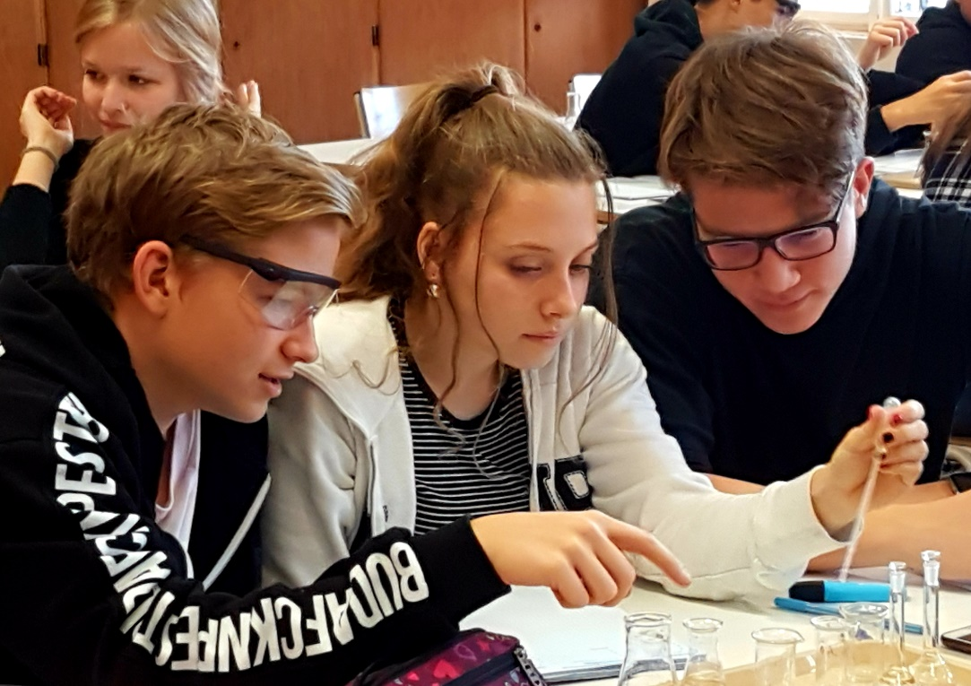
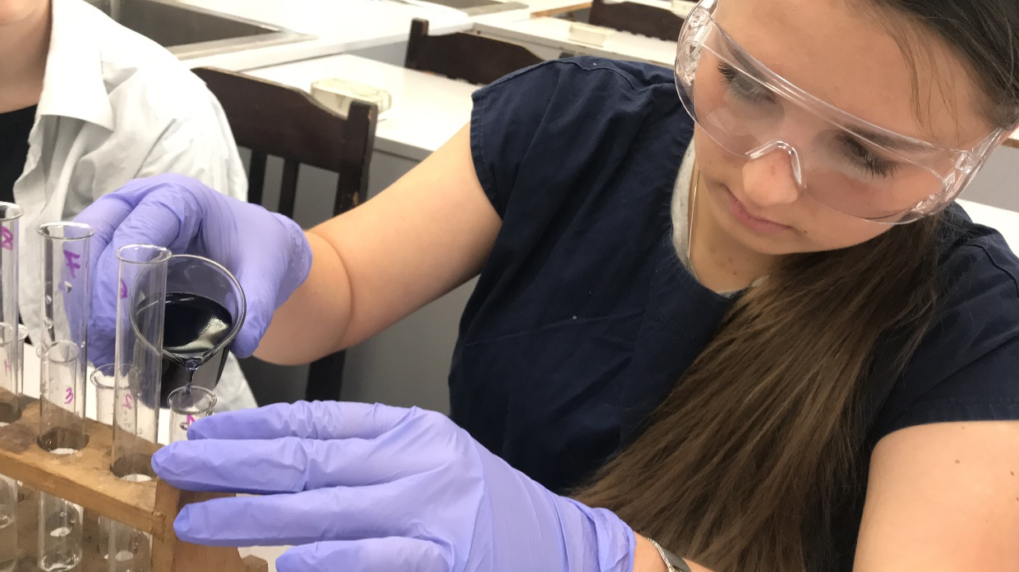
Content
Introduction and research questions
Main characteristics of the research
Methods of the analysis of data
Results of the first year
Modified research model: preliminary results
Summary and context of results

Slide 3
I. Introduction and research questions

Slide 4
I.1.Inquiry-based science education is the solution of the problems in teaching science!(?)
PISA-Schock (2006)
„Rocard report” (2007)¹: suggested solution of the problems of teaching science in Europe: „inquiry based science education”, IBSE
2008: a national committee in Hungary concerning science education.
Framework programmes of the European Union (FP6 and FP7): Min. 2 million € /project! (PRIMAS, Fibonacci, Mind the Gap, STEAM etc.)
Vast amount of literature: Is it effective?²
Hungarian reality: Is it realistic? (Lack of time, assisstance, materials and equipment, tried and tested student sheets, necessary in-service teacher cources etc.)
1 https://ec.europa.eu/research/science-society/document_library/pdf_06/report-rocard-on-science-education_en.pdf
² Pl. Kirschner, P. A., Sweller, J., Clark, R. E., (2006), Why Minimal Guidance During Instruction Does Not Work: An Analysis of the Failure of Constructivist, Discovery, Problem-Based, Experiential, and Inquiry-Based Teaching, Educational Psychologist, 41(2), 75–86.

Slide 5
1.2. A previous brief empirical research¹
3 lessons + pre-test and post-test in school year 2014/15
12 Hungarian schools, 15 teachers
31 groups of 14-15-year-old students
    16 control groups: following ‚step-by-step’ recipes while doing student experiments
    15 experimental groups: partly designing and doing the same student experiments as the control groups
660 students completed both the pre-test and post-test
  N (control) = 325 (49.2%)
  N (experimental) = 335 (50.8%)
gender ratio (boys/girls, the difference is not significant):
  control: 121/204
  experimental: 141/194
¹Financed by TÁMOP 4.1.2.B.2-13/1-2013-0007” NATIONWIDE COORDINATION FOR THE RENEWAL OF TEACHER EDUCATION”
Notes:
This previous research happened in the school year 2014/15. It was funded by a European project. You can read the name and the number here. The intervention consisted of three lessons, a pre-test and a post-test, all together five chemistry lessons. This research took place in twelve Hungarian schools with the participation of 15 teachers and 31 groups of 14-15 years old students. The groups were divided into 16 control groups and 15 experimental groups. All groups did the same student experiments. The only difference was that the control groups were given step-by-step recipes while the experimental groups were asked to design at least one step in the experiments. Here you can see details of the sample. There are no significant differences between the numbers of boys and girls nor between the gender ratios.

Slide 6
I.3. Results of the precious research and new questions
Encouraging results of the previous brief research:
In short term and 9th grade students positive results: students of the experimental group had significantly better avarage scores on the experimental design tasks than the avarage scores of the students of the control group.
Szalay, L., Tóth, Z., (2016), An inquiry-based approach of traditional ’step- by-step’ experiments, Chem. Educ. Res. Pract., 17, 923-961.
New research questions:
  How would the ability of designing experiments and the disciplinary content knowledge change in a longitudinal research?
  Does the intervention change the students’ attitudes and motivation?
  Does it matter if the students actually carry out the designed experiments, or designing the experiments in theory has got similar effect?
  ¹https://mta.hu/tantargy-pedagogiai-kutatasi-program/mta-elte-kutatasalapu-kemiatanitas-kutatocsoport-107088

Slide 7
II. Main characteristics of the research

Slide 8
II.1. Research group and research method
Research group:
  24 chemistry teachers
  5 university educators
  5 pre-service chemistry teacher students.
Research method:
  4 school years
  4 x 6 = 24 student sheets and teacher guides (6/school year)
  T0 test: September 2016 and T1, T2, T3 és T4 tests in the end of each school year:
    Experiment design skill tasks (50%, 9 item), EDS
    Disciplinary content knowledge (recall, understanding, application (50%, 9 item), DCK
    Background information (gender, grade, school, mother’s education)
    Attitude questions

Slide 9
II.2. Sample
18 schools, where students study chemistry from grade 7 to grade 10
31 classes/groups
920 seventh graders (12-13 years old)
T0 test was completed by 883 students
All these students carry out the SAME experiments.
Students were randomly divided into 3 groups:
  Group 1 – control: only step-by-step experiments
  Group 2 – ‚theoretical’: step-by-step experiments +
  in 2016/2017: design experiments on paper
  Group 3 – ‚practical’: design and carry out the same experiments as Group 1 and Group 2; in 2016/2017: no help on the student sheets.
T1 test was completed by 784 students
T2 test was completed by 692 students

Slide 10
3.3 kutatási módszer – a modell
II.3. Research model of school year 2016/2017
6 student sheets for 6 lessons
(45 min) in 3 versions:
Type 1: step-by-step experiments
Type 2: step-by-step experiments + experimental design tasks on paper
Type 3: experimental design in practice
Statistical analysis of data
Choosing sample
Group 1
Pre-test
6 lessons:
Type 1 student sheets
Post-test
Group 2
Pre-test
6 lessons:
Type 2 student sheets
Post-test
Data collection
Group 3
Pre-tes
6 lessons:
Type 3 student sheets
Post-test

Slide 11
III. Methods of the analysis of data

Slide 12
III.1. ANCOVA and matched pair method
in case of T0 and T1 tests
There is a significant difference among the avarage scores of the 3 groups on T0 test → it might influence the effect of the intervention
It was assumed that the effect of intervention might be influenced by other parameters too:
  school ranking: 3 categories according to the „legjobbiskola.hu”
  social background: has got the student’s mother a degree in higher education (HE) or not?
  gender: boy/girl.
The only background parameter that has not got a significant effect on the results of T0 test is the gender!
Matched pair method: choosing 170 students from each group (170+170+170=510): there is no difference in the ratio of school ranking and mother’s education among the 3 groups.
Statistical analysis of the T1 results of the reduced sample (510)

Slide 13
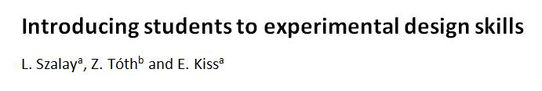

Szalay, L., Tóth, Z., Kiss, E., Chem. Educ. Res. Pract., (2019), DOI: 10.1039/c9rp00234k

Slide 14
III.2. ANCOVA without matched pair method for the preliminary statistical analysis of T0, T1, T2 and T3
Analysis of covariance (ANCOVA) – effect size: Partial Eta Squared
Dependent variable: results of test/sub-test (%), or the change in the answers of the attitude questions and grades (as a continous variable)
Parameters (independent variables):
  type of intervention (Group 1, Group 2, Group 3)
  school ranking (lowest, medium, highest)
  mother’s education (has/has not got a degree in HE)
  achievement on the previous test (lowest, medium, highest)
  gender (boy, girl)
Covariates:
  grade in science (T0)/chemistry (T1, etc.): 1 – 5 (5 is the best )
  ‚enjoyment of subject’ (0 – 4 Likert scale)
  ‚importance of experiments’ (0 – 4 Likert scale)
  ‚preference of step-by-step experiments’ (0 – 4 Likert scale)

Slide 15
IV. Results of the first year

Slide 16
IV.1. Results of the whole test
According to the Parameter Estimates, in terms of the total scores achieved on the T1 test (T1_{total}) neither of the experimental groups’ results are significantly different to that of the control group’s:
*p < 0.05 would be regarded significant (when there is a 95% probability that the experimental group’s achievement is different to the control’s).
**PES characterises the effect size in case of analysis of covariance (SPSS ANCOVA).
Group | Estimated avarage (T1_{total}) | Significance of difference* | Partial Eta Squared, (PES) **
Group 1 (control) | 37,05% | - | -
Group 2 („theoretical”) | 40,49% | p = 0.081 | 0.006
Group 3 („practical”) | 35,29% | p = 0.371 | 0.002

Slide 17
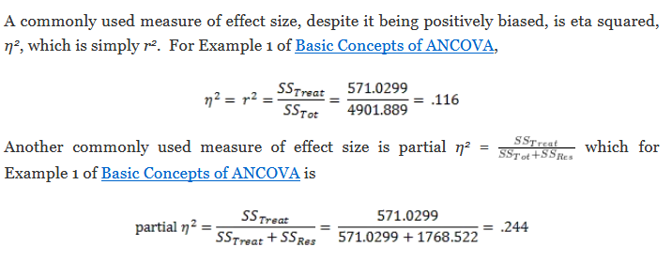
Eta Squared and Partial Eta Squared

Slide 18
IV.2. Results on the sub-tests
Sub-tests:
Disciplinary content knowledge (recall, understand, apply): DCK
Experimental design skills: EDS
Group 2 achieved significantly better results than the other two groups on the DCK tasks.
There was not any significant difference among the groups in terms of EDS tasks.
Group | T1_{DCK} | T1_{EDS}
Group 1 (control) | 42.51% | 31.89%
Group 2 („theoretical”) | 46.98% | 34.46%
Group 3 („practical”) | 38.92% | 32.17%
p < 0.05 | Group 1 – Group 2 Group 2 – Group 3 | -

Slide 19
IV.3. Effects of the significant parameters (PES)
T0 test: mother’s education
T1 EDS sub-test: school ranking (students of the highest ranking schools achieved significantly better results than students of the medium or lowest ranking schools).
T1 DCK sub-test : the type of intervention (Group 2 is significantly better than the other two groups).
 | Whole test |  | DCK tasks |  | EDS tasks
Parameter | T0 | T1 | T0 | T1 | T0 | T1
Group (type of intervention) |  | 0.014 |  | 0.029
School ranking |  | 0.020 |  |  |  | 0.020
Mother’s education | 0.087 |  | 0.071 |  | 0.037

Slide 20
IV.4. Conclusions and assumptions
We have not managed to achieve a positive effect in the development of the experimental design skills.
  In case of 12-13 years old students previous research: 14-15 years old students
  Intervention lasting 1 school year previous research 3 lessons
ASSUMPTIONS:
  Change between concrete and abstract operational stages between 12 and 14? (Piaget)
  6 lessons/school year are not enough?
  The positive effect is not retained in long term?
  Did the students get too tired by the end of the school year?
  The results of the 45 min tests cannot be trusted?
  Students are demotivated by the crowded chemistry curriculum ?
  The teacher’s effect and role has got a determining effect?

Slide 21
V. Modified research model: preliminary results

Slide 22
V.1. „Redesigning”…
Psychologist: the two samples came from different cohorts +
  digital natives: „trial and error” does not suit the systematic approach requested by scientific research.
  computer games: contingency and immediate feed back children do not get used to the hard work needed for research.
  12-13 years old students are still in the concrete operational stage after solving the 6 concrete experimental design tasks, they probably could not generalise the knowledge gained.
  The essence of the experimental design has to be directly taught, and the explanation should be composed using the language understandable for the children.
  Experimental design should be taught!!! E.g. the „only one thing/parameter should be changed at a time” principle.
    In case of Group 2: AFTER doing the step-by-step experiments
    In case of Group 3: BEFORE designing and carrying out the designed experiments.

Slide 23
3.3 kutatási módszer – a modell
V.2. Research model from the school year 2017/2018
6 student sheets for 6 lessons
(45 min) in 3 versions:
Type 1: step-by-step experiments
Type 2: step-by-step experiments + principles of experimental design explained AFTER the experiments
Type 3: principles of experimental design explained BEFORE the experiments and used in practice
Statistical analysis of data
Choosing the sample
Group 1
Pre-test
6 lessons:
Type 1 student sheets
Post-test
Group 2
Pre-tes
6 lessons:
Type 2 student sheets
Post-test
Data collection
Group 3
Pre-tes
6 lessons:
Type 3 student sheets
Post-test

Slide 24
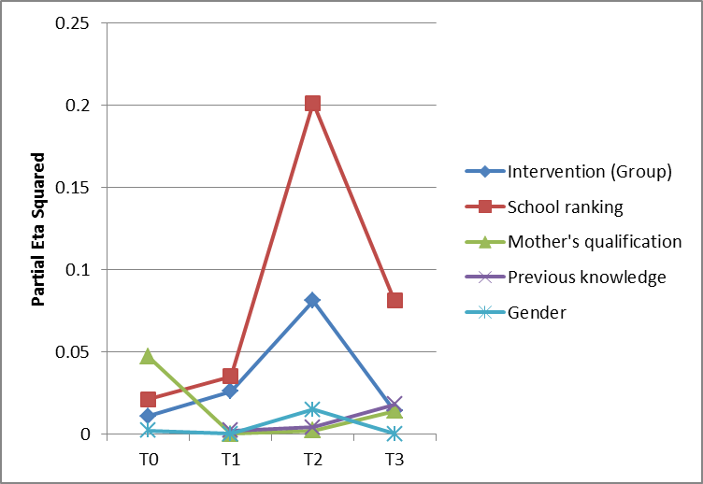
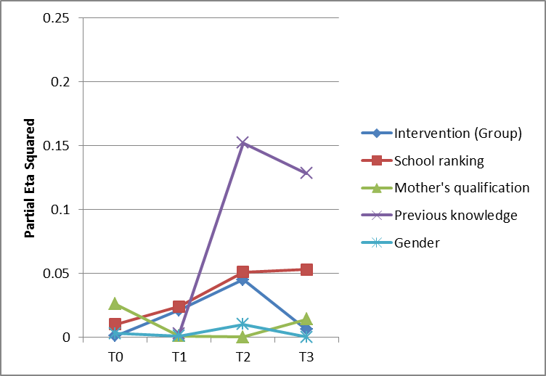
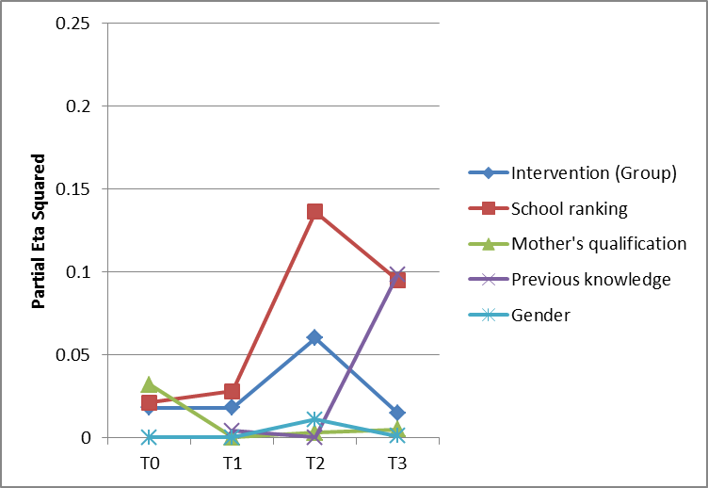
Effect of the assumed parameters
Effect size on the whole test
Effect size on the DCK tasks
Effect size on the EDS tasks

Slide 25
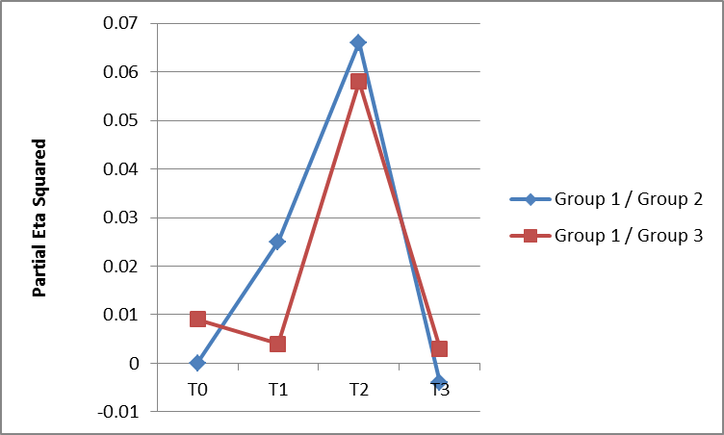
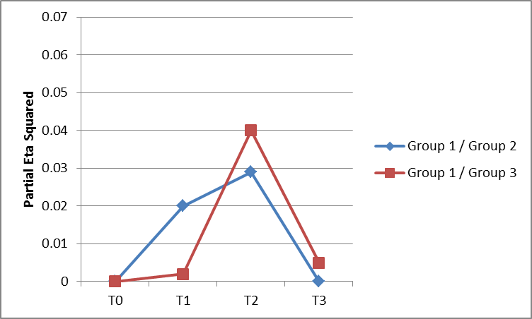
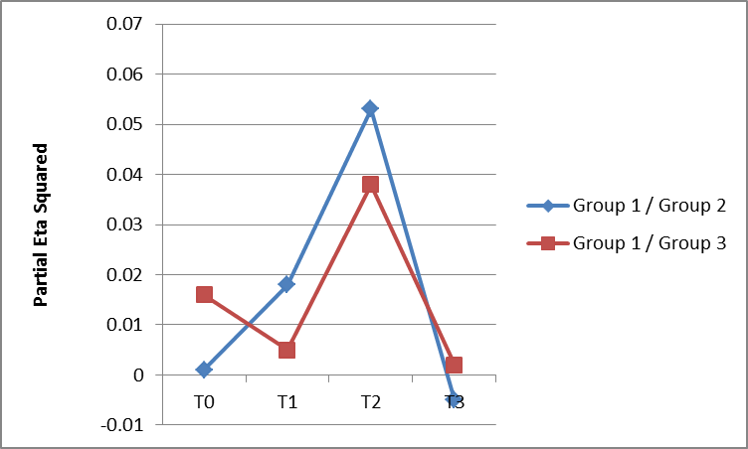
Effect size on the whole test
Effect of the intervention compared to the
control group
Effect size on the DCK tasks
Effect size on the EDS tasks

Slide 26
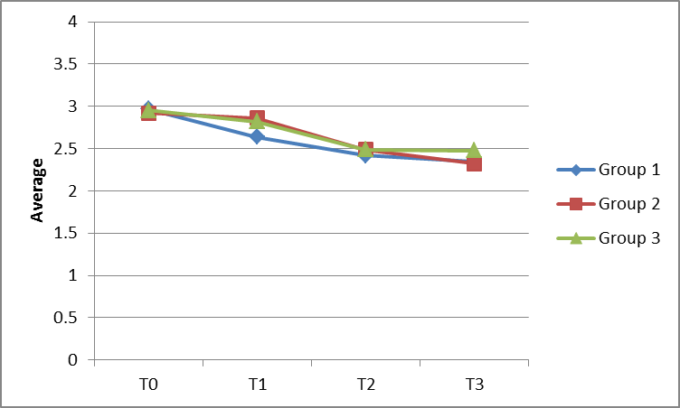
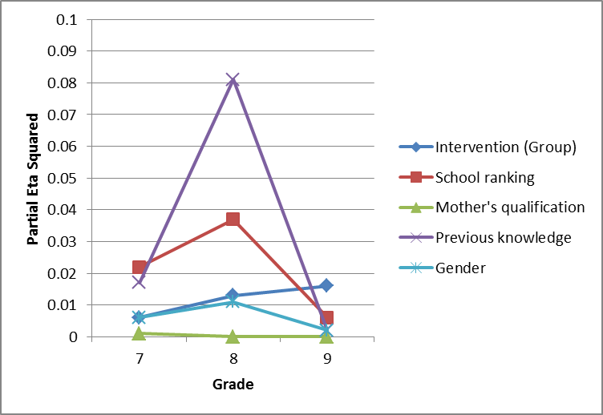
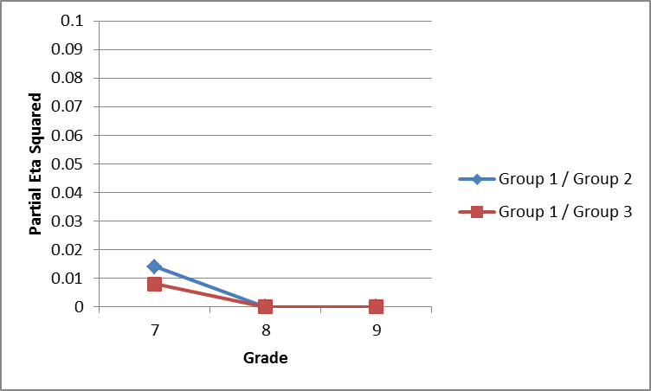
‚Enjoyment of subject’

Slide 27
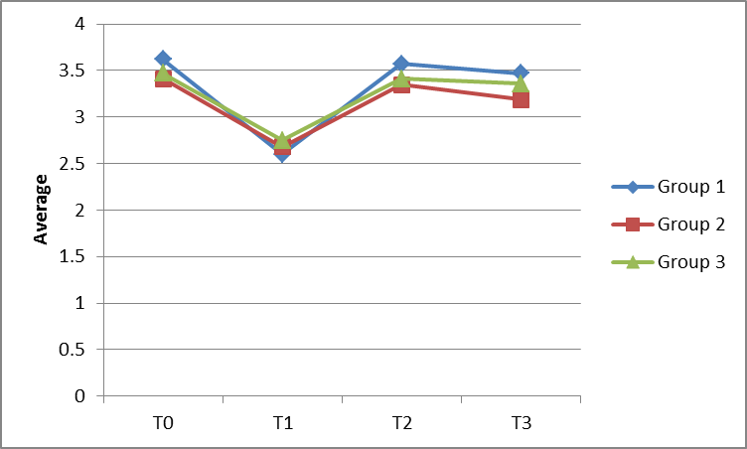
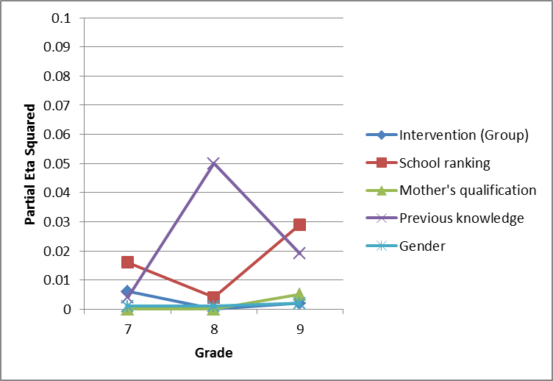
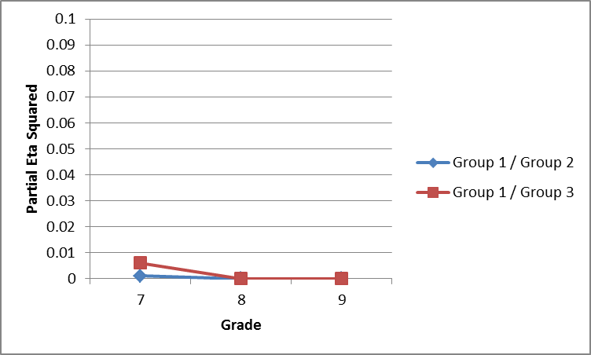
‘Importance of experiments’

Slide 28
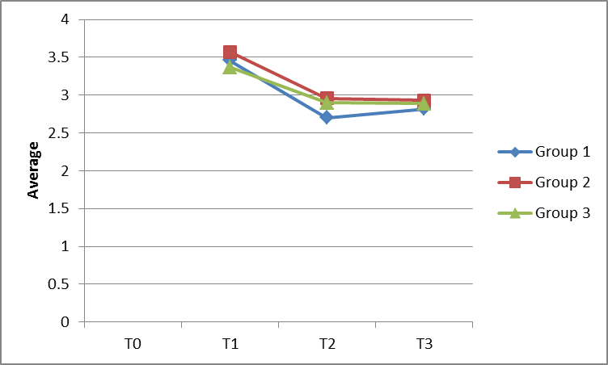
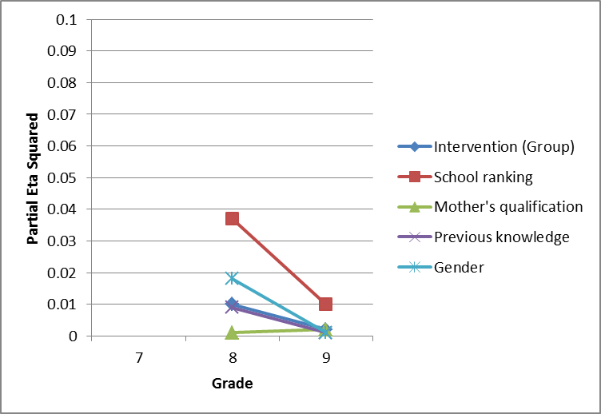
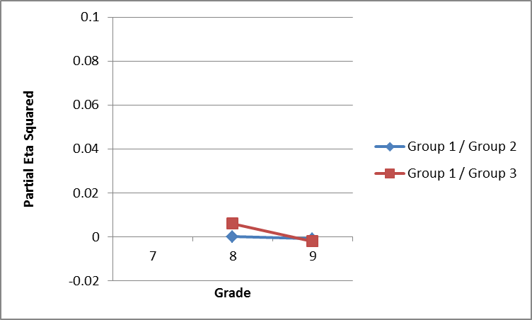
‚Preference of step-by-step experiments’

Slide 29
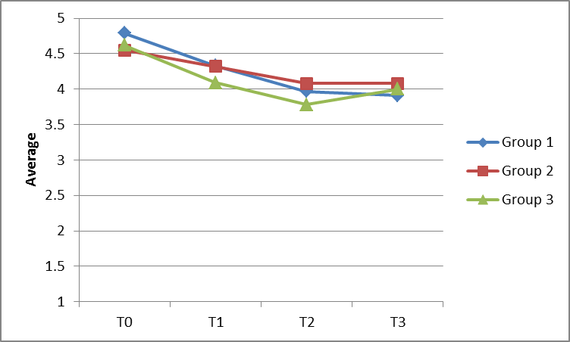
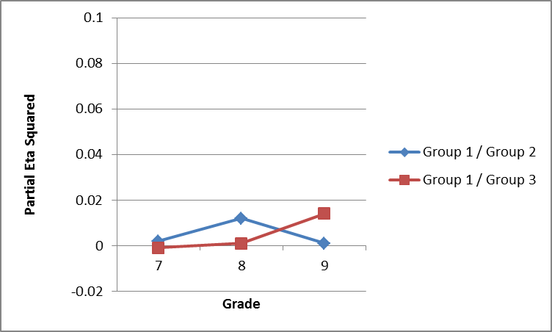
Changes of grades

Slide 30
VI. Summary and context of results

Slide 31
VI.1. Effects of the intervention
7th grade : weak effect on the Group 2 (‚theoretical’)
but the school ranking has got a similar effect size.
8th grade: medium effect size in both experimental groups and
on both sub-tests (EDS and DCK);
however, the effect size of intervention is exceeded by the effect sizes of the following parameters:
previous knowledge (DCK sub-test)
school ranking (EDS sub-test).
9th grade: the development of the experimental groups (compared to the control group) stopped on both sub-tests and on both tests the following parameters had more influence:
previous knowledge
school ranking.

Slide 32
VI.2. Changes of attitudes and grades
The „enjoyment of subject” has decreased over time,
the positive effect of the intervention could only be detected in the 7th grade and
the effects of school ranking and previous knowledge are much stronger.
In terms of „importance of experiments” there is a negative change in the 7th grade and a positive change in the 8th grade,
but the type of intervention only had a weak positive effect only in the 7th grade (Group 3, „practical”) and
the effects of school ranking and previous knowledge are much stronger.
The ‚preference of the step-by-step experiments’ has decreased in each group,
but the intervention practically did not have any effect on this.
The grades have decreased over time,
but a bit less in the Group 3 („practical”), although the of school ranking and previous knowledge have got a determining effect.

Slide 33
VI.3. International context of the results
John Hattie’s book (Univ. of Auckland, New Zealand): Visible Learning: A synthesis of over 800 meta-analyses relating to achievement
Snook, I. et al. (Massey University): Invisible Learnings? A Commentary on John Hattie’s book: Visible Learning: A synthesis of over 800 meta-analyses relating to achievement
The socioeconomic status has got a determining effect (p.6.):
„These studies typically find that most of the variance comes from the
social variables and only a small part from the school (including the teachers).”
The teacher’s effect is the most important in the school (p.7.):
„…the teacher is the most important variable, that is, more important than the principal, the curriculum, the school size or the policies.”
ALL OF THESE DO NOT EXCUSE US FROM TRYING HARD TO FIND EFFECTIVE TEACHING AND LEARNING METHODS!
Video interview with Prof. John Hattie
The reason of the modest effect size of inquiry-based learning is that it is applied too early (first the preliminary knowledge is needed).

Slide 34
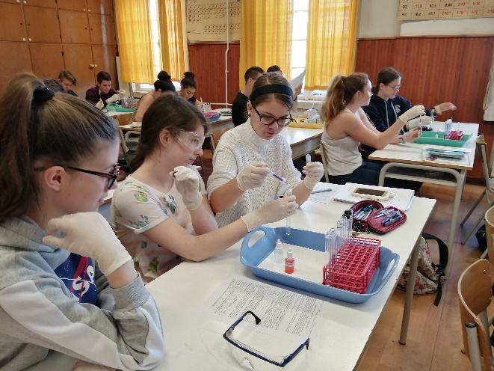
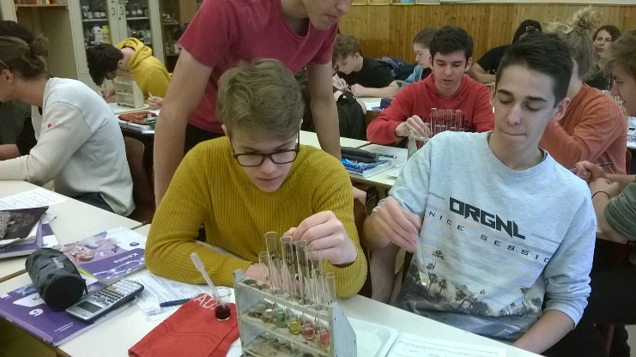
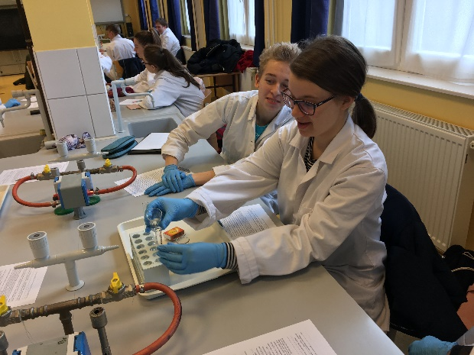
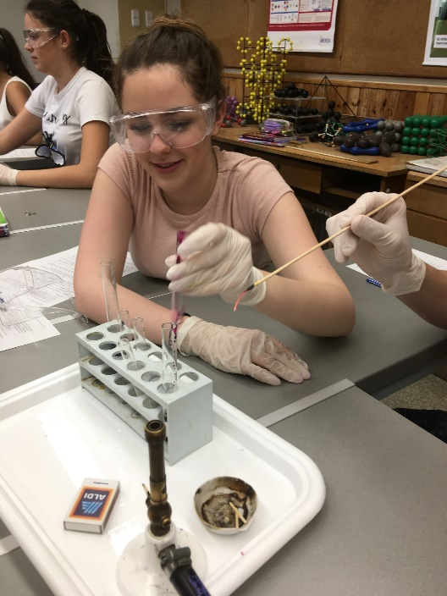
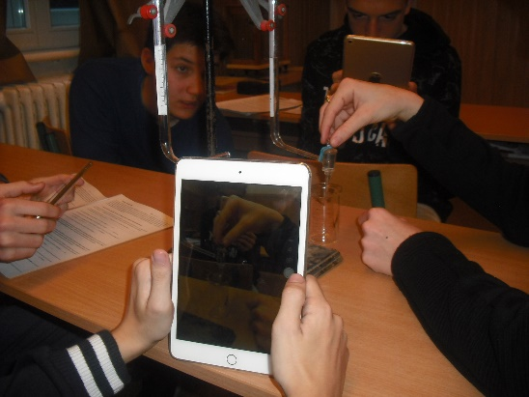
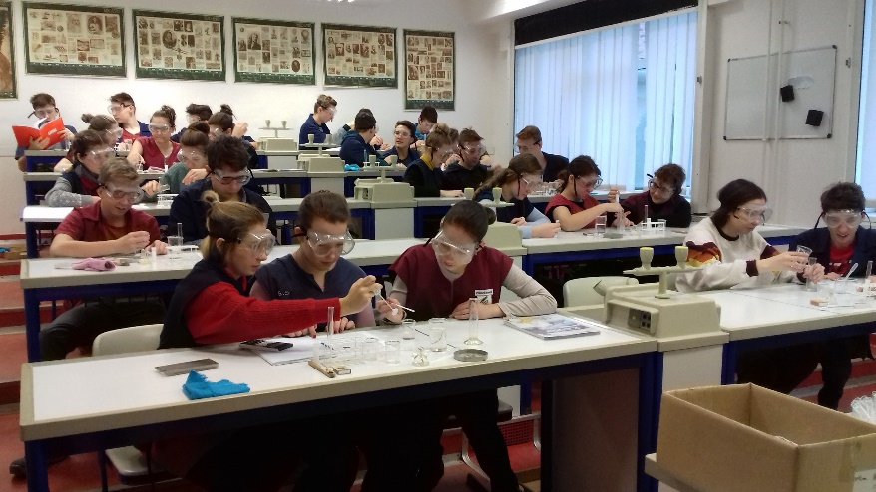
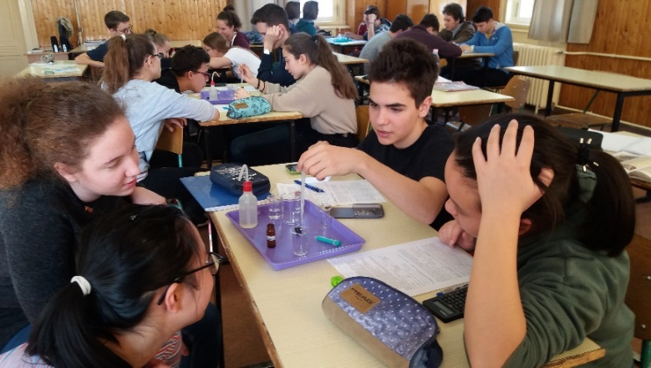
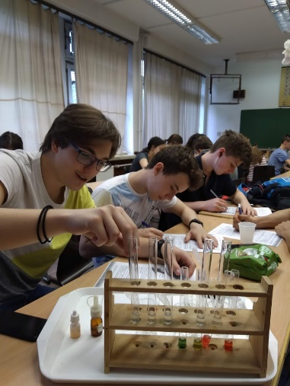
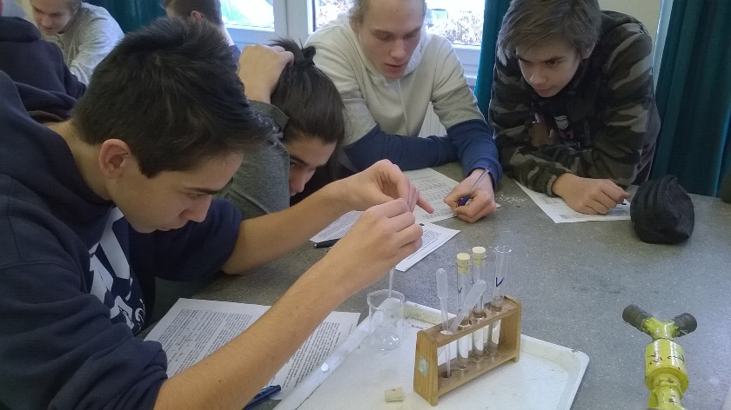
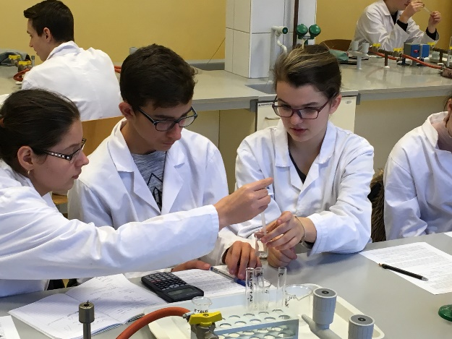
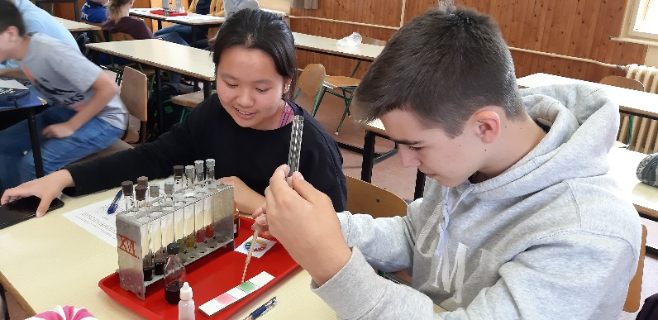
This study was funded by the Content Pedagogy Research Program of the Hungarian Academy of Sciences.
Many thanks for the colleagues and students’ work.
Website: http://ttomc.elte.hu/publications/90
E-mail: luca@chem.elte.hu

Slide 35
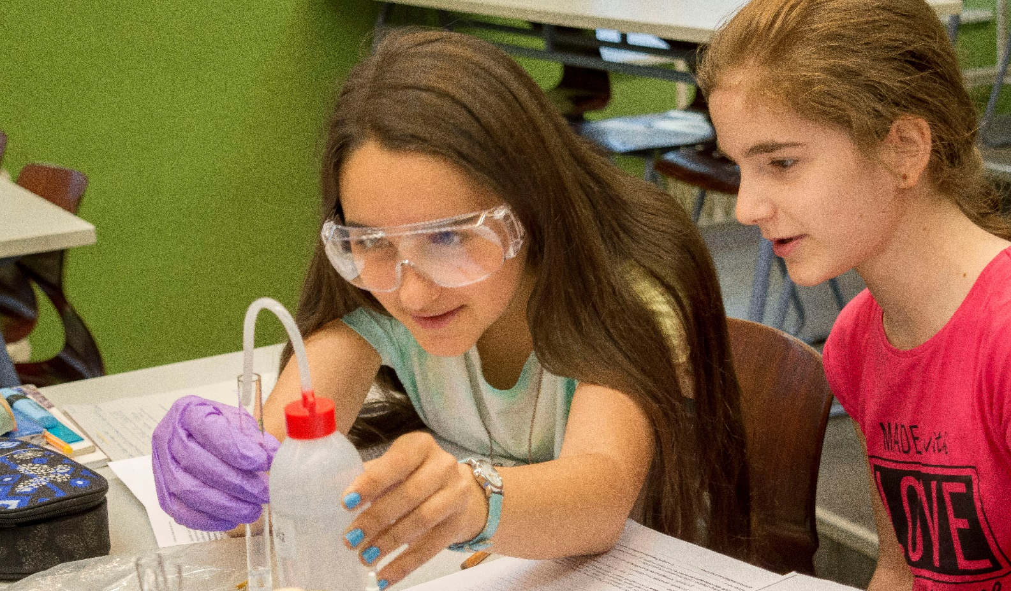
THANK YOU FOR YOUR ATTENTION!

